Slide 1
Slide Deck Overview
This presentation on the Dietary Guidelines for Americans, 2020-2025 is intended for use and adaptation by nutrition and health professionals to communicate about the Dietary Guidelines. This full presentation contains all slides available for download, including several additional introductory and miscellaneous slides not included in the other professional presentations available for download on DietaryGuidelines.gov. Professionals are encouraged to download and edit the presentation(s) to best suit their intended use and audience. Learn more about using the content within these slides by reviewing the permission to use statement below.
Permission to Use
The content within these presentations and any Graphs, Figures, and Tables within the Dietary Guidelines for Americans, 2020-2025 are in the public domain and may be used without permission. Most Photos and Illustrations included in these presentations are NOT in the public domain, thus permission cannot be granted for their use or reproduction for other purposes. However, Photos used in Figures 1-8 and 1-9 are in the public domain and may be used without permission. We ask, however, that if you reproduce this content, either electronically or in print, that you use content as originally designed; that it not be altered or modified; and that it be sourced to the Dietary Guidelines for Americans, 2020-2025. If content is altered or modified, do not source the Dietary Guidelines. Please contact us at dietaryguidelines@usda.gov for further questions.
Suggested citation
U.S. Department of Agriculture and U.S. Department of Health and Human Services. Dietary Guidelines for Americans, 2020-2025. 9th Edition. December 2020. Available at DietaryGuidelines.gov.
USDA is an equal opportunity provider, employer, and lender.
November 2021

Slide 2
Notes:
The Dietary Guidelines for Americans, 2020-2025 was released on December 29, 2020. The new edition includes an important call to action for health professionals and policymakers, to help the public “make every bite count” with the Dietary Guidelines for Americans.
This presentation provides background on the scientific review process that informed the development of the Dietary Guidelines and an overview of the content of the new edition.

Slide 3

Presentation Objectives
Provide an in-depth look at the Dietary Guidelines for Americans, 2020-2025.
Highlight Key Recommendations that provide further guidance on healthy eating across the lifespan.
0

Slide 4
Introduction
Notes:
The U.S. Departments of Agriculture (USDA) and of Health and Human Services (HHS) update the Dietary Guidelines at least every 5 years, based on the current science.
A fundamental premise of the Dietary Guidelines is that everyone, no matter their age, race, or ethnicity, economic circumstances, or health status, can benefit from shifting food and beverage choices to better support healthy dietary patterns.
Although many recommendations have remained relatively consistent over time, the Dietary Guidelines also has evolved as scientific knowledge has grown. The 2020-2025 Dietary Guidelines for Americans reflects this in three important ways.
The first is its recognition that diet-related chronic diseases, such as cardiovascular disease, type 2 diabetes, obesity, and some types of cancer, are very prevalent among Americans and pose a major public health problem.
The second is its focus on dietary patterns. Researchers and public health experts understand that nutrients and foods are not consumed in isolation. Rather, people consume them in various combinations over time—a dietary pattern—and these foods and beverages act synergistically to affect health. The 2020-2025 Dietary Guidelines carries forward this emphasis on the importance of a healthy dietary pattern as a whole— rather than on individual nutrients, foods, or food groups in isolation.
The third is its focus on a lifespan approach. This edition of the Dietary Guidelines highlights the importance of encouraging healthy dietary patterns at every life stage from infancy through older adulthood. For the first time since the 1985 edition, the 2020- 2025 Dietary Guidelines includes recommendations for healthy dietary patterns for infants and toddlers.

Slide 5
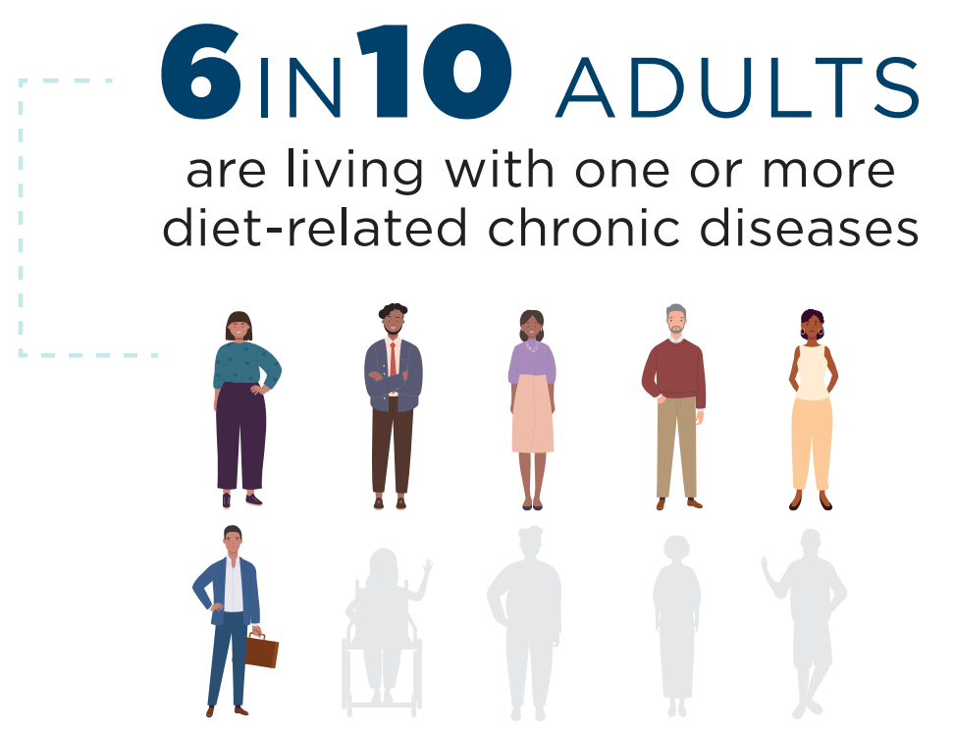
The foods and beverages we consume have a profound impact on our health
Notes:
The foods and beverages that people consume have a profound impact on their health. It has become increasingly clear that diet-related chronic diseases, such as cardiovascular disease, type 2 diabetes, obesity, liver disease, some types of cancer, and dental caries, pose a major public health problem for Americans. Today, 60 percent of adults have one or more diet-related chronic diseases.

Slide 6
About the Dietary Guidelines for Americans
The Dietary Guidelines provides science-based advice on what to eat and drink to promote health, help reduce risk of chronic disease, and meet nutrient needs.
Serves as the cornerstone of federal nutrition programs and policies.
Mandated to reflect the preponderance of scientific evidence, and published jointly by USDA and HHS every five years.
Written for a professional audience, including policymakers, healthcare professionals, nutrition educators, and federal nutrition program operators.
Notes:
The Dietary Guidelines is an important part of a complex, multifaceted approach to promote health and reduce chronic disease risk.
An important audience is health professionals who work with the general public to help them consume a healthy and nutritionally adequate diet.
Comprehensive, coordinated strategies built on the science-based foundation of the Dietary Guidelines—and a commitment to drive these strategies over time across sectors and settings—can help all Americans consume healthy dietary patterns, achieve and maintain good health, and reduce the risk of chronic diseases.

Slide 7
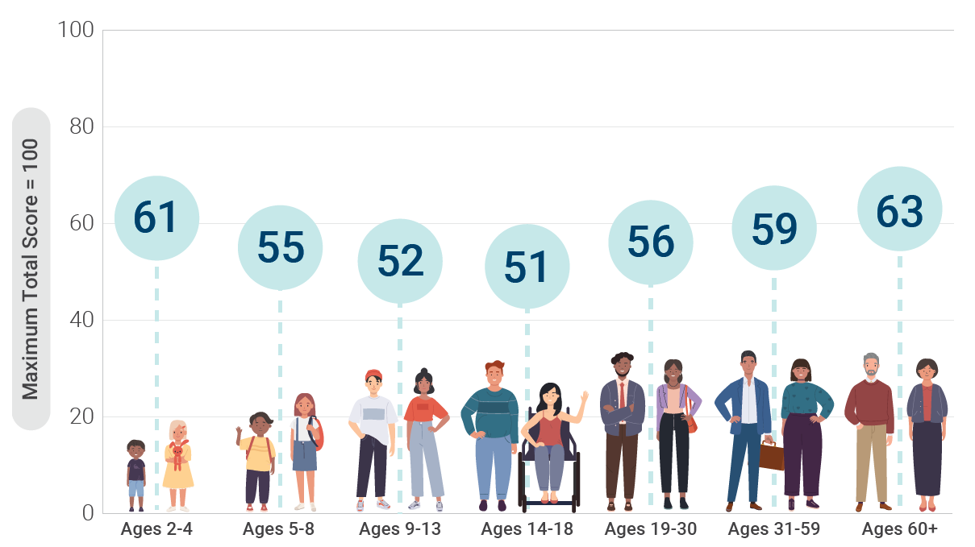
Adherence of the U.S. Population to the Dietary Guidelines Across Life Stages, as Measured by Average Total Healthy Eating Index-2015 Scores
The Healthy Eating Index (HEI) measures how closely food and beverage choices align with the Dietary Guidelines. A higher total score indicates a higher quality diet.
NOTE: HEI-2015 total scores are out of 100 possible points. A score of 100 indicates that recommendations on average were met or exceeded. A higher total score indicates a higher quality diet.
Data Source: Analysis of What We Eat in America, NHANES 2015-2016, ages 2 and older, day 1 dietary intake data, weighted.
Notes:
The scientific connection between food and health has been well documented for many decades, with substantial evidence showing that healthy dietary patterns can help people achieve and maintain good health and reduce the risk of chronic diseases throughout all stages of the lifespan. Over time, eating patterns in the United States have remained far below Dietary Guidelines recommendations.
While the science linking food and health has only become stronger, our Healthy Eating Index (HEI) score has remained low. The HEI measures how closely food and beverage choices align with the Dietary Guidelines. Our HEI score is higher early in life and in older adulthood, but we all fall far short of following the Dietary Guidelines.
The importance of following the Dietary Guidelines across all life stages has been brought into focus even more with the emergence of COVID-19, as people living with diet-related chronic conditions and diseases are at an increased risk of severe illness from the novel coronavirus

Slide 8
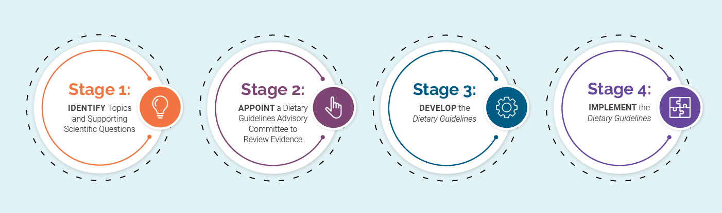
Developing the Dietary Guidelines for Americans
Notes:
The process to develop the Dietary Guidelines has evolved over time, in step with developments in nutrition science, public health, and best practices in scientific review and guidance development. USDA and HHS work together to determine the approach for each edition.
In establishing the process for the 2020-2025 Dietary Guidelines, USDA and HHS considered and integrated recommendations from a comprehensive 2017 National Academies’ study, Review of the Process to Update the Dietary Guidelines. Greater transparency figured prominently in the Academies’ recommendations. As a result, in developing the 2020-2025 process, USDA and HHS made significant changes to increase transparency and public participation while maintaining the core element of scientific integrity.
The 2020-2025 process consisted of four stages: (1) identify the topics and supporting scientific questions to be examined; (2) appoint a Dietary Guidelines Advisory Committee to review current scientific evidence; (3) develop the new edition of the Dietary Guidelines; and (4) implement the Dietary Guidelines through Federal programs and non-Federal program entities.

Slide 9

Stage 1: Identify Topics and Supporting Scientific Questions
A new step of identifying topics and scientific questions was added to the beginning of the process.
Topics and questions were made available for the public to view and provide comments.
Final topics and questions were posted along with the public call for nominations to the 2020 Dietary Guidelines Advisory Committee.
Notes:
The Departments added a new step of identifying topics and scientific questions to begin the process of developing the next Dietary Guidelines. This was done to promote a deliberate and transparent process, better define the expertise needed on the Committee, and ensure the scientific review conducted by the Committee would address Federal nutrition policy and program needs and help manage resources.

Slide 10
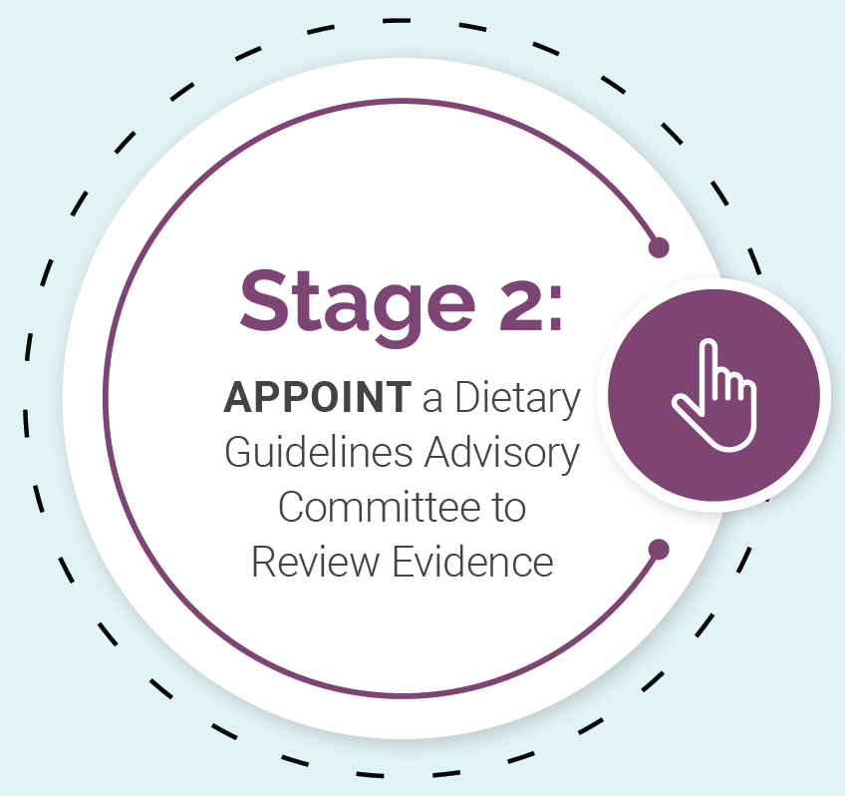

Stage 2: Appoint a Dietary Guidelines Advisory Committee to Review Evidence
The Committee answered questions on diet and health using one of three approaches.
Each of these approaches has its own rigorous, protocol-driven methodology, and plays a unique, complementary role in examining the science.
Notes:
In the second stage, the Secretaries of USDA and HHS appointed the Committee with the single, time-limited task of reviewing the 2015-2020 Dietary Guidelines, examining the evidence on the selected nutrition and public health topics and scientific questions, and providing independent, science-based advice and recommendations to USDA and HHS. The 20 nationally recognized scientific experts appointed to the Committee represented a mix of practitioners, epidemiologists, scientists, clinical trialists, and others from every region of the United States.
The Committee’s work had three defining characteristics: the use of three approaches to examine the evidence, the creation of transparent protocols before the evidence review began, and the development of scientific review conclusion statements.

Slide 11



Approaches to Examine the Evidence
Data Analysis
A collection of analyses that uses national data sets to describe understand the current health and dietary intakes of Americans. These data help make the Dietary Guidelines practical, relevant, and achievable. The Committee conducted more than 150 analyses of Federal data sets.
Food Pattern Modeling
Analysis that shows how changes to the amounts or types of foods and beverages in a pattern might impact meeting nutrient needs across the U.S. population. Several food pattern modeling analyses were completed, and representing for the first time, the 6 to 24 month life stage.
NESR Systematic Review
Research project that answers a question on diet and health by searching for, evaluating, and synthesizing all relevant, peer-reviewed studies. More than 270,000 citations were screened and nearly 1,500 original research articles included in 33 original systematic reviews.
Notes:
(continued)

Slide 12
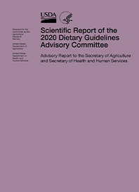
From Conclusion Statements to Advice
The Committee looked across all of the conclusion statements – the totality of the scientific review – to develop overarching advice for USDA and HHS to consider as the Departments developed the 2020-2025 Dietary Guidelines.

Slide 13
Once the Committee submitted its Scientific Report, USDA and HHS used the findings to develop the Dietary Guidelines for Americans
Each edition of the Dietary Guidelines builds on the preceding edition, with the scientific justification for revisions informed by the Advisory Committee’s Scientific Report, consultation with subject matter experts within Federal agencies, and consideration of comments from these agencies and the public.
Development of the Dietary Guidelines for Americans, 2020-2025 involved a step-by-step process of writing, review, and revision conducted by a writing team of Federal staff from USDA and HHS.
The writing team included Federal nutrition scientists with expertise in the Dietary Guidelines and related research and programs as well as specialists with expertise in communicating nutrition information.
Notes:
Each edition of the Dietary Guidelines builds on the preceding edition, with the scientific justification for revisions informed by the Advisory Committee’s Scientific Report, consultation with subject matter experts within Federal agencies, and consideration of comments from these agencies and the public. USDA and HHS received 38,000 comments on the Advisory Committee’s Scientific Report, and these were considered in the development of the Dietary Guidelines.
Developing the Dietary Guidelines involves a step-by-step process of writing, review, and revision supported by a writing team of Federal staff from USDA and HHS. The review culminates with the Secretaries of USDA and HHS. After approval by the Secretaries, the Departments release the Dietary Guidelines to Federal agencies and the public for implementation across programs and through educational activities.
The writing team included Federal nutrition scientists with expertise in the Dietary Guidelines and related research and programs as well as specialists with expertise in communicating nutrition information.
More information about the process to develop the Dietary Guidelines is available here: https://www.dietaryguidelines.gov/usda-hhs-development-dietary-guidelines

Slide 14
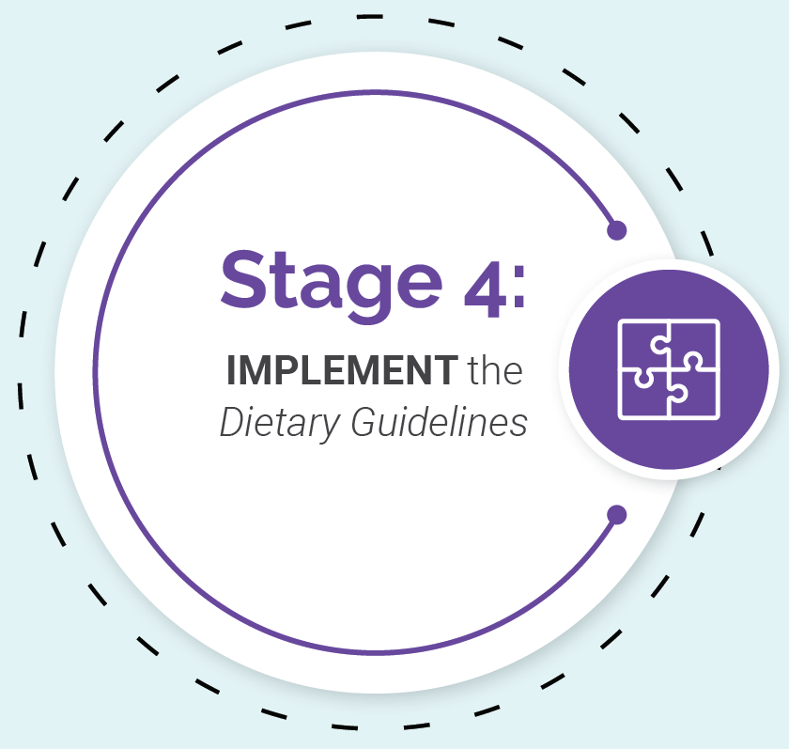
Stage 4: Implement the Dietary Guidelines
The Dietary Guidelines provides the framework for following a healthy dietary pattern from birth through older adulthood.
Everyone has a role to play in helping all Americans shift to a healthy dietary pattern and achieve better health.
Broad and multisector collaboration is needed to help people achieve this goal.
Notes:
The U.S. Government uses the Dietary Guidelines as the basis of its food assistance and meal programs, nutrition education efforts, and decisions about national health objectives.
The Dietary Guidelines also provides a critical structure for State and local public health promotion and disease prevention initiatives. In addition, it provides foundational, evidence-based nutrition guidance for use by individuals and those who serve them in public and private settings, including health professionals, public health and social service agencies, health care and educational institutions, researchers, agricultural producers, food and beverage manufacturers, and more.
The Dietary Guidelines for Americans is developed and written for a professional audience. Therefore, its translation into actionable consumer messages and resources is crucial to help individuals, families, and communities achieve healthy dietary patterns.

Slide 15

A Roadmap to the Dietary Guidelines for Americans, 2020-2025
Executive Summary
Introduction
Chapter 1. Nutrition and Health Across the Lifespan: The Guidelines and Key Recommendations
Chapter 2. Infants and Toddlers
Chapter 3. Children and Adolescents
Chapter 4. Adults
Chapter 5. Women Who Are Pregnant or Lactating
Chapter 6. Older Adults
Appendixes
Notes:
This edition of the Dietary Guidelines highlights the importance of encouraging healthy dietary patterns at every life stage from infancy through older adulthood. For the first time, the 2020- 2025 Dietary Guidelines includes recommendations for healthy dietary patterns for infants and toddlers.
It provides recommendations for healthy dietary patterns by life stage, identifying needs specific to each life stage and considering healthy dietary pattern characteristics that should be carried forward into the next stage of life.

Slide 16
Nutrition and
Health Across the Lifespan:
The Guidelines and
Key Recommendations
Notes:
Chapter 1 of the Dietary Guidelines provides foundational guidance across each life stage and it sets up the remaining chapters.

Slide 17








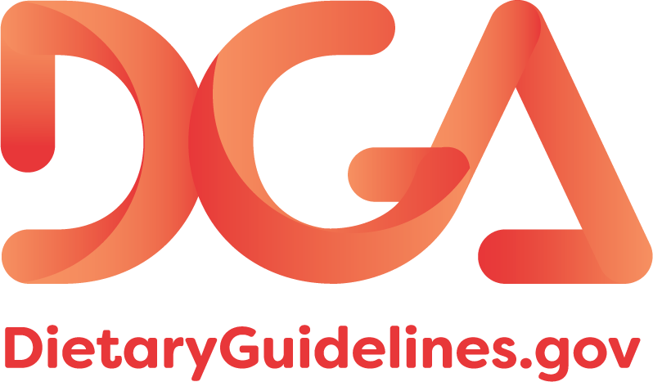
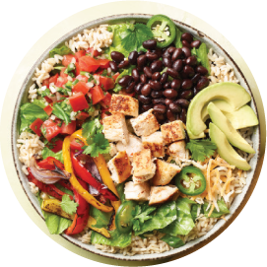


The Guidelines
Follow a healthy dietary
pattern at every life stage.
Customize and enjoy nutrient-dense food and beverage choices to reflect personal preferences, cultural traditions, and budgetary considerations.
Limit foods
and beverages higher in
added sugars, saturated fat, and sodium, and limit alcoholic
beverages.
Focus on meeting food group needs with nutrient-dense foods and beverages, and stay within calorie limits.
Notes:
There are four overarching guidelines. The Guidelines have supporting Key Recommendations that explain how they can be met. The Guidelines and their Key Recommendations are presented in more detail on the following slides.

Slide 18

Key Dietary Principles
Meet nutritional needs primarily from foods and beverages
Choose a variety of options from each food group
Pay attention to portion size
Notes:
In addition to the Guidelines and Key Recommendations, Chapter 1 provides several dietary principles to help inform decisions about nutrient-dense food and beverage choices to achieve a healthy dietary pattern.

Slide 19
Follow a healthy dietary pattern at every life stage
At every life stage—infancy, toddlerhood, childhood, adolescence, adulthood, pregnancy, lactation, and older adulthood—it is never too early or too late to eat healthfully.
For about the first 6 months of life, exclusively feed infants human milk. Continue to feed infants human milk through at least the first year of life, and longer if desired. Feed infants iron-fortified infant formula during the first year of life when human milk is unavailable. Provide infants with supplemental vitamin D beginning soon after birth.
At about 6 months, introduce infants to nutrient-dense complementary foods. Introduce infants to potentially allergenic foods along with other complementary foods. Encourage infants and toddlers to consume a variety of foods from all food groups. Include foods rich in iron and zinc, particularly for infants fed human milk.
From 12 months through older adulthood, follow a healthy dietary pattern across the lifespan to meet nutrient needs, help achieve a healthy body weight, and reduce the risk of chronic disease.
Notes:
The first Guideline is to follow a healthy dietary pattern at every life stage. It is never too early or too late to eat healthfully.
Achieving a healthy dietary pattern at each life stage not only supports health at that point in time, but also supports health in the next life stage and possibly for future generations.
The Key Recommendations under Guideline 1 highlight some important considerations for a healthy dietary pattern across the life span.

Slide 20
What is a Dietary Pattern?
Represents the totality of what individuals habitually eat and drink.
The parts of the pattern act synergistically to affect health.
May better predict overall health status and disease risk than individual foods or nutrients.
A healthy dietary pattern consists of nutrient-dense forms of foods and beverages across all food groups, in recommended amounts, and within calorie limits.
Notes:
The importance of healthy dietary patterns for health promotion and disease prevention is a focus of Dietary Guidelines for Americans, 2020-2025.
A dietary pattern is the totality of what individuals habitually eat and drink – the combination of foods and beverages consumed over time – and science shows that these foods and beverages act synergistically to affect health. As a result, the dietary pattern may better predict overall health status and disease risk than individual foods or nutrients
A healthy dietary pattern consists of nutrient-dense forms of foods and beverages across all food groups, in recommended amounts, and within calorie limits.

Slide 21
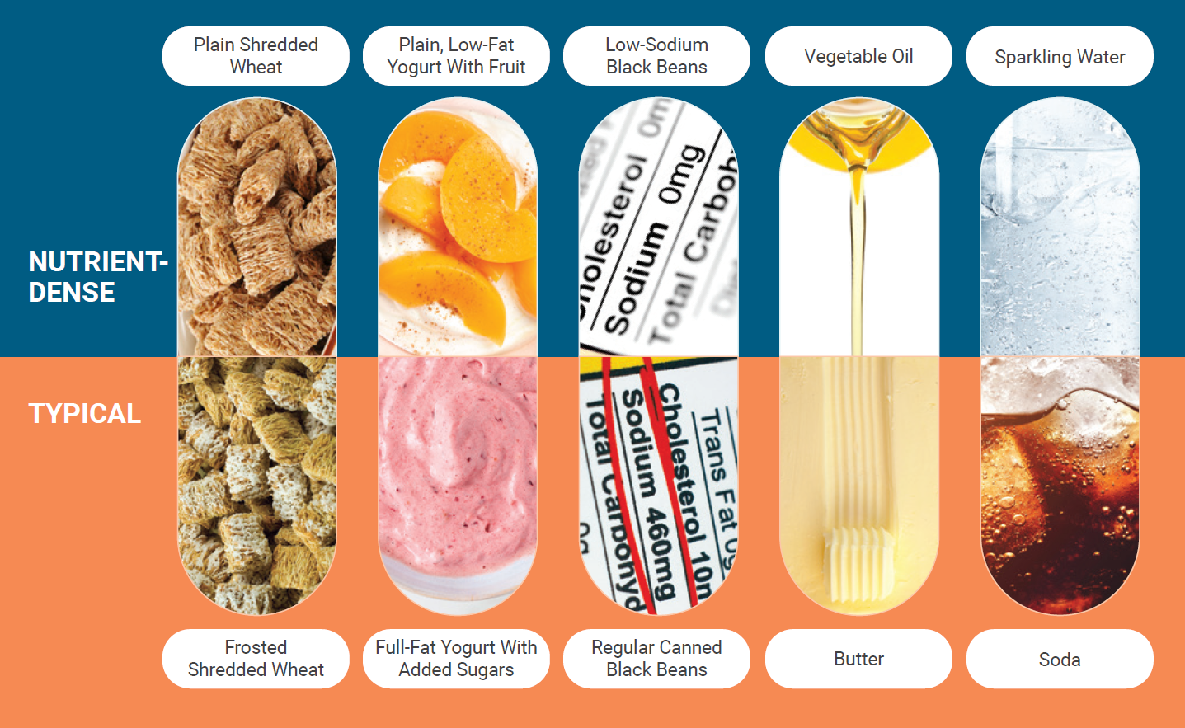
Making Nutrient-Dense Choices:
One Food or Beverage At a Time
Every food and beverage choice is an opportunity to move toward a healthy dietary pattern. Small changes in single choices add up and can make a big difference. These are a few examples of realistic, small changes to nutrient-dense choices that can help people adopt healthy dietary patterns.
Notes:
The importance of nutrient-dense choices is a theme of the Dietary Guidelines for Americans, 2020-2025. Nutrient-dense foods and beverages provide vitamins, minerals, and other health promoting components and have little added sugars, saturated fat, and sodium.
Vegetables, fruits, whole grains, seafood, eggs, beans, peas, and lentils, unsalted nuts and seeds, fat-free and low-fat dairy products, and lean meats and poultry – when prepared with no or little added sugars, saturated fat, and sodium- are nutrient-dense foods.

Slide 22
USDA Dietary Patterns
The primary USDA Dietary Pattern is the Healthy U.S.-Style Dietary Pattern, which provides a framework for healthy eating that all Americans can follow.
  Based on the types and proportions of foods typically consumed, but in nutrient-dense forms and appropriate amounts.
Variations of the Healthy U.S-Style Dietary Pattern that have the same core elements include:
  Healthy Mediterranean-Style Dietary Pattern
  Healthy Vegetarian Dietary Pattern
Notes:
The Healthy U.S.-Style Dietary Pattern, USDA’s primary Dietary Pattern, provides a framework for healthy eating that all Americans can follow. It is based on the types and proportions of foods Americans of all ages, genders, races, and ethnicities typically consume, but in nutrient-dense forms and appropriate amounts. This Dietary Pattern is carried forward from the 2015-2020 Dietary Guidelines for Americans.
The Healthy Mediterranean-Style Dietary Pattern and the Healthy Vegetarian Dietary Pattern— also carried forward from the 2015-2020 Dietary Guidelines for Americans—are variations of the Healthy U.S.-Style Dietary Pattern that have the same core elements.

Slide 23
The Health Benefits of a
Healthy Dietary Pattern
Science shows that there are many health benefits related to:
Consuming a healthy dietary pattern
Meeting food group and nutrient needs with nutrient-dense foods and beverages
Limiting intake of foods and beverages that are not nutrient-dense
Notes:
Science also supports the idea that every life stage provides an opportunity to make food choices that promote health and well-being, achieve and maintain appropriate weight status, and reduce risk of diet-related chronic disease.

Slide 24

Healthy Eating Can Promote Health and Reduce Risk of Chronic Disease*
Children and Adolescents
Women Who Are
Pregnant or Lactating
• Lower adiposity
• Lower total and low-density
lipoprotein (LDL) cholesterol
• Favorable cognitive development in the
child
• Favorable folate status in women during
pregnancy and lactation
Adults, Including
Older Adults
Birth Through
23 Months
• Lower risk of all-cause mortality
• Lower risk of cardiovascular
disease
• Lower risk of cardiovascular
disease mortality
• Lower total and LDL cholesterol
• Lower blood pressure
• Lower risk of obesity
• Lower body mass index, waist
circumference, and body fat
• Lower risk of type 2 diabetes
• Lower risk of cancers of the
breast, colon, and rectum
• Favorable bone health, including
lower risk of hip fracture
• Lower risk of overweight
and obesity
• Lower risk of type 1
diabetes
• Adequate iron status and
lower risk of iron deficiency
• Lower risk of peanut allergy
• Lower risk of asthma
*See the Scientific Report of the 2020 Dietary Guidelines Advisory Committee for more information about the relationships between diet and health examined by the 2020 Dietary Guidelines Advisory Committee.
Notes:
The science supporting the Dietary Guidelines is extensively documented in the Scientific Report of the 2020 Dietary Guidelines Advisory Committee, which is available at DietaryGuidelines.gov. The report examined the science on key topics related to diet and health, and the figure on this slide shows outcomes with Strong or Moderate evidence.

Slide 25
A Healthy Dietary Pattern Supports Appropriate Calorie Levels
The total number of calories a person needs each day varies depending on a number of factors.
Calorie needs generally decrease for adults as they age.
A need to lose, gain, or maintain weight affects how many calories should be consumed.
The best way to evaluate calorie intake, in comparison to calorie needs, is by measuring body weight status.
Notes:
The total number of calories a person needs each day varies depending on a number of factors, namely the person’s age, sex, height, weight, level of physical activity, and pregnancy or lactation status. Due to reductions in basal metabolic rate that occur with aging, calorie needs generally decrease for adults as they age. In addition, a need to lose, maintain, or gain weight affects how many calories should be consumed.
The Dietary Guidelines provides estimates of calorie needs based on the Estimated Energy Requirement (EER) equations established by the National Academies of Sciences, Engineering, and Medicine using reference heights and reference weights for each age-sex group. The best way to evaluate calorie intake, in comparison to calorie needs, is by measuring body weight status.

Slide 26



Customize and enjoy nutrient-dense food and beverage choices to reflect personal preferences, cultural traditions, and budgetary considerations
A healthy dietary pattern can benefit all individuals regardless of age, race, or ethnicity, or current health status. The Dietary Guidelines provides a framework intended to be customized to individual needs and preferences, as well as the foodways of the diverse cultures in the United States.
Notes:
The second guideline is to customize and enjoy nutrient-dense food and beverage choices to reflect personal preferences, cultural traditions, and budgetary considerations.
Eating should be enjoyed, and a healthy dietary pattern can be enjoyable, from early life to older adulthood. The Dietary Guidelines provides a framework intended to be customized to fit individual, household, and Federal program participants’ preferences, as well as the foodways of the diverse cultures in the United States. The Dietary Guidelines framework purposely provides recommendations by food groups and subgroups—not specific foods and beverages—to avoid being prescriptive. This framework approach ensures that people can “make it their own” by selecting healthy foods, beverages, meals, and snacks specific to their needs and preferences.
In every setting, across all cultures, and at any age or budget, there are foods and beverages that can fit within this framework.

Slide 27
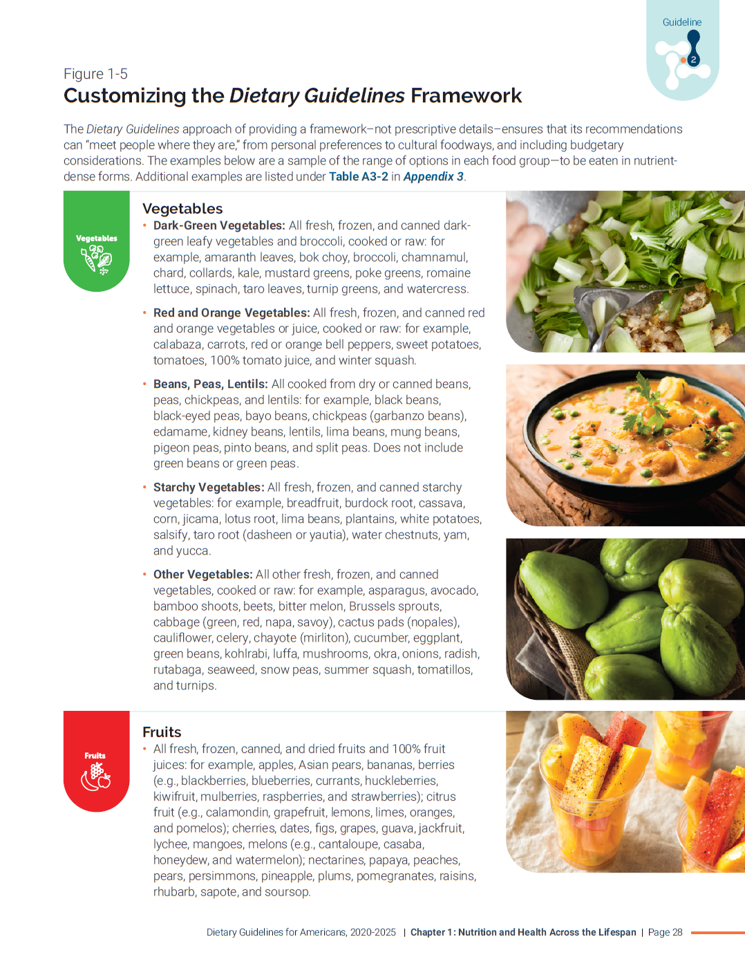
Customizing the Dietary Guidelines Framework
There are a range of options in each food group – to be eaten in nutrient-dense forms – that fit in the Dietary Guidelines framework.
The Dietary Guidelines framework ensures that its recommendations can “meet people where they are”.
Notes:
Figure 1-5, “Customizing the Dietary Guidelines Framework,” is a resource that is useful for helping individuals understand how their taste preferences, budget, and cultural considerations can be accommodated to meet food group recommendations.

Slide 28
Focus on meeting food group needs with nutrient-dense foods and beverages, and stay within calorie limits
An underlying premise of the Dietary Guidelines is that nutritional needs should be met primarily from foods and beverages—specifically, nutrient-dense foods and beverages. Nutrient-dense foods provide vitamins, minerals, and other health-promoting components and have no or little added sugars, saturated fat, and sodium.
A healthy dietary pattern consists of nutrient-dense forms of foods and beverages across all food groups, in recommended amounts, and within calorie limits.
The core elements that make up a healthy dietary pattern include:
Vegetables of all types—dark green; red and orange; beans, peas, and lentils; starchy; and other vegetables
Fruits, especially whole fruit
Grains, at least half of which are whole grain
Dairy, including fat-free or low-fat milk, yogurt, and cheese, and/or lactose-free versions and fortified soy beverages and yogurt as alternatives
Protein foods, including lean meats, poultry, and eggs; seafood; beans, peas, and lentils; and nuts, seeds, and soy products
Oils, including vegetable oils and oils in food, such as seafood and nuts
Notes:
The third Guideline is to focus on meeting food group needs with nutrient-dense foods and beverages, and stay within calorie limits
The Dietary Guidelines include recommendations for food groups—vegetables, fruits, grains, dairy, and protein foods— eaten at an appropriate calorie level and in forms with limited amounts of added sugars, saturated fat, and sodium. Science shows that these same core elements of a healthy dietary pattern are consistent across each life stage.

Slide 29
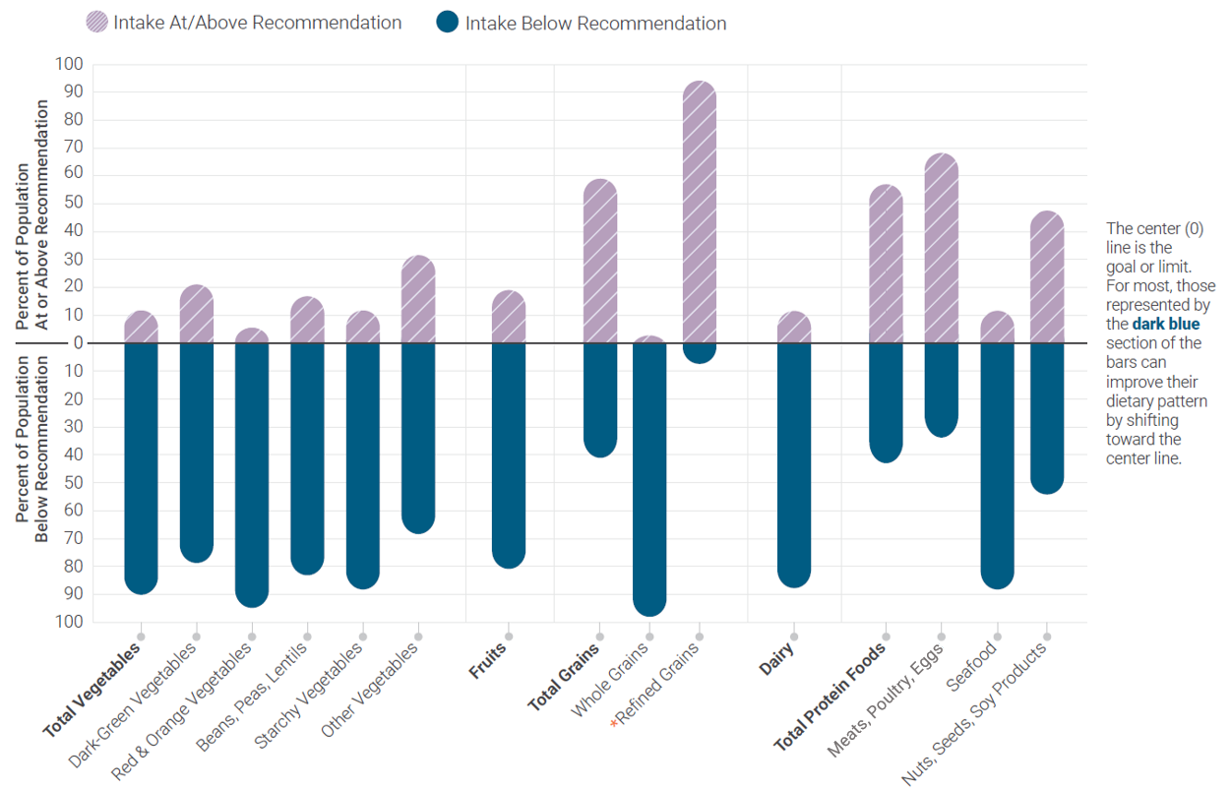
Dietary Intakes Compared to Recommendations
*
NOTE: Recommended daily intake of whole grains is to be at least half of total grain consumption, and the limit for refined grains is to be no more than half of total grain consumption.
Data Source: Analysis of What We Eat in America, NHANES 2013-2016, ages 1 and older, 2 days dietary intake data, weighted. Recommended Intake Ranges: Healthy U.S.-Style Dietary Patterns
Notes:
Most Americans have substantial room for improvement when it comes to food group intake. The Bar Chart shows on average 80 percent or more of the population ages 1 year and older have intakes below recommendations for vegetables, fruit, and dairy. For grains, most of the population meets or exceeds refined grain recommendations while falling below recommendations for whole grains. More than 50 percent of the population meets or exceeds recommendations for total protein foods, but most do not meet recommendations for the subgroups of seafood and nuts, seeds, and soy products.

Slide 30
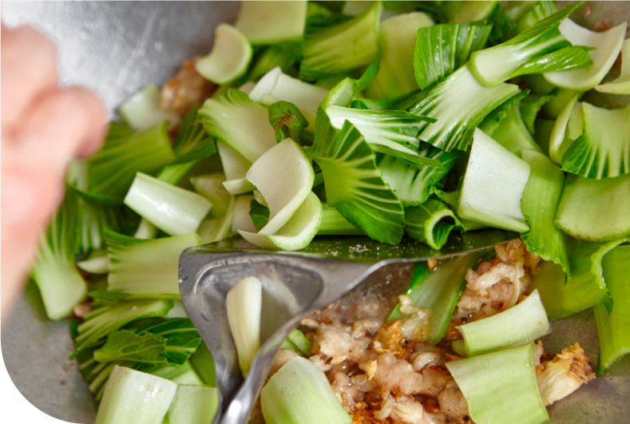



Vegetables
Healthy dietary patterns include a variety of vegetables from all five vegetable subgroups.
  Includes all fresh, frozen, canned, and dried options in cooked or raw forms, including 100% vegetable juices.
  Nutrient-dense forms have limited additions such as salt, butter, or creamy sauces.
Almost 90% of Americans do not meet the recommendation for vegetables.
Most people need to increase total vegetable intake and intake from all vegetable subgroups, shift to nutrient-dense forms, and increase the variety of different vegetables consumed over time.
Strategies to increase vegetable intake include increasing the vegetable content of mixed dishes and eating more vegetables as side dishes or snacks—keeping these nutrient-dense.
Notes:
The following slides provide details about each food group and can be deleted for shorter presentations.

Slide 31


Fruits
Includes whole fruits and 100% fruit juice.
  At least half should come from whole fruit (fresh, canned, frozen, and dried forms).
  Juice should be 100% juice and always pasteurized or 100% juice diluted with water (without added sugars).
  When selecting canned fruit, choose options that are canned with 100% juice or options lowest in added sugars.
About 80% of Americans do not meet fruit recommendations.
Most people would benefit from increasing their intake of fruit, mostly as whole fruits in nutrient-dense forms.
Strategies to increase fruit intake include choosing more whole fruits as snacks and including them in meals.

Slide 32
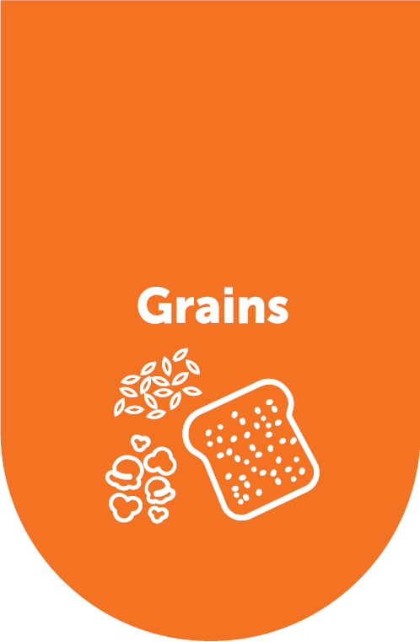

Grains
Healthy dietary patterns include whole grains and limit refined grains.
  At least half of total grains should be whole grains.
  Individuals who eat refined grains should choose enriched grains.
  Individuals who consume all of their grains as whole grains should include some that have been fortified with folic acid.
98% of Americans fall below recommendations for whole grains and 74% exceed limits for refined grains.
Strategies to improve intake include shifting from refined to whole-grain versions of commonly consumed foods, shifting to more nutrient-dense forms of grains, and reducing intake of cakes, cookies, and other grain desserts.

Slide 33

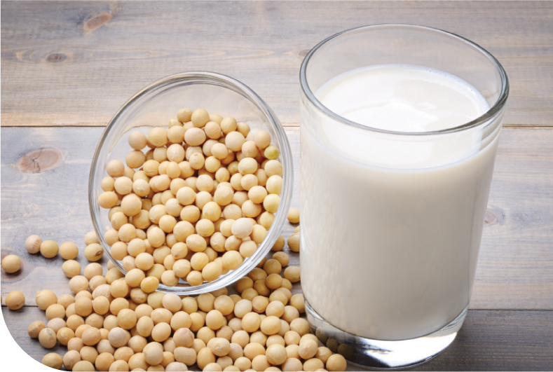
Dairy and Fortified Soy Alternatives
Healthy dietary patterns feature dairy, including fat-free and low-fat (1%) milk, yogurt, and cheese.
Individuals who are lactose intolerant can choose low-lactose and lactose-free dairy products.
Fortified soy beverages (commonly known as “soy milk”) and soy yogurt are included as part of the dairy group.
Other products sold as “milks” but made from plants (e.g., almond, rice, oat “milks”) are not included as part of the dairy group because their overall nutritional content is not similar to dairy milk and fortified soy beverages.
About 90% of Americans do not meet dairy recommendations.
  Dairy is generally consumed in forms with higher amounts of sodium or saturated fat and can be a source of added sugars.
Strategies to increase dairy intake include drinking fat-free or low-fat milk or a fortified soy beverage with meals or incorporating unsweetened fat-free or low-fat yogurt into breakfast or snacks.

Slide 34
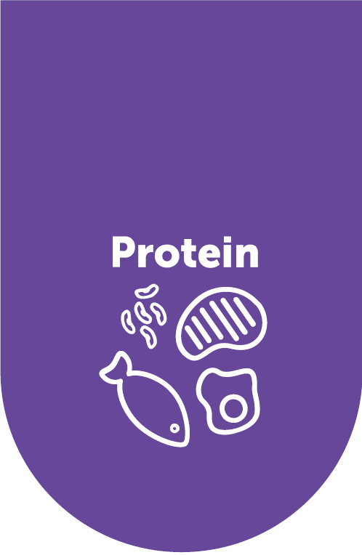

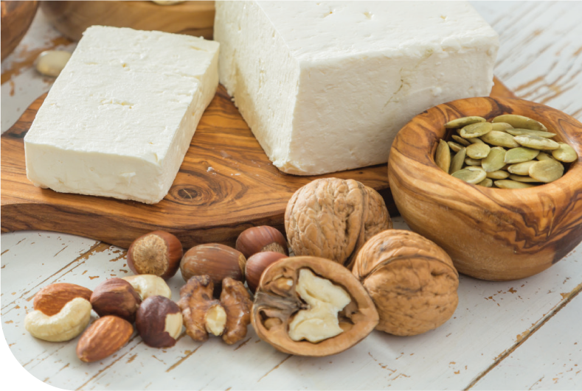
Protein Foods
Healthy dietary patterns include a variety of protein foods in nutrient-dense forms.
Subgroups include:
  Meats, poultry, and eggs
  Seafood
  Nuts, seeds, and soy products
  Beans, peas, and lentils
Most intake of meats and poultry should be from fresh, frozen, or canned, and in lean forms versus processed meats
A healthy vegetarian dietary pattern can be achieved by incorporating protein foods from plants.
Seafood provides beneficial fatty acids (e.g. EPA and DHA).
  Choices higher in EPA and DHA and lower in methylmercury are encouraged.
Notes:
For more information about best sources of seafood see:https://www.epa.gov/fish-tech/epa-fda-advice-about-eating-fish-and-shellfish#:~:text=EPA%20and%20FDA%20provide%20advice%20on%20eating%20fish,the%20risk%20of%20heart%20disease-related%20deaths%20and%20obesity.

Slide 35
Protein Foods (continued)
Intakes of protein foods are close to the target amounts, but many Americans do not meet recommendations for specific subgroups.
  Meet or exceed the recommendation for meats, poultry, and eggs.
  Do not meet the recommendation for seafood or nuts, seeds, and soy products.
Protein foods are generally consumed in forms with higher amounts of saturated fat or sodium and often part of mixed dishes that include other ingredients that are not in nutrient-dense forms.
Shifts are needed to add variety to protein subgroup intakes.
  Selecting from the seafood or beans, peas, and lentils subgroups more often.
  Replacing processed or high fat meats with these subgroups.

Slide 36

Beverages
When choosing beverages in a healthy dietary pattern, both the calories and nutrients that they provide are important considerations.
Beverages that are calorie-free—especially water—or that contribute beneficial nutrients, such as fat-free and low-fat milk and 100% juice, should be the primary beverages consumed.
Coffee, tea, and flavored waters also are options, but the most nutrient-dense options for these beverages include little, if any, sweeteners or cream.
Sugar-sweetened beverages and alcohol should be limited (see Guideline 4).
Notes:
Dietary patterns include both foods and beverages. When choosing beverages in a healthy dietary pattern, both the calories and nutrients that they provide are important considerations. Beverages that are calorie-free—especially water—or that contribute beneficial nutrients, such as fat-free and low-fat milk and 100% juice, should be the primary beverages consumed. Coffee, tea, and flavored waters also are options, but the most nutrient-dense options for these beverages include little, if any, sweeteners or cream. Sugar-sweetened beverages and alcohol are discussed in greater detail under Guideline 4.

Slide 37
Dietary Components of Public Health Concern for Underconsumption
Calcium, potassium, dietary fiber, and vitamin D are considered dietary components of public health concern for the general U.S. population because low intakes are associated with health concerns.
If a healthy dietary pattern is consumed, amounts of calcium, potassium, and dietary fiber can meet recommendations.
Vitamin D recommendations are harder to achieve through natural sources from diet alone and would require consuming foods and beverages fortified with vitamin D. In many cases, taking a vitamin D supplement may be appropriate.
Notes:
Current inadequate intake of nutrient-dense foods and beverages across food groups has resulted in underconsumption of some nutrients and dietary components. Calcium, potassium, dietary fiber, and vitamin D are considered dietary components of public health concern for the general U.S. population because low intakes are associated with health concerns. Additional dietary components that are underconsumed during specific life stages are highlighted in each chapter.
If a healthy dietary pattern is consumed, amounts of calcium, potassium, and dietary fiber can meet recommendations. Individuals should be encouraged to make shifts to increase the intake of vegetables, fruits, beans, whole grains, and dairy to move intakes of these underconsumed dietary components closer to recommendations. In some cases, fortified foods and dietary supplements may be useful in providing one or more nutrients that otherwise may be consumed in less than recommended amounts.
Vitamin D recommendations are harder to achieve through natural sources from diet alone and would require consuming foods and beverages fortified with vitamin D. In many cases, taking a vitamin D supplement may be appropriate especially when sunlight exposure is limited due to climate or the use of sunscreen. Lists of dietary sources of calcium, potassium, dietary fiber, and vitamin D are available at DietaryGuidelines.gov.

Slide 38
Limit foods and beverages higher in added sugars, saturated fat, and sodium, and limit alcoholic beverages
At every life stage, meeting food group recommendations—even with nutrient-dense choices—requires most of a person’s daily calorie needs and sodium limits. A healthy dietary pattern doesn’t have much room for extra added sugars, saturated fat, or sodium—or for alcoholic beverages. A small amount of added sugars, saturated fat, or sodium can be added to nutrient-dense foods and beverages to help meet food group recommendations, but foods and beverages high in these components should be limited.
Limits are:
Added sugars—Less than 10 percent of calories per day starting at age 2. Avoid foods and beverages with added sugars for those younger than age 2.
Saturated fat—Less than 10 percent of calories per day starting at age 2.
Sodium—Less than 2,300 milligrams per day—and even less for children younger than age 14.
Alcoholic beverages—Adults of legal drinking age can choose not to drink or to drink in moderation by limiting intake to 2 drinks or less in a day for men and
1 drink or less in a day for women, when alcohol is consumed. Drinking less is better for health than drinking more. There are some adults who should not drink alcohol, such as women who are pregnant.
Notes:
The fourth Guideline is to limit foods and beverages higher in added sugars, saturated fat, and sodium, and limit alcoholic beverages.

Slide 39
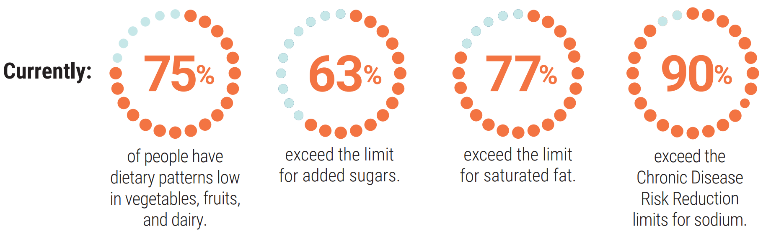
Limit foods and beverages higher in added sugars, saturated fat, and sodium, and limit alcoholic beverages

Slide 40


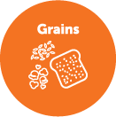



The 85-15 Guide: Percentage of Calories Needed To Meet Food Group Needs With Nutrient-Dense Choices and Percentage Left for Other Uses
Total Calories Per Day
85%
of calories are needed
per day to meet food group recommendations healthfully,
in nutrient-dense forms
Most of the calories a person needs to eat each day—around 85 percent—are needed to meet food group recommendations healthfully, in nutrient-dense forms. The remaining calories—around
15 percent—are calories available for other uses, including for added sugars or saturated fat beyond the small amounts found in nutrient-dense forms of foods and beverages within the pattern, to consume more than the recommended amount of a food group, or for alcoholic beverages. This equates to 250 to 350 remaining calories for calorie patterns appropriate for most Americans.
15%
of remaining calories are available for other uses (including added sugars and saturated fat)
Notes:
Most of the calories a person needs to eat each day—around 85 percent—are needed to meet food group recommendations healthfully, in nutrient-dense forms. The remaining calories—around 15 percent—are calories available for other uses, including for added sugars or saturated fat beyond the small amounts found in nutrient dense forms of foods and beverages within the pattern, to consume more than the recommended amount of a food group, or for alcoholic beverages. This equates to 250 to 350 remaining calories for calorie patterns appropriate for most Americans.

Slide 41

Making Nutrient-Dense Choices:
One Meal At a Time
Slight changes to individual parts of a meal can make a big difference. This meal shows examples of small shifts to more nutrient-dense choices that significantly improve the nutritional profile of the meal overall while delivering on taste and satisfaction.
Typical Burrito Bowl Total Calories = 1,120 | Nutrient-Dense Burrito Bowl Total Calories = 715
White rice (1½ cups) | Brown rice (1 cup) + Romaine lettuce (½ cup)
Black beans (⅓ cup) | Black beans, reduced sodium (⅓ cup)
Chicken cooked with sauce (2 ounces) | Grilled chicken with spice rub (2 ounces)
No grilled vegetables | Added grilled vegetables (⅓ cup)
Guacamole (½ cup) | Sliced avocado (5 slices)
Jarred salsa (¼ cup) | Fresh salsa/pico de gallo (¼ cup)
Sour cream (¼ cup) | No sour cream
Cheese (⅓ cup) | Reduced-fat cheese (⅓ cup)
Jalapeño (5 slices) | Jalapeño (5 slices)
Iced tea with sugar (16 ounces) | Iced tea, no sugar (16 ounces)
Notes:
The first image is a typical meal and the second image demonstrates improvements to the meal to make it more nutrient-dense. The typical meal contains 1,120 calories and after the more nutrient-dense meal contains 715 calories. Shifts to improve nutrient-density include changing white rice to a smaller portion of brown rice, using reduced sodium black beans, increasing the amount of vegetables, and reducing saturated fat through reduced fat shredded cheese and removing the sour cream. Choosing unsweetened iced tea instead of sweetened tea reduces added sugars in this meal.

Slide 42
Added Sugars
A healthy dietary pattern limits added sugars to less than 10% of calories per day.
Most Americans have less than 8% of calories available for added sugars, including the added sugars inherent to a healthy dietary pattern.
For those with a weight loss goal, limiting intake of foods and beverages high in added sugars is a strategy to help reduce calorie intake.
Replacing added sugars with low- and no-calorie sweeteners may reduce calorie intake in the short-term and aid in weight management, yet questions remain about their effectiveness as a long-term weight management strategy.
Notes:
A healthy dietary pattern limits added sugars to less than 10 percent of calories per day. Even the nutrient-dense choices included in the Healthy U.S.-Style Dietary Pattern, which are based on availability in the U.S. food supply, include some calories from added sugars (17-50 calories or 1.5-2% of total calories).
Foods and beverages high in calories from added sugars should be limited to help achieve healthy dietary patterns within calorie limits. When added sugars in foods and beverages exceed 10 percent of calories, a healthy dietary pattern within calories limits is very difficult to achieve. Most Americans have less than 8 percent of calories available for added sugars, including the added sugars inherent to a healthy dietary pattern. For example, based on a set of assumptions outlined in the Dietary Guidelines, an individual who needs 2,000 calories per day has less than 7% of calories available for added sugars.
For those with a weight loss goal, limiting intake of foods and beverages high in added sugars is a strategy to help reduce calorie intake. It should be noted that replacing added sugars with low- and no-calorie sweeteners may reduce calorie intake in the short-term and aid in weight management, yet questions remain about their effectiveness as a long-term weight management strategy. For additional information about high-intensity sweeteners permitted for use in food in the United States, visit FDA.gov.

Slide 43
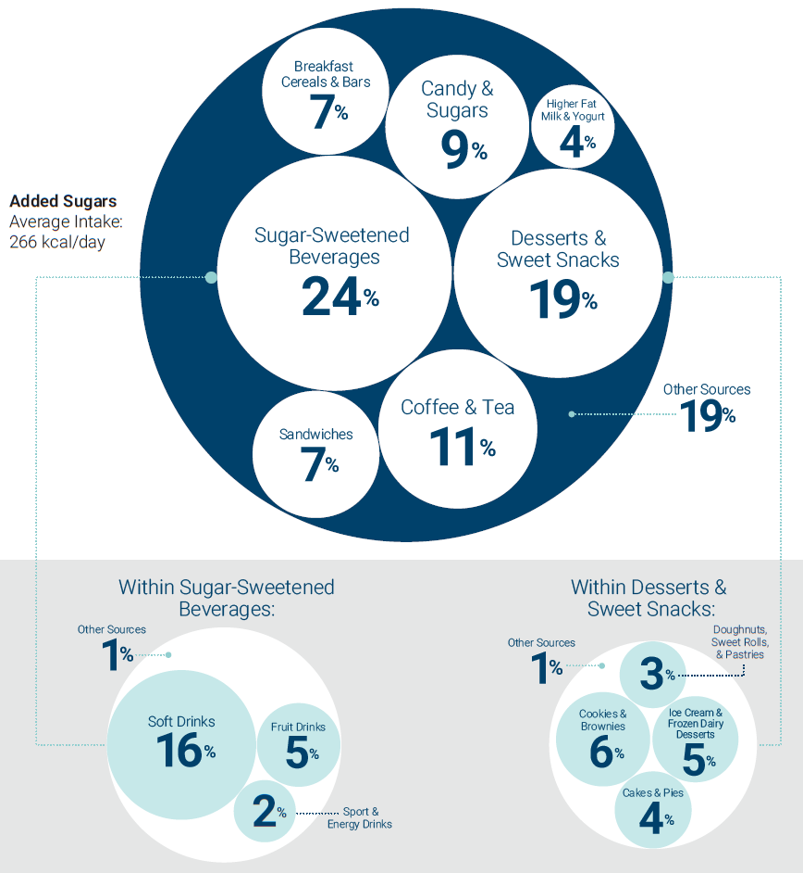
Top Sources and Average Intakes of Added Sugars
Data Source: Analysis of What We Eat in America, NHANES 2013-2016, ages 1 and older, 2 days dietary intake data, weighted.
Notes:
Added sugars account on average for almost 270 calories—or more than 13 percent of total calories—per day in the U.S. population. As shown on this slide, the major sources of added sugars in typical U.S. diets are sugar-sweetened beverages, desserts and sweet snacks, sweetened coffee and tea, and candy. Together, these food categories make up more than half of the intake of all added sugars while contributing very little to food group recommendations.
Individuals have many potential options for reducing the intake of added sugars, including reducing the intake of major sources of added sugars. Strategies include reducing portions, consuming these items less often, and selecting options low in added sugars.

Slide 44
Saturated Fat
For those 2 years and older, intake of saturated fat should be limited to less than 10% of calories per day by replacing them with unsaturated fats, particularly polyunsaturated fats.
Approximately 5% of total calories inherent to the nutrient-dense foods in the Healthy U.S.-Style Dietary Pattern are from saturated fat.
There is little room to include additional saturated fat in a healthy dietary pattern while staying within limits for saturated fat and total calories.
The National Academies recommends that trans fat and dietary cholesterol consumption be as low as possible without compromising the nutritional adequacy of the diet.
Notes:
For those 2 years and older, intake of saturated fat should be limited to less than 10 percent of calories per day by replacing them with unsaturated fats, particularly polyunsaturated fats. Although some saturated fat is inherent in foods (e.g., high-fat meat), some sources are added (e.g., butter on toast). Similar to added sugars, some of the nutrient-dense choices included in the Healthy U.S.-Style Dietary Pattern include saturated fat. Approximately 5 percent of total calories inherent to the nutrient-dense foods in the Healthy U.S.-Style Dietary Pattern are from saturated fat from sources such as lean meat, poultry, and eggs; nuts and seeds; grains; and saturated fatty acids in oils. As such, there is little room to include additional saturated fat in a healthy dietary pattern while staying within limits for saturated fat and total calories.
The National Academies recommends that trans fat and dietary cholesterol consumption to be as low as possible without compromising the nutritional adequacy of the diet. The USDA Dietary Patterns are limited in trans fats and low in dietary cholesterol. Cholesterol and a small amount of trans fat occur naturally in some animal source foods. As of June 2018, partially hydrogenated oils (PHOs), the major source of artificial trans fat in the food supply, are no longer Generally Recognized as Safe (GRAS). Therefore, PHOs are no longer added to foods.

Slide 45
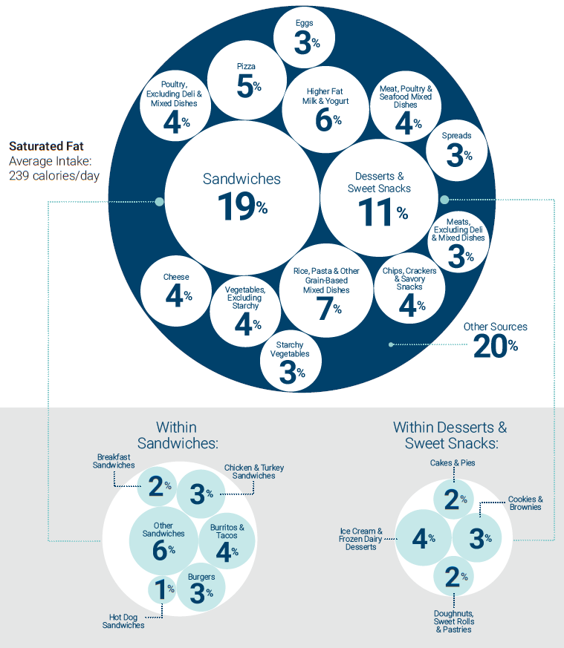
Top Sources and Average Intakes of Saturated Fat
Data Source: Analysis of What We Eat in America, NHANES 2013-2016, ages 1 and older, 2 days dietary intake data, weighted.
Notes:
Current average intakes of saturated fat are 11 percent of calories. Only 23 percent of individuals consume amounts of saturated fat consistent with the limit of less than 10 percent of calories. As shown on this slide, the main sources of saturated fat in the U.S. diet include sandwiches, including burgers, tacos, and burritos; desserts and sweet snacks; and rice, pasta, and other grain-based mixed dishes. Saturated fat is commonly found in higher amounts in high-fat meat, full-fat dairy products (e.g., whole milk, ice cream, cheese), butter, coconut oil, and palm kernel and palm oil.
Strategies to lower saturated fat intake include reducing intakes of dessert and sweet snacks by consuming smaller portion sizes and eating these foods less often. Additional strategies include reading food labels to choose packaged foods lower in saturated fats and choosing lower fat forms of foods and beverages (e.g., fat-free or low-fat milk instead of 2 percent or whole milk; lean rather than fatty cuts of meat). When cooking and purchasing meals, select lean meat and lower fat cheese in place of high-fat meats and regular cheese—or replace them with ingredients with oils, such as nuts, seeds, or avocado. Cook and purchase products made with oils higher in polyunsaturated and monounsaturated fat (e.g., canola, corn, olive, peanut, safflower, soybean, and sunflower) rather than butter, shortening, or coconut or palm oils.

Slide 46
Sodium
Healthy eating patterns limit sodium to the Chronic Disease Risk Reduction (CDRR) levels (e.g. 2,300 mg/day for ages 14 and older).
The nutrient-dense choices in the Healthy U.S.-Style Dietary Pattern provide approximately 60-100% of the age-specific CDRR for sodium across calorie levels.
For most calorie levels and at most ages, there is very little room for food choices that are high in sodium.
Notes:
Sodium is an essential nutrient primarily consumed as salt (sodium chloride). Healthy eating patterns limit sodium to the Chronic Disease Risk Reduction (CDRR) levels defined by the National Academies— 1,200 mg/day for ages 1 through 3; 1,500 mg/day for ages 4 through 8; 1,800 mg/day for ages 9 through 13; and 2,300 mg/day for all other age groups. The CDRR for sodium was established using evidence of the benefit of reducing sodium intake on cardiovascular risk and hypertension risk.
The nutrient-dense choices in the Healthy U.S.-Style Dietary Pattern provide approximately 60-100 percent of the age-specific CDRR for sodium across calorie levels with amounts ranging from about 1,000 to 2,200 mg. For most calorie levels and at most ages, there is very little room for food choices that are high in sodium.

Slide 47
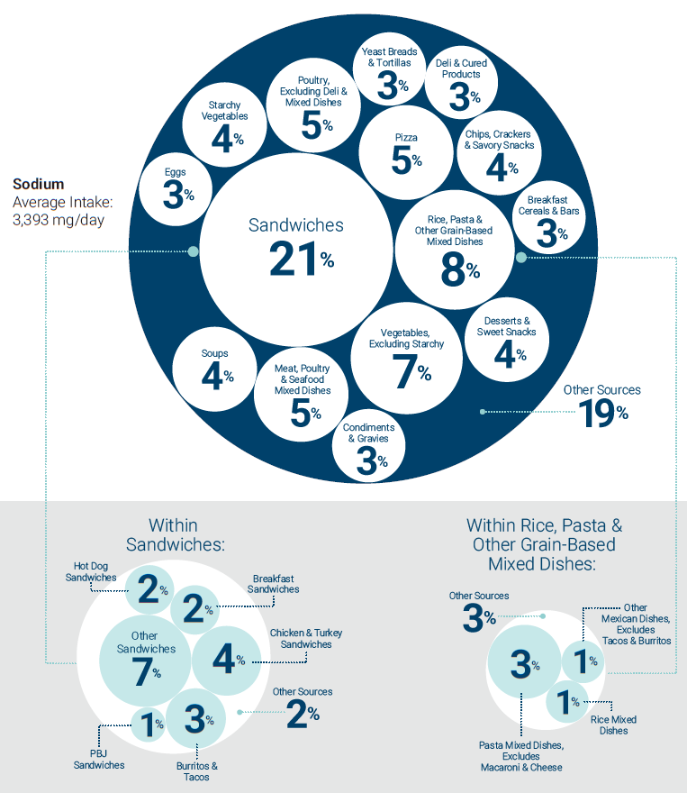
Top Sources and Average Intakes of Sodium
Data Source: Analysis of What We Eat in America, NHANES 2013-2016, ages 1 and older, 2 days dietary intake data, weighted.
Notes:
Average intakes of sodium are high across the U.S. population compared to the CDRRs. Average intakes for those ages 1 and older is 3,393 milligrams per day, with a range of about 2,000 to 5,000 mg per day. Only a small proportion of total sodium intake is from sodium inherent in foods or from salt added in home cooking or at the table. Most sodium consumed in the United States comes from salt added during commercial food processing and preparation, including foods prepared at restaurants.
As this slide illustrates, sodium is found in foods from almost all food categories across the food supply, including mixed dishes such as sandwiches, burgers, and tacos; rice, pasta, and grain dishes; pizza; meat, poultry, and seafood dishes; and soups. Calorie intake is highly associated with sodium intake (i.e., the more foods and beverages people consume, the more sodium they tend to consume).
Because sodium is found in so many foods, multiple strategies should be implemented to reduce sodium intake to the recommended limits. Careful choices are needed in all food groups to reduce intake. Strategies to lower sodium intake include cooking at home more often; using the Nutrition Facts label to choose products with less sodium, reduced sodium, or no-salt-added, etc.; and flavoring foods with herbs and spices instead of salt based on personal and cultural foodways.

Slide 48
Alcoholic Beverages
The Dietary Guidelines does not recommend that individuals who do not drink alcohol start drinking for any reason.
There are also some people who should not drink at all.
If adults age 21 years and older choose to drink alcoholic beverages, drinking less is better for health than drinking more.
The amount of alcohol and calories in beverages varies and should be accounted for within the limits of healthy dietary patterns, so that calorie limits are not exceeded.
Notes:
The Dietary Guidelines does not recommend that individuals who do not drink alcohol start drinking for any reason. There are also some people who should not drink at all, such as if they are pregnant or might be pregnant; under the legal age for drinking; if they have certain medical conditions or are taking certain medications that can interact with alcohol; and if they are recovering from an alcohol use disorder or if they are unable to control the amount they drink. If adults age 21 years and older choose to drink alcoholic beverages, drinking less is better for health than drinking more.
Evidence indicates that, among those who drink, higher average alcohol consumption is associated with an increased risk of death from all causes compared with lower average alcohol consumption. Alcohol misuse or consuming alcohol in excess of recommendations increases risk of several other conditions such as liver disease, cardiovascular disease, injuries, and alcohol use disorders.
Alcoholic beverages are not a component of the USDA Dietary Patterns. The amount of alcohol and calories in beverages varies and should be accounted for within the limits of healthy dietary patterns, so that calorie limits are not exceeded. Among those who drink, alcoholic beverages, alone, account for most of the calories that remain after meeting food group recommendations in nutrient-dense forms—leaving very few calories for added sugars or saturated fat.

Slide 49
Alcoholic Beverages (continued)
Adults of legal drinking age can choose not to drink or to drink in moderation by limiting intakes to 2 drinks or less in a day for men and 1 drink or less in a day for women, when alcohol is consumed.
  In the absence of binge drinking, intakes at these levels is lower risk for most adults; however, caution is recommended.
  Emerging evidence suggests that even drinking within these guidelines may increase the overall risk of death from various causes, such as from several types of cancer and some forms of cardiovascular disease.
Notes:
For the purposes of evaluating amounts of alcohol that may be consumed, the Dietary Guidelines defines drink equivalents. One alcoholic drink equivalent is defined as containing 14 grams (0.6 fl oz) of pure alcohol. Twelve fluid ounces of regular beer (5% alcohol), 5 fluid ounces of wine (12% alcohol), or 1.5 fluid ounces of 80 proof distilled spirits (40% alcohol) each count as one alcoholic drink equivalent . To help Americans move toward a healthy dietary pattern and minimize risks associated with drinking, adults of legal drinking age can choose not to drink or to drink in moderation by limiting intakes to 2 drinks or less in a day for men and 1 drink or less in a day for women, on days when alcohol is consumed. This is not intended as an average over several days, but rather the amount consumed on any single day.
Emerging evidence suggests that even drinking within the recommended limits may increase the overall risk of death from various causes, such as from several types of cancer and some forms of cardiovascular disease. Alcohol has been found to increase risk for cancer, and for some types of cancer, the risk increases even at low levels of alcohol consumption (less than 1 drink in a day). Caution, therefore, is recommended.

Slide 50

Support Healthy Dietary Patterns for All Americans
Everyone has a role to play to support access to healthy foods and beverages where people live, learn, work, play, and gather.
Having access to healthy, safe, and affordable food is crucial for an individual to achieve a healthy dietary pattern.
Notes:
Everyone has a role to play to support access to healthy foods and beverages in multiple settings nationwide where people live, learn, work, play, and gather. Having access to healthy, safe, and affordable food is crucial for an individual to achieve a healthy dietary pattern. Concerted efforts within communities, businesses and industries, organizations, government, and other segments of society are needed to support individuals and families in making lifestyle choices that align with the Dietary Guidelines.

Slide 51
For lifelong good health, make every bite count with the Dietary Guidelines for Americans

Slide 52
Infants & Toddlers
Notes:
Chapter 2 includes a focused discussion on infants and toddlers including key recommendations for this age group.
The time from birth until a child’s second birthday is a critically important period for proper growth and development. It also is key for establishing healthy dietary patterns that may influence the trajectory of eating behaviors and health throughout the life course. During this period, nutrients critical for brain development and growth must be provided in adequate amounts. Children in this age group consume small quantities of foods, so it’s important to make every bite count!

Slide 53
Key Recommendations
For about the first 6 months of life, exclusively feed infants human milk. Continue to feed infants human milk through at least the first year of life, and longer if desired. Feed infants iron-fortified infant formula during the first year of life when human milk is unavailable.
Provide infants with supplemental vitamin D beginning soon after birth.
At about 6 months, introduce infants to nutrient-dense complementary foods.
Introduce infants to potentially allergenic foods along with other complementary foods.
Notes:
Human milk feeding alone is the ideal form of nutrition from birth through about age 6 months. Human milk provides necessary nutrients, protective factors against disease, and other unique immunological benefits. If human milk is unavailable, infants should be fed an iron-fortified commercial infant formula. Once an infant is developmentally ready, foods and beverages should be introduced to complement human milk feeding. These complementary foods and beverages are essential to meet the nutrient requirements of infants starting at about age 6 months and should be selected carefully to help meet these needs. As an infant becomes a toddler, and learns to eat a variety of foods, flavors, and textures, the goal of complementary feeding becomes establishing a healthy dietary pattern and transitioning to a healthy family diet by age 2.

Slide 54
Key Recommendations (cont’d)
Encourage infants and toddlers to consume a variety of foods from all food groups. Include foods rich in iron and zinc, particularly for infants fed human milk.
Avoid foods and beverages with added sugars.
Limit foods and beverages higher in sodium.
As infants wean from human milk or infant formula, transition to a healthy dietary pattern.

Slide 55
Putting the Key Recommendations
Into Action
Birth Through 23 Months

Slide 56
Feed Infants Human Milk for the First 6 Months,
If Possible
Human milk can support an infant’s nutrient needs for about the first 6 months of life, with the exception of vitamin D and possibly iron.
  Human milk provides nutrients, bioactive substances, and immunologic properties that support infant health, growth, and development.
If human milk is unavailable, feed infants iron-fortified commercial infant formula regulated by the FDA. Homemade infant formulas and those that are improperly and illegally imported without mandated FDA review should not be used.
Take precautions to ensure that expressed human milk and infant formula are handled and stored safely.
Donor human milk should only be obtained from a source that has screened its donors and taken appropriate safety precautions.
Notes:
More information on storing and handling human milk is available at cdc.gov/ breastfeeding/recommendations/handling_breastmilk.htm. More information on storing and preparing powdered infant formula is available at cdc.gov/ nutrition/downloads/prepare-store-powered-infant-formula-508.pdf.
When human milk is obtained directly from individuals or through the internet, the donor is unlikely to have been screened for infectious diseases, and it is unknown whether the human milk has been collected or stored in a way to reduce possible safety risks to the baby. More information is available at fda.gov/science-research/
pediatrics/use-donor-human-milk

Slide 57
Supplemental Vitamin D
All infants who are fed human milk exclusively or who receive both human milk and infant formula (mixed fed) will need a vitamin D supplement of 400 IU per day beginning soon after birth.
Infant formula is fortified with vitamin D, thus, when an infant is receiving full feeds of infant formula, vitamin D supplementation is not needed.
Young children may need to continue taking a vitamin D supplement after age 12 months. Consult with a healthcare professional to determine how long to supplement.

Slide 58


Introduce Nutrient-Dense
Complementary Foods at About 6 Months
Complementary foods, as a supplement to human milk or infant formula feedings, are necessary to ensure adequate nutrition and exposure to flavors, textures, and different types of foods.
Some infants may show developmental signs of readiness before age 6 months, but introducing complementary foods before age 4 months – or waiting until after 6 months - is not recommended.
For infants fed human milk, it is particularly important to include complementary foods that are rich in iron and zinc.
Provide age and developmentally appropriate foods to help prevent choking.

Slide 59
Readiness for Beginning Solid Foods
Signs of readiness:
  Able to control head and neck
  Sitting up alone or w/ support
  Bringing objects to the mouth
  Trying to grasp small objects
  Swallowing food rather than pushing it back out
Developmentally appropriate foods prevent choking risk:
  Offer foods in the appropriate size, consistency, and shape
  Feed in a high chair or other safe, supervised place
  Ensure adult supervision
  Do not put infant cereal of solid foods in a bottle
*More information on foods that can present choking hazards is available from USDA at wicworks.fns. usda.gov/resources/reducing-risk-choking-youngchildren-mealtimes

Slide 60
Introduce Potentially Allergenic Foods When Other Complementary Foods are Introduced
There is no evidence that delaying introduction of allergenic foods, beyond when other complementary foods are introduced, helps to prevent food allergy.
Foods like peanuts, egg, cow milk products, tree nuts, wheat, crustacean shellfish, fish, and soy should be introduced when other complementary foods are introduced.
  Introducing peanut-containing foods in the first year reduces the risk that an infant will develop a food allergy to peanuts.
  Cow milk, as a beverage, should be introduced at age 12 months or later.

Slide 61

Infants at High Risk for Peanut Allergy
If an infant has severe eczema, egg allergy, or both, age-appropriate, peanut-containing foods should be introduced into the diet as early as age 4 to 6 months – this helps reduce the risk of developing a peanut allergy.
Caregivers of infants at high risk should check with the infant’s healthcare provider before feeding the infant peanut-containing foods.
Notes:
Caregivers of infants at high risk for peanut allergy should check with the infant’s healthcare provider before feeding the infant peanut-containing foods. A blood test or skin prick may be recommended to determine whether peanut should be introduced to the infant, and, if so, the safest way to introduce it. More information is available in the Addendum Guidelines for the Prevention of Peanut Allergy in the United States at niaid.nih.gov/sites/default/files/addendum-peanut-allergy-prevention-guidelines.pdf.

Slide 62
Encourage Consumption of a Variety of Complementary Foods and Beverages
Complementary foods and beverages should be rich in nutrients, meet calorie and nutrient requirements, and stay within limits of dietary components such as added sugars and sodium.
At about 6 months old introduce:
  Iron-rich foods (meats and seafood rich in heme iron, iron-fortified cereals)
  Zinc-rich foods (meats, beans, fortified cereals)
  A variety of foods from all food groups, knowing it may take up to 8 to 10 exposures for an infant to accept a new food

Slide 63

A nutrient-dense, diverse diet from age
6 through 23 months includes a variety of food sources from each food group.
Protein foods, including meats, poultry, eggs, seafood, nuts, seeds, and soy products, are important sources of iron, zinc, protein, choline, and long chain polyunsaturated fatty acids.
Offer vegetables and fruits, especially those rich in potassium, vitamin A, and vitamin C. Beans, peas, and lentils provide a good source of protein and dietary fiber.
Introduce yogurt and cheese, including soy-based yogurt, before 12 months; do not offer cow milk, as a beverage, or fortified soy beverage, before age 12 months.
Grains, including iron-fortified infant cereal, play an important role in meeting nutrient needs during this life stage.

Slide 64
Dietary Components to Limit
Avoid added sugars
  Young children have virtually no room in their diet for added sugars.
Avoid foods higher in sodium
  Taste preferences for salty food may be established early in life.
Avoid honey and unpasteurized foods and beverages
  Raw and cooked honey can contain the Clostridium botulinum organism and cause serious illness or death among infants.

Slide 65

Establish a Healthy Beverage Pattern
Small amounts of plain, fluoridated water can be given with the introduction of complementary foods, not before.
Do not provide cow milk or fortified soy beverages before 12 months to replace human milk or infant formula. Plain cow milk (whole milk) as a beverage can be offered beginning around 12 months to help meet calcium, potassium, vitamin D, and protein needs.
Plant-based milk alternatives (e.g., rice, oat, coconut, almond) should not be used in the first year of life.
100% fruit or vegetable juices should not be given to infants. In the second year of life, fruit juice is not necessary; if provided, limit intake to 4 ounces per day.

Slide 66
Establish a Healthy Beverage Pattern (cont’d)
Sugar-sweetened beverages should not be given to children younger than age 2.
Toddler milk and toddler drinks (i.e., beverages supplemented with nutrients) are not needed. These beverages often contain added sugars.
Avoid beverages with caffeine. No safe limits of caffeine have been established for infants and toddlers.

Slide 67
Healthy Dietary Pattern During the Toddler’s Second Year of Life

Slide 68
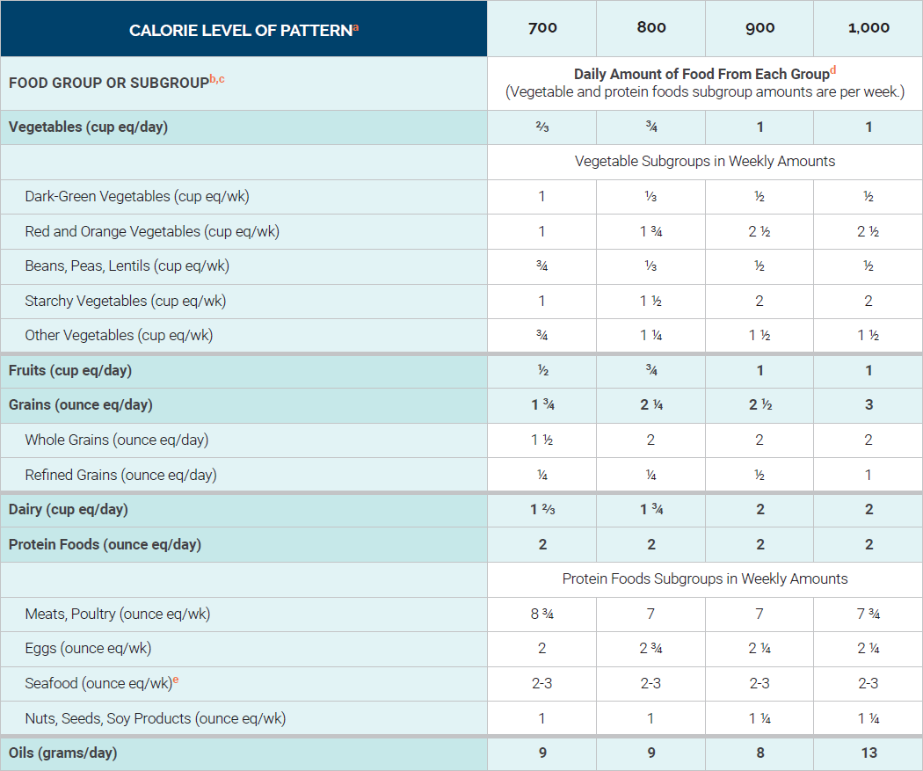
Healthy U.S. Style Dietary Pattern: Toddlers Ages 12 Through 23 Months Who Are No Longer Receiving Human Milk or Infant Formula
Notes:
This table displays the Healthy U.S.-Style Dietary Pattern to illustrate the specific amounts and limits for food groups and other dietary components that make up healthy dietary patterns. The pattern is provided at calorie levels ranging from 700 to 1,000 calories per day, which are appropriate for most toddlers ages 12 through 23 months. A healthy dietary pattern includes a variety of nutrient-dense fruits, vegetables, grains, protein foods (including lean meats, poultry, eggs, seafood, nuts, and seeds), dairy (including milk, yogurt, and cheese), and oils.
Footnotes:
ª Calorie level ranges: Energy levels are calculated based on median length and body weight reference individuals. Calorie needs vary based on many factors. The DRI Calculator for Healthcare Professionals, available at https://www.nal.usda.gov/fnic/dri-calculator, can be used to estimate calorie needs based on age, sex, and weight.
^{b} Definitions for each food group and subgroup and quantity (i.e., cup or ounce equivalents) are provided in Chapter 1 and are compiled in Appendix 3.
^{c} All foods are assumed to be in nutrient-dense forms and prepared with minimal added sugars, refined starches, or sodium. Food are also lean or in low-fat forms with the exception of dairy, which includes whole-fat fluid milk, reduced-fat plain yogurts, and reduced-fat cheese. There are no calories available for additional added sugars, saturated fat, or to eat more than the recommended amount of food in a food group.
^{d} In some cases, food subgroup amounts are greatest at the lower calorie levels to help achieve nutrient adequacy when relatively small number of calories are required.
^{e} If consuming up to 2 ounces of seafood per week, children should only be fed cooked varieties from the “Best Choices” list in the FDA/EPA joint “Advice About Eating Fish,” available at FDA.gov/fishadvice and EPA.gov/fishadvice. If consuming up to 3 ounces of seafood per week, children should only be fed cooked varieties from the “Best Choices” list that contain even lower methylmercury: flatfish (e.g., flounder), salmon, tilapia, shrimp, catfish, crab, trout, haddock, oysters, sardines, squid, pollock, anchovies, crawfish, mullet, scallops, whiting, clams, shad, and Atlantic mackerel. If consuming up to 3 ounces of seafood per week, many commonly consumed varieties of seafood should be avoided because they cannot be consumed at 3 ounces per week by children without the potential of exceeding safe methylmercury limits; examples that should not be consumed include: canned light tuna or white (albacore) tuna, cod, perch, black sea bass. For a complete list please see: FDA.gov/fishadvice and EPA.gov/fishadvice.
Note: Vegetarian Dietary Pattern During the Second Year of Life
A Healthy Vegetarian Dietary Pattern for young children ages 12 through 23 months who are not fed human milk or infant formula is included in Appendix 3. This pattern describes a lacto-ovo vegetarian diet that includes regular consumption of eggs, dairy products, soy products, and nuts or seeds, in addition to vegetables including beans, peas, and lentils, fruits, grains, and oils. Iron may be of particular concern because plant source foods contain only non-heme iron, which is less bioavailable than is heme iron. Food source lists for both heme and non-heme iron are available at DietaryGuidelines.gov. Vitamin B12 also may be of concern because it is present only in animal source foods. When feeding infants and toddlers a lacto-ovo vegetarian diet, parents, caregivers, and guardians should consult with a healthcare provider to determine whether supplementation of iron, vitamin B12, and/or other nutrients is necessary and if so, appropriate levels to meet their unique needs.

Slide 69
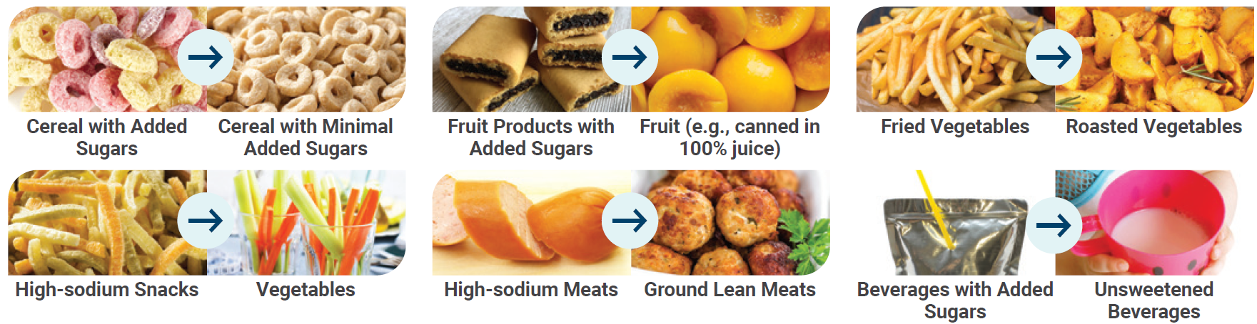
Make Healthy Shifts to Empower Toddlers to
Eat Nutrient-Dense Foods in Dietary Patterns
Science shows that early food preferences influence later food choices.
Make the first choice the healthiest choices that set toddlers on a path of making nutrient-dense choices for years to come.
Notes:
Science shows that early food preferences influence later food choices. Make the first choice the healthiest choices that set toddlers on a path of making nutrient-dense food choices in the years to come. Examples of shifts in common choices to healthier, more nutrient-dense choices are shown here.
Because very young children are being exposed to new textures and flavors for the first time, it may take up to 8 to 10 exposures for an infant to accept a new type of food. Repeated offering of foods such as fruits and vegetables increases the likelihood of an infant accepting them.

Slide 70
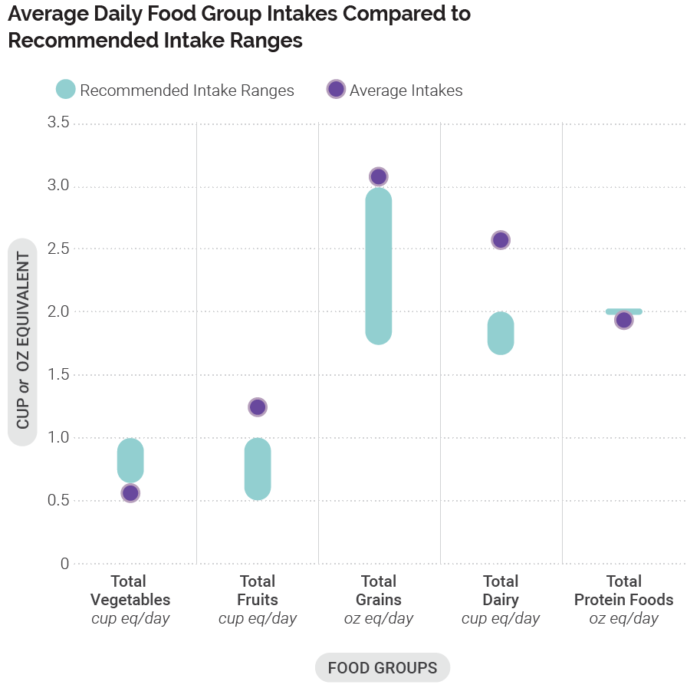
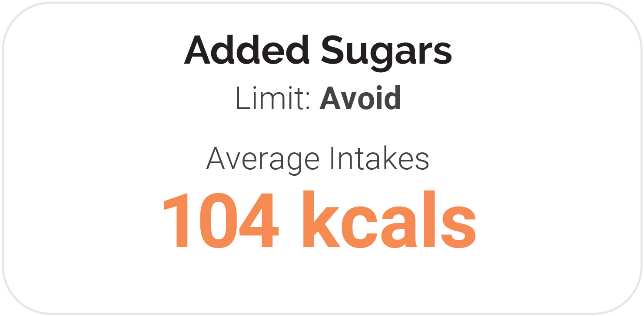

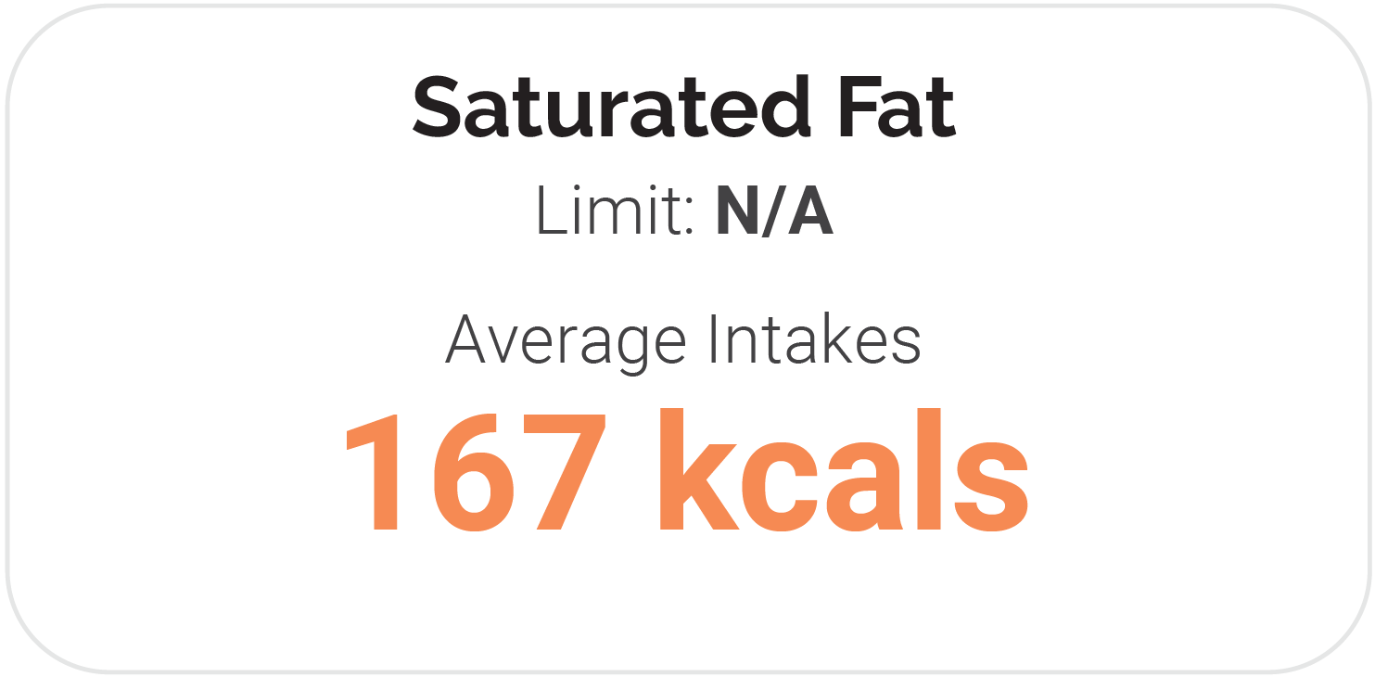
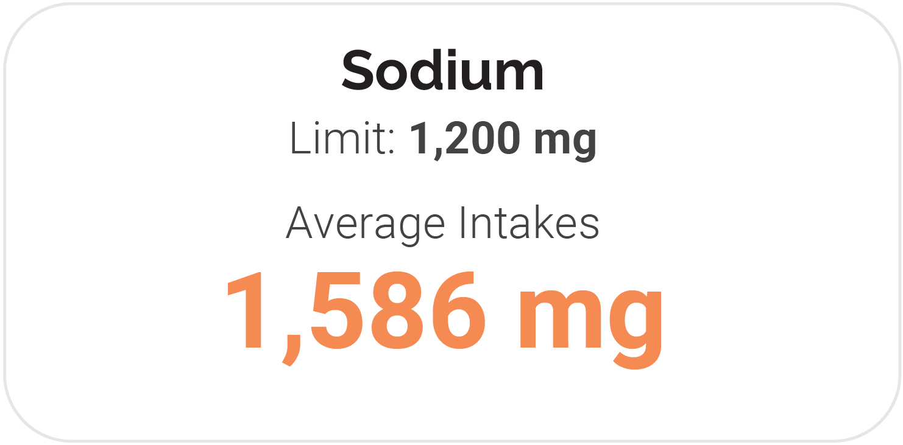
Current Intakes: 12 Through 23 Months
Data Source: Average Intakes: Analysis of What We Eat in America, NHANES 2007-2016, day 1 dietary intake data, weighted. Recommended Intake Ranges: Healthy U.S.-Style Dietary Patterns.
Notes:
The bar chart shows average intakes of food groups per day compared to recommended intake ranges for those ages 12 through 23 months. Average intakes of total fruits, total grains and dairy foods exceed recommended intake ranges, while average daily intakes of total vegetables and total protein foods fall below recommended intake ranges. The figure also displays average intakes of added sugars, saturated fat, and sodium. The average intake of added sugars is 104 calories per day and exceeds the limit to avoid added sugars for this age group. While there is no established limit for saturated fat, 167 calories per day come from saturated fat. Average intake of sodium for this age group is close to 1,600 milligrams per day, which exceeds the recommended limit by almost 400 milligrams of sodium.

Slide 71
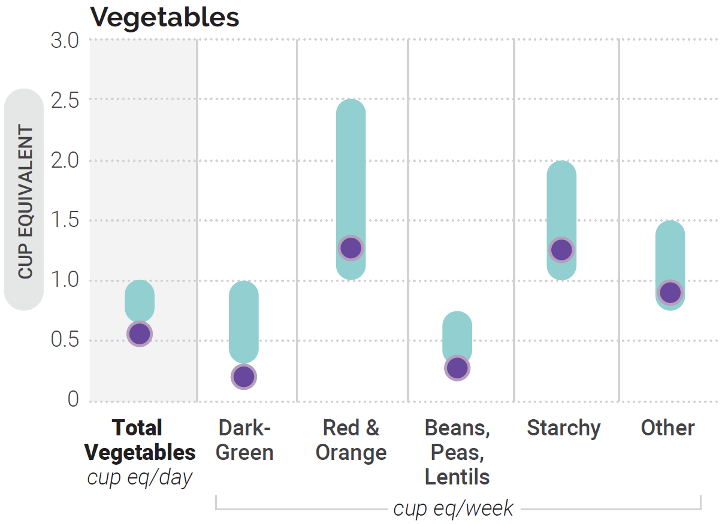
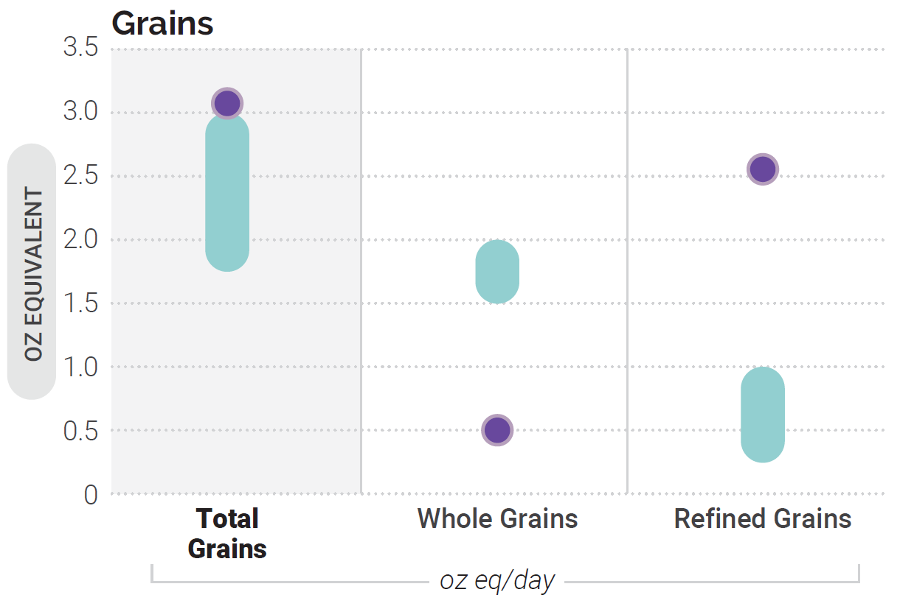
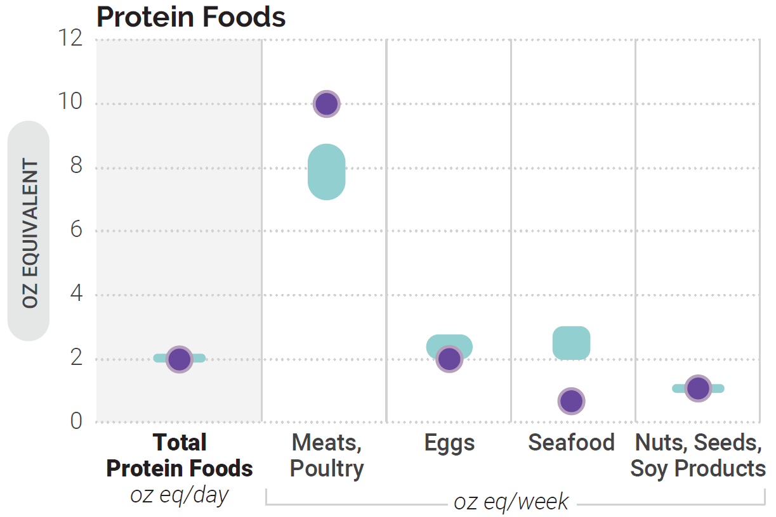
Average Intakes of Subgroups Compared to
Recommended Intake Ranges: 12 Through 23 Months
Data Source: Average Intakes: Analysis of What We Eat in America, NHANES 2007-2016, day 1 dietary intake data, weighted. Recommended Intake Ranges: Healthy U.S.-Style Dietary Patterns.
Notes:
Three bar charts show the average intakes for ages 12 through 23 months, compared to recommended intake ranges of total and subgroup amounts for vegetables, grains, and protein foods. Average weekly intakes for vegetable subgroups fall below recommendations for dark-green vegetables, and beans, peas and lentils, and within recommendations for red and orange, starchy, and other vegetables. Average daily intakes fall well below recommended ranges for whole grains and well above recommendations for refined grains. Average weekly intakes fall below recommendations for seafood. Average weekly intakes of meat and poultry are above recommendations, while intakes of eggs and for nuts, seeds, and soy products fall within the recommended intake ranges.

Slide 72
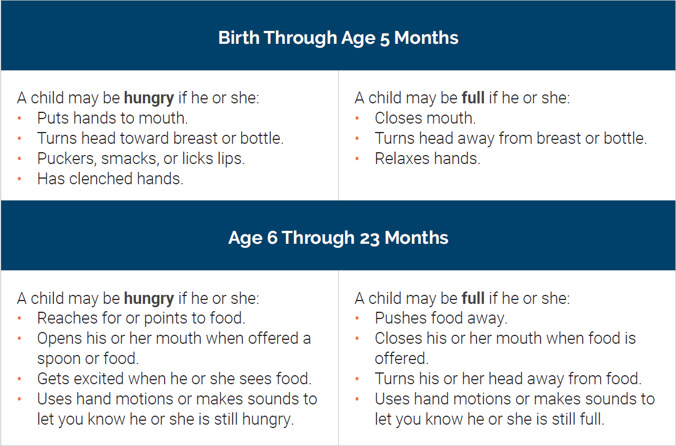
Supporting Healthy Eating
Signs a Child is Hungry or Full*
Parents, guardians, and caregivers play an important role in nutrition during this life stage because infants and toddlers are fully reliant on them for their needs.
In addition to “what” to feed children, “how” to feed young children is critical.
*More information is available at: cdc.gov/nutritioninfantandtoddlernutrition/mealtime/ signs-your-child-is-hungry-or-full.html; wicworks.fns.usda.gov/sites/default/files/media/document/Infant_Nutrition_ and_Feeding_Guide.pdf
Notes:
Responsive feeding is a term used to describe a feeding style that emphasizes recognizing and responding to the hunger or fullness cues of an infant or young child. Responsive feeding helps young children learn how to self-regulate their intake.
It is important to listen to the child’s hunger and fullness cues to build healthy eating habits during this critical age. If parents, guardians, or caregivers have questions or concerns, a conversation with a healthcare provider will be helpful.
More information on signs a child is hungry or full is available at
cdc.gov/nutrition/infantandtoddlernutrition/mealtime/signs-your-child-is-hungry-or-full.html.
More information on infant development skills, hunger and satiety cues, and typical daily portion sizes is available at
wicworks.fns.usda.gov/sites/default/files/media/document/Infant_Nutrition_and_Feeding_Guide.pdf.

Slide 73

Resources
Federal Programs
WIC | Special Supplemental Nutrition Program for Women, Infants, and Children
CACFP | Child and Adult Care Food Program
SNAP | Supplemental Nutrition Assistance Program
 | Head Start
Notes:
Many resources exist to support healthy growth and development during infancy and toddlerhood. These include the following Government programs that aim to support a healthy dietary pattern for infants and toddlers living in households with limited incomes:
The Special Supplemental Nutrition Program for Women, Infants, and Children (WIC) supports infant and early childhood nutrition through supplementing the diets of women who are pregnant or lactating and by providing breastfeeding support and iron-fortified infant formula when human milk is unavailable or fed only partially. WIC accommodates the transition to solid foods by providing nutrient-dense foods in the supplemental food packages offered to older infants and toddlers. Nutrition education and counseling and referrals to health care and social services are other important resources offered to income-eligible WIC participants.
The Child and Adult Care Food Program (CACFP) provides reimbursement for nutrient-dense meals and snacks served to infants and toddlers in participating child care centers, including at Head Start programs, and day care homes where infants and toddlers also have access to health screenings and families can be connected to health services to support their overall well-being.
The Supplemental Nutrition Assistance Program (SNAP) is the largest food assistance program in the United States. SNAP helps meet the nutritional needs of infants and toddlers living in low-income households by providing temporary monthly benefits that can be used to access a healthy dietary pattern.

Slide 74
Children & Adolescents
Notes:
Chapter 3 provides tailored information specific to children and adolescents. Children and adolescents include individuals ages 2 through 18—a life stage characterized by transitions and the formation of dietary patterns.
Suboptimal current intake patterns among children and adolescents and inadequate physical activity contribute to overweight and obesity in this life stage and risk of chronic disease (e.g., type 2 diabetes, cardiovascular disease) later in life. Changing this trajectory is crucial because dietary patterns established during this life stage tend to continue into adult years.

Slide 75
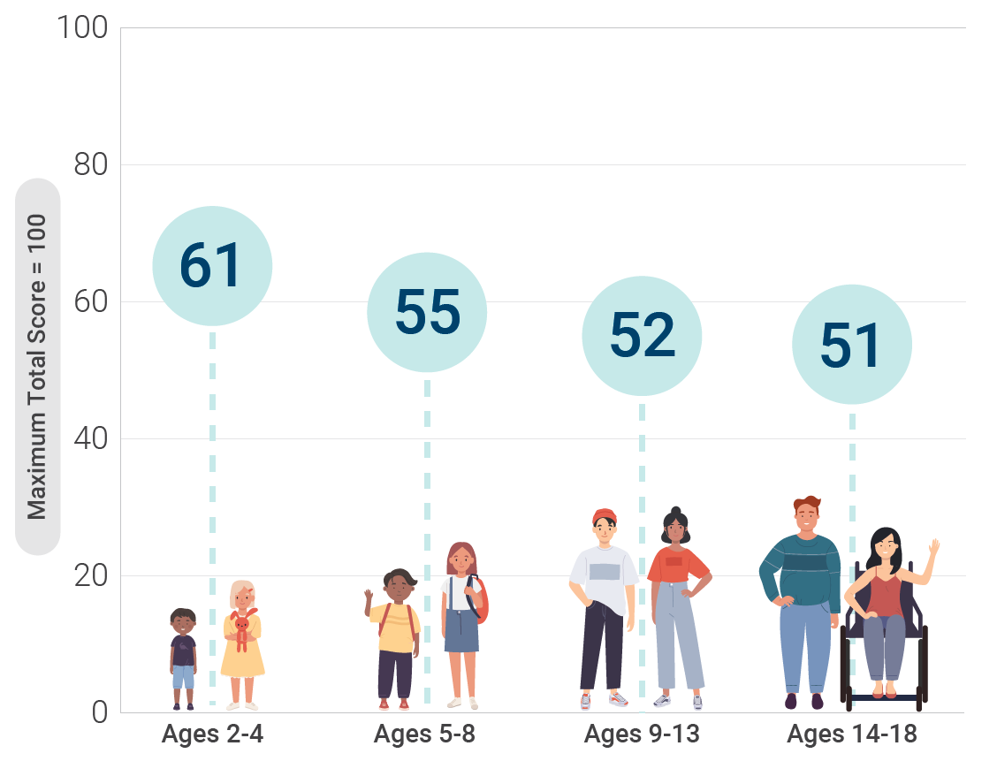
Healthy Eating Index Scores
Across Childhood and Adolescence
Data Source: Analysis of What We Eat in America, NHANES 2015-2016, ages 1 through 18, day 1 dietary intake, weighted.
Notes:
The Bar Chart shows Healthy Eating Index-2015 Scores across 4 age groups within children and adolescents using data from What We Eat In America, NHANES 2015-2016. The maximum total score is 100. Ages 2-4 is highest, 61. Ages 5-8 is 55. Ages 9-13 is 52. Ages 14-18 is lowest, 51.

Slide 76
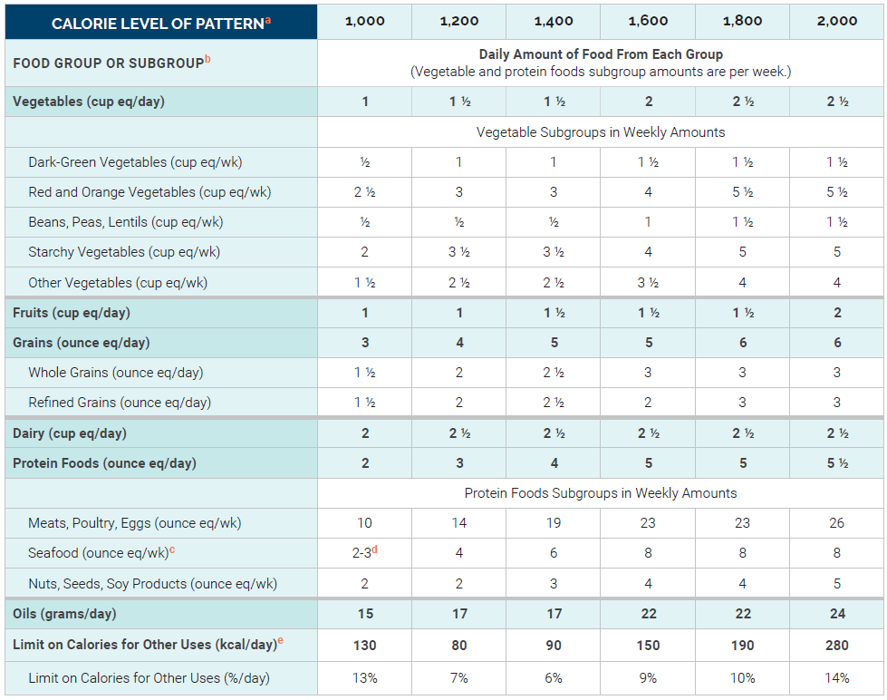
Healthy U.S. Style Dietary Pattern:
Ages 2 Through 8
Notes:
Children and adolescents are encouraged to follow the recommendations on the types of foods and beverages that make up a healthy dietary pattern described in Chapter 1. Nutrition and Health Across the Lifespan: The Guidelines and Key Recommendations. This table displays the Healthy U.S.-Style Dietary Pattern to illustrate the specific amounts and limits for food groups and other dietary components that make up healthy dietary patterns at the calorie levels appropriate for most children ages 2 through 8.
In early childhood (ages 2 through 4 years) females require about 1,000 to 1,400 calories per day and males require about 1,000 to 1,600 calories per day. With the transition to school-age (ages 5 through 8 years), females require about 1,200 to 1,800 calories per day and males require about 1,200 to 2,000 calories per day.
Key Points on Food Groups:
Vegetables: 1-2.5 cups/day
Fruits: 1-2 cups/day
Grains: 3-6 oz/day
Dairy: 2-2.5 cups/day
Protein Foods: 2-5.5 oz/day
Oils: 15-24 g/day
Footnotes:
ª Calorie level ranges: Ages 2 through 4, Females: 1,000-1,400 calories; Males: 1,000-1,600 calories. Ages 5 through 8, Females: 1,200-1,800 calories; Males: 1,200-2,000 calories. Energy levels are calculated based on reference height (median) and reference weight (healthy) corresponding with a healthy body mass index (BMI). Calorie needs vary based on many factors. The DRI Calculator for Healthcare Professionals, available at nal.usda.gov/fnic/dri-calculator, can be used to estimate calorie needs based on age, sex, height, weight, and activity level.
^{b} Definitions for each food group and subgroup and quantity (i.e., cup or ounce equivalents) are provided in Chapter 1 and are compiled in Appendix 3.
^{c}The U.S. Food and Drug Administration (FDA) and the U.S. Environmental Protection Agency (EPA) provide joint advice regarding seafood consumption to limit methylmercury exposure for children. Depending on body weight, some children should choose seafood lowest in methylmercury or eat less seafood than the amounts in the Healthy US-Style Dietary Pattern. More information is available on the FDA and EPA websites at FDA.gov/fishadvice and EPA.gov/fishadvice.
^{d} If consuming up to 2 ounces of seafood per week, children should only be fed cooked varieties from the “Best Choices” list in the FDA/EPA joint “Advice About Eating Fish,” available at FDA.gov/fishadvice and EPA.gov/fishadvice. If consuming up to 3 ounces of seafood per week, children should only be fed cooked varieties from the “Best Choices” list that contain even lower methylmercury: flatfish (e.g., flounder), salmon, tilapia, shrimp, catfish, crab, trout, haddock, oysters, sardines, squid, pollock, anchovies, crawfish, mullet, scallops, whiting, clams, shad, and Atlantic mackerel. If consuming up to 3 ounces of seafood per week, many commonly consumed varieties of seafood should be avoided because they cannot be consumed at 3 ounces per week by children without the potential of exceeding safe methylmercury limits; examples that should not be consumed include: canned light tuna or white (albacore) tuna, cod, perch, black sea bass. For a complete list please see: FDA.gov/fishadvice and EPA.gov/fishadvice.
^{e} Foods are assumed to be in nutrient-dense forms; lean or low-fat; and prepared with minimal added sugars, refined starches, saturated fat, or sodium. If all food choices to meet food group recommendations are in nutrient-dense forms, a small number of calories remain within the overall limit of the pattern (i.e., limit on calories for other uses). The number of calories depends on the total calorie level of the pattern and the amounts of food from each food group required to meet nutritional goals. Calories up to the specified limit can be used for added sugars and/or saturated fat, or to eat more than the recommended amount of food in a food group.
NOTE: The total dietary pattern should not exceed Dietary Guidelines limits for added sugars and saturated fat; be within the Acceptable Macronutrient Distribution Ranges for protein, carbohydrate, and total fats; and stay within calorie limits. Values are rounded. See Appendix 3 for all calorie levels of the pattern.

Slide 77
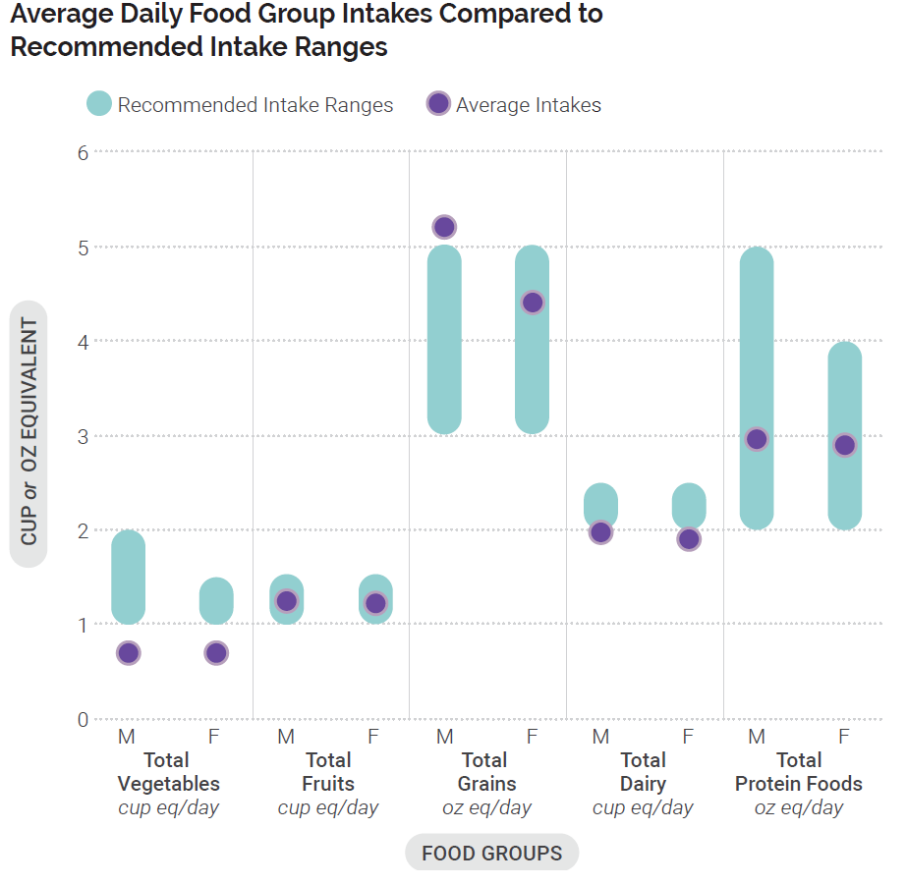
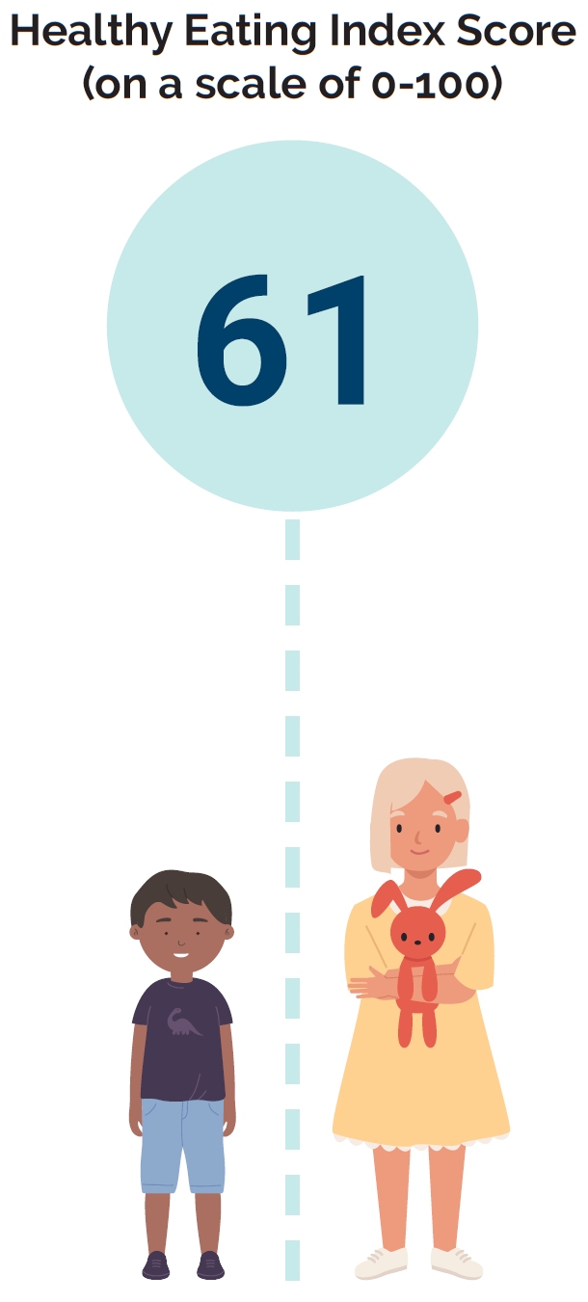
Current Intakes: Ages 2 Through 4
Data Source: Average Intakes and HEI-2015 Scores: Analysis of What We Eat in America, NHANES 2015-2016, day 1 dietary intake data, weighted. Recommended Intake Ranges: Healthy U.S.-Style Dietary Patterns.
Notes:
The Bar Chart shows average intakes of the food groups per day compared to recommended intake ranges for males and females ages 2 through 4. Average intakes of total fruits, and total protein foods fall within the recommended intake ranges for males and females. Average intake of total vegetables fall below recommended intake ranges for both males and females. Average intakes of total grains among males exceeds the recommended intake range and among females falls within the recommended intake range. Average daily intake of dairy foods among males is at the lowest level of the recommended intake range, and among females falls below the recommended intake range.
NOTE: Children ages 2 through 3 should reduce sodium intake if above 1,200 mg/d and those age 4 should reduce intake if above 1,500 mg/d.

Slide 78
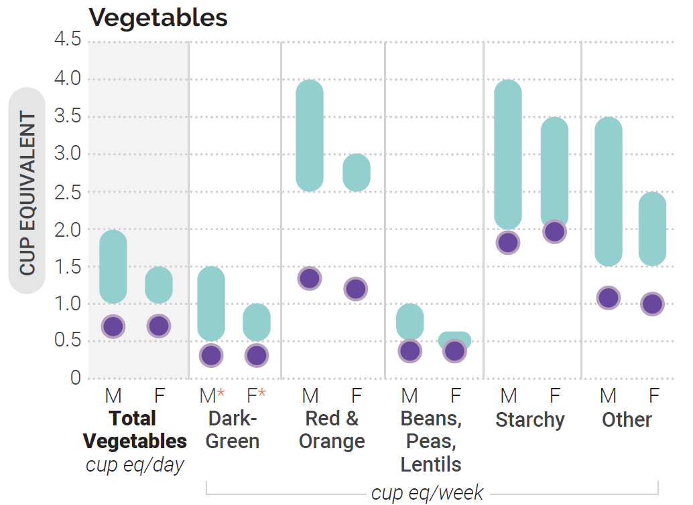
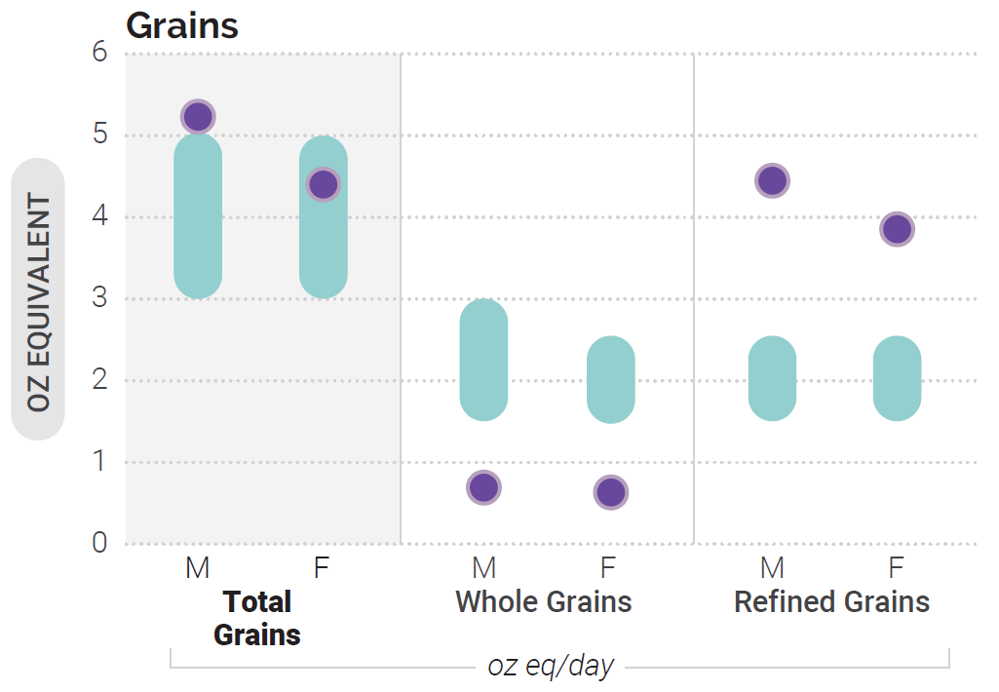
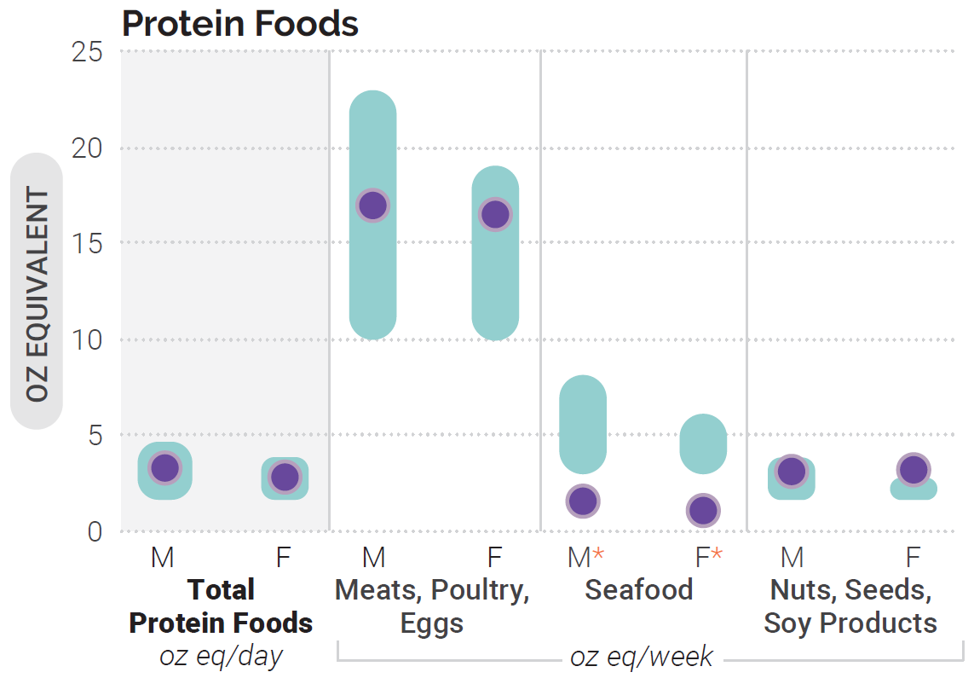
Average Intakes of Subgroups Compared to
Recommended Intake Ranges: Ages 2 Through 4
*Note: Estimates may be less precise than others due to small sample size and/or large relative standard error.
Data Source: Average Intakes: Analysis of What We Eat in America, NHANES 2015-2016, day 1 dietary intake data, weighted. Recommended Intake Ranges: Healthy U.S.-Style Dietary Patterns.
Notes:
Three bar charts show the average intakes for males and females ages 2 through 4, compared to recommended intake ranges of total vegetables and vegetable subgroups, total grains and grain subgroups, and total protein foods and protein food subgroups. Average daily intakes of total vegetables as well as weekly intakes of all vegetable subgroups including dark-green, red and orange, beans, peas and lentils, starchy, and other vegetables are below recommended intake ranges for both males and females. Average daily intake of total grains is above the recommended intake range for males, and is within the recommended intake range for females, however weekly intakes of whole grains fall below recommendations and refined grain intake is above recommendations. Average daily intake of total protein foods is within the recommended range of intakes for both males and females. Average weekly intakes of seafood is below recommended intake ranges.

Slide 79
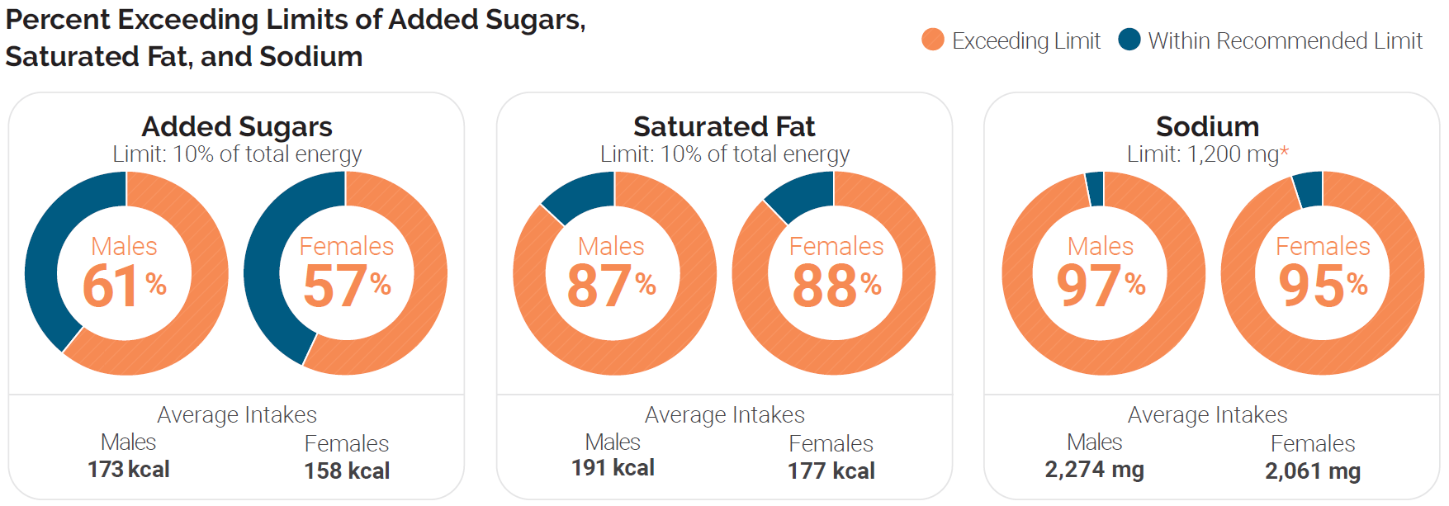
Current Intakes: Ages 2 Through 4
Added Sugars, Saturated Fat & Sodium
Data Source: Percent Exceeding Limits: What We Eat in America, NHANES 2013-2016, 2 days dietary intake data, weighted.
Notes:
Circle charts are used to show the percent of this age group who exceed limits for added sugars, saturated fat and sodium. 61 and 57% of males and females, respectively, exceed the limit for added sugars. 87 and 88% of males and females, respectively, exceed the limit for saturated fat. 97 and 95% of males and females, respectively, exceed the limit for sodium.

Slide 80
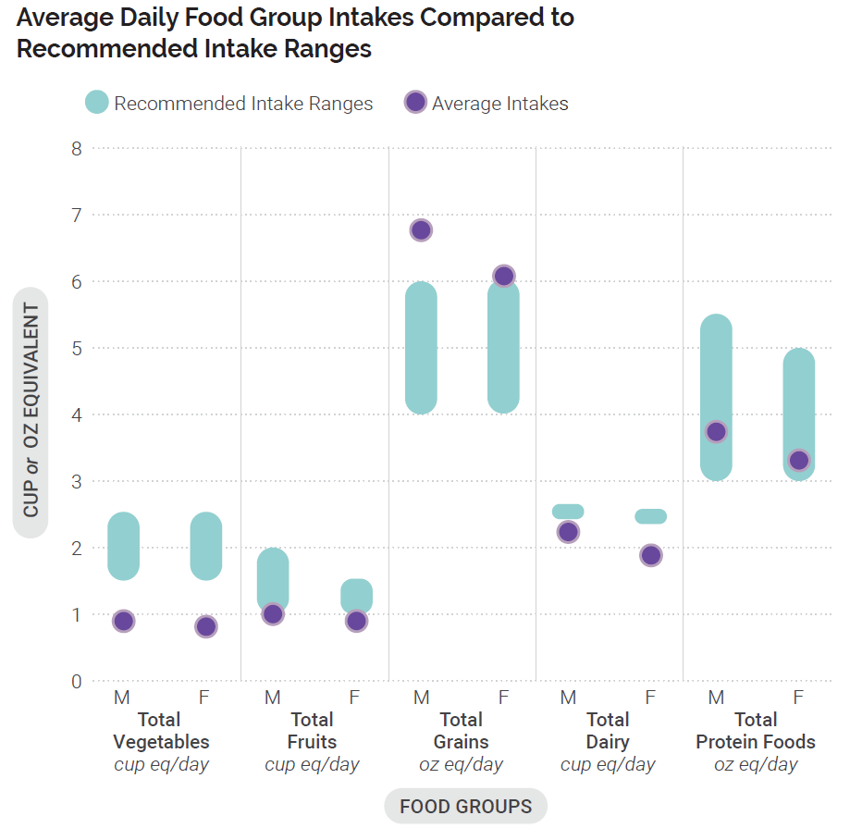
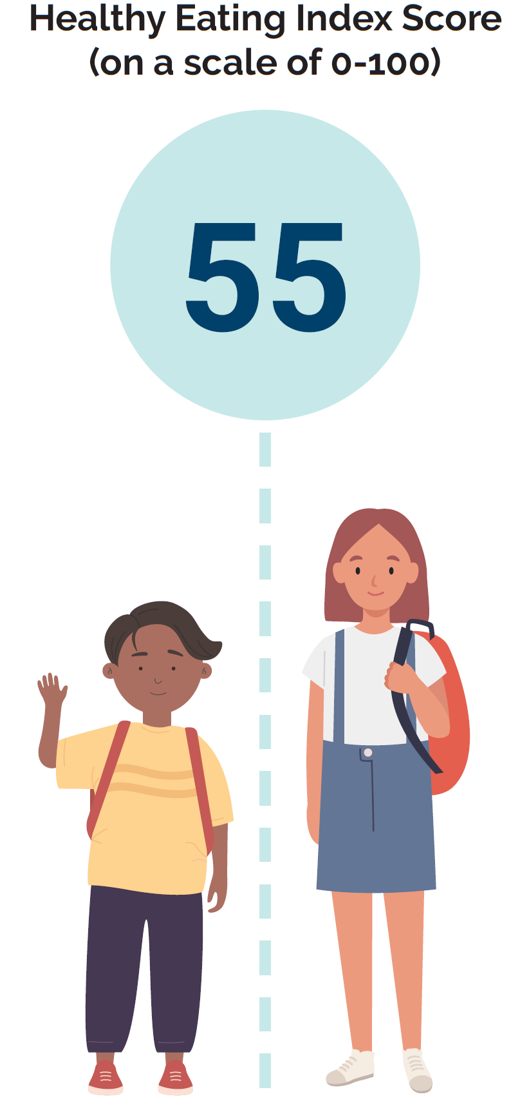
Current Intakes: Ages 5 Through 8
Data Source: Average Intakes and HEI-2015 Scores: Analysis of What We Eat in America, NHANES 2015-2016, day 1 dietary intake data, weighted. Recommended Intake Ranges: Healthy U.S.-Style Dietary Patterns.
Notes:
The bar chart shows average intakes of the food groups per day compared to recommended intake ranges for males and females ages 5 through 8. Average daily intakes of total vegetables, and dairy foods are below the recommended intake ranges for both males and females. Average daily intakes of total protein foods are within the recommended intake range for both males and females. Average daily intake of total fruit is equal to the lowest level of the recommended intake range for males, and for females is below the recommended intake range. Average daily intake of total grains exceeds the recommended intake range for both males and females. The Healthy Eating Index score for this age group is 55 out of 100.

Slide 81
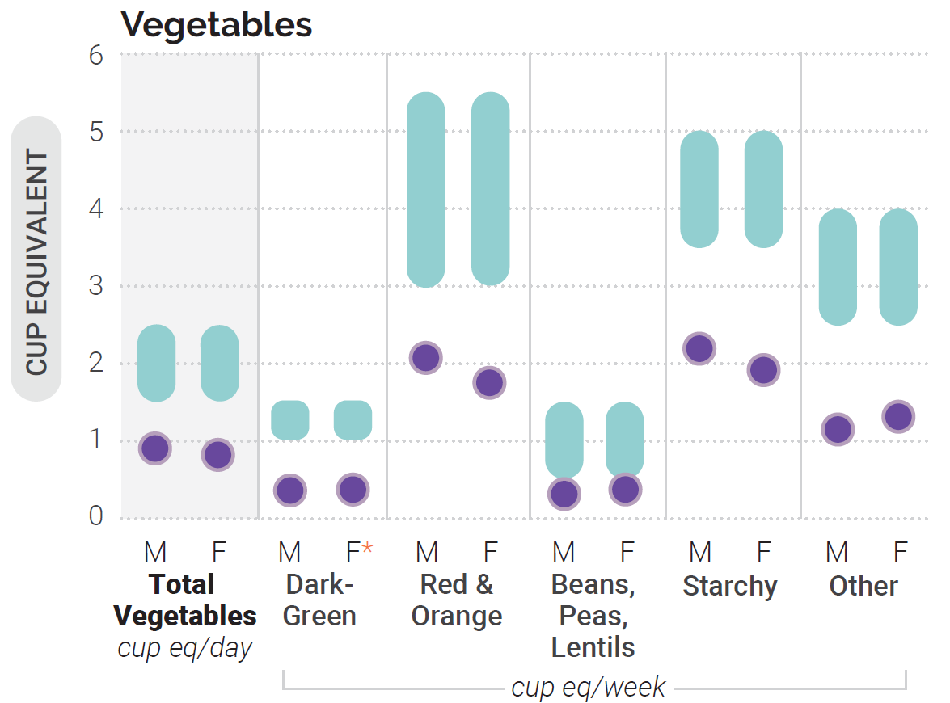
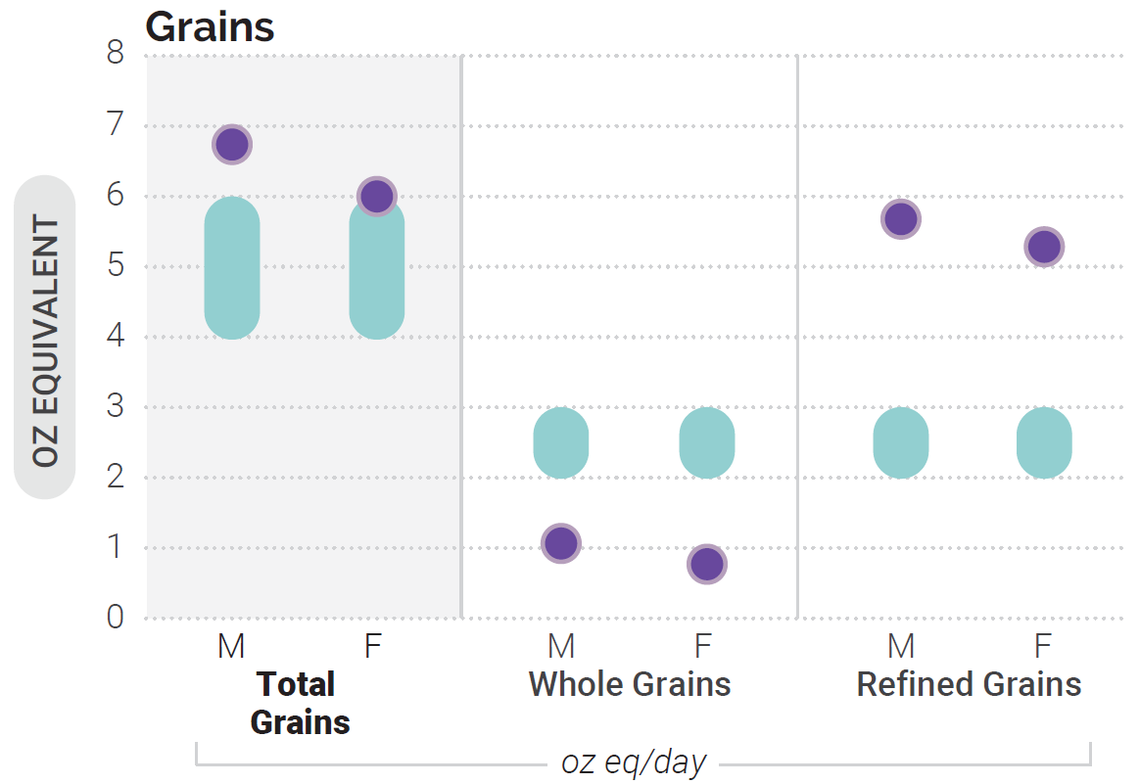
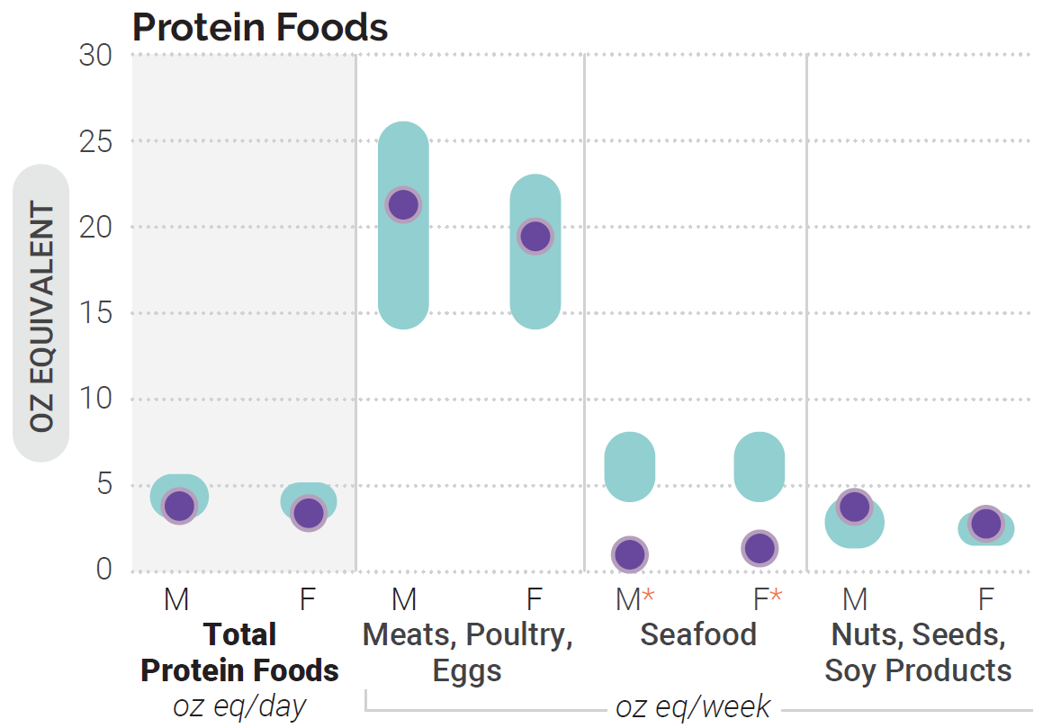
Average Intakes of Subgroups Compared to
Recommended Intake Ranges: Ages 5 Through 8
*Note: Estimates may be less precise than others due to small sample size and/or large relative standard error.
Data Source: Average Intakes: Analysis of What We Eat in America, NHANES 2015-2016, day 1 dietary intake data, weighted. Recommended Intake Ranges: Healthy U.S.-Style Dietary Patterns.
Notes:
Three bar charts show the average intakes for males and females ages 5 through 8, compared to recommended intake ranges of total vegetables and vegetable subgroups, total grains and grain subgroups, and total protein foods and protein food subgroups. Average daily intakes of total vegetables as well as weekly intakes of all vegetable subgroups, including dark-green, red and orange, bean, peas and lentils, starchy, and other vegetables are below recommended intake ranges for both males and females. For grains overall, average daily intakes are above the recommended intake ranges for both males and females. However, average daily intakes of whole grains are below and refined grains are above recommended ranges. Average daily intake of total protein foods is within the range of recommended intakes. Average weekly intakes of the protein food subgroups meats, poultry and eggs and nuts, seeds and soy are within the range of recommended intakes for both males and females. Average weekly intake of seafood is below the range of recommended intakes for both males and females.

Slide 82
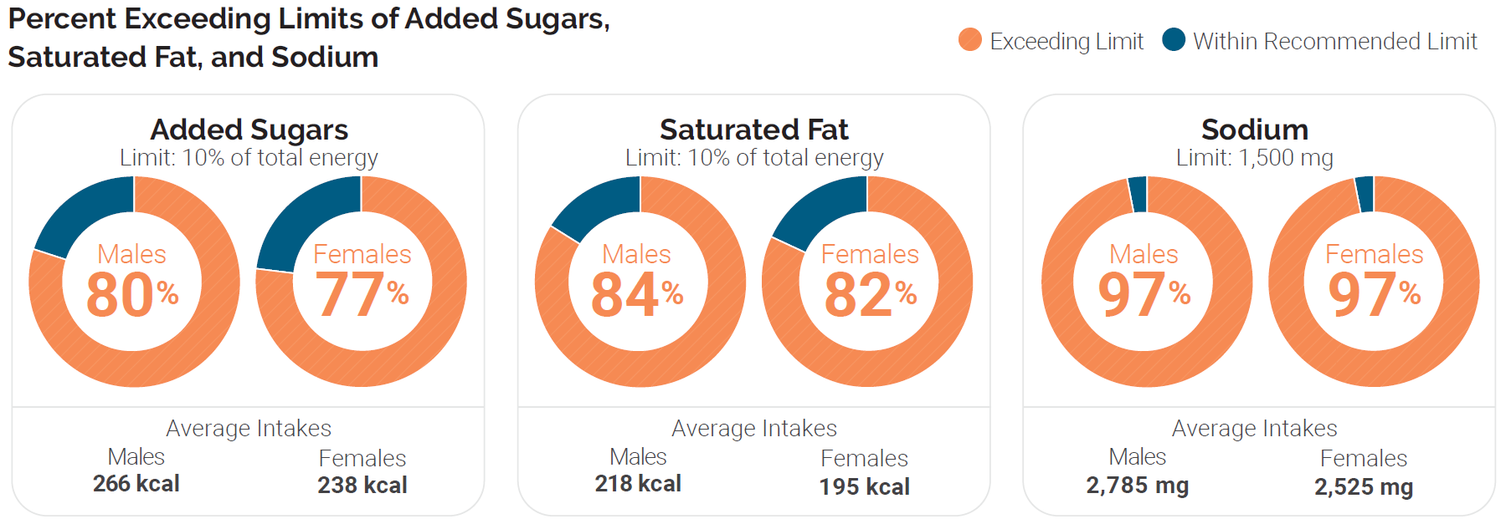
Current Intakes: Ages 5 Through 8
Added Sugars, Saturated Fat & Sodium
Data Source: Percent Exceeding Limits: What We Eat in America, NHANES 2013-2016, 2 days dietary intake data, weighted.
Notes:
Circle charts are used to show the percent of this age group who exceed limits for added sugars, saturated fat and sodium. 80 and 77% of males and females, respectively, exceed the limit for added sugars. 84 and 82% of males and females, respectively, exceed the limit for saturated fat. 97% of both males and females exceed the limit for sodium.

Slide 83
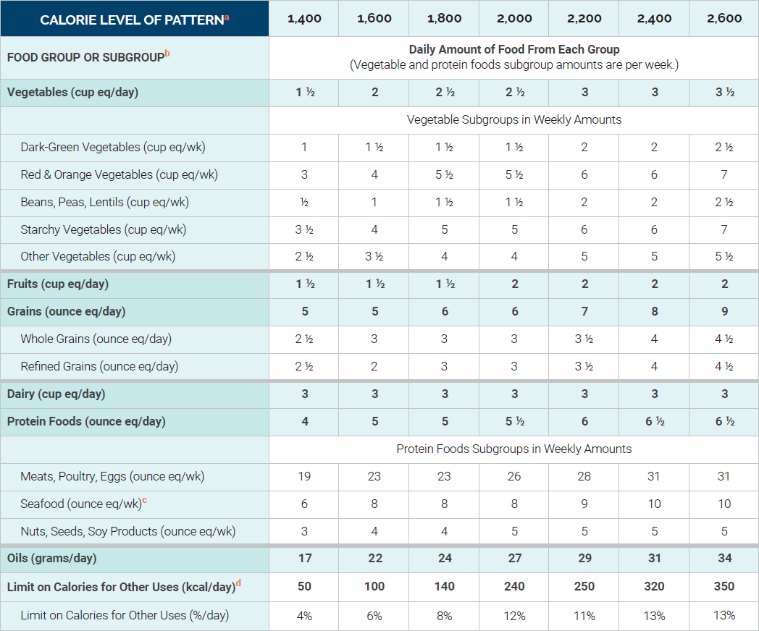
Healthy U.S. Style Dietary Pattern: Ages 9 Through 13
Notes:
Children and adolescents are encouraged to follow the recommendations on the types of foods and beverages that make up a healthy dietary pattern described in Chapter 1. Nutrition and Health Across the Lifespan: The Guidelines and Key Recommendations. This table displays the Healthy U.S.-Style Dietary Pattern to illustrate the specific amounts and limits for food groups and other dietary components that make up healthy dietary patterns at the calorie levels appropriate for most children ages 9 through 13.
During adolescence, the range of calorie intakes widens to support diverse growth trajectories. In the late childhood and early adolescence stage, females require about 1,400 to 2,200 calories per day and males require about 1,600 to 2,600 calories per day.
Key Points on Food Groups:
Vegetables: 2-3.5 cups/day
Fruits: 1.5-2 cups/day
Grains: 5-9 oz/day
Dairy: 3 cups/day
Protein Foods: 4-6.5 oz/day
Oils: 17-34 g/day
Footnotes:
ª Calorie level ranges: Females: 1,400-2,200; Males: 1,600-2,600. Energy levels are calculated based on reference height (median) and reference weight (healthy) corresponding with a healthy body mass index (BMI). Calorie needs vary based on many factors. The DRI Calculator for Healthcare Professionals, available at nal.usda.gov/fnic/dri-calculator, can be used to estimate calorie needs based on age, sex, height, weight, and activity level.
^{b} Definitions for each food group and subgroup and quantity (i.e., cup or ounce equivalents) are provided in Chapter 1 and are compiled in Appendix 3.
^{c} The U.S. Food and Drug Administration (FDA) and the U.S. Environmental Protection Agency (EPA) provide joint advice regarding seafood consumption to limit methylmercury exposure for children. Depending on body weight, some children should choose seafood lowest in methylmercury or eat less seafood than the amounts in the Healthy US-Style Dietary Pattern. More information is available on the FDA and EPA websites at FDA.gov/fishadvice and EPA.gov/fishadvice.
^{d} All foods are assumed to be in nutrient-dense forms; lean or low-fat; and prepared with minimal added sugars, saturated fat, refined starches, or sodium. If all food choices to meet food group recommendations are in nutrient-dense forms, a small number of calories remain within the overall limit of the pattern (i.e., limit on calories for other uses). The number of calories depends on the total calorie level of the pattern and the amounts of food from each food group required to meet nutritional goals. Calories up to the specified limit can be used for added sugars and/or saturated fat, or to eat more than the recommended amount of food in a food group.
NOTE: The total dietary pattern should not exceed Dietary Guidelines limits for added sugars and saturated fat; be within the Acceptable Macronutrient Distribution Ranges for protein, carbohydrate, and total fats; and stay within calorie limits. Values are rounded. See Appendix 3 for all calorie levels of the pattern.

Slide 84
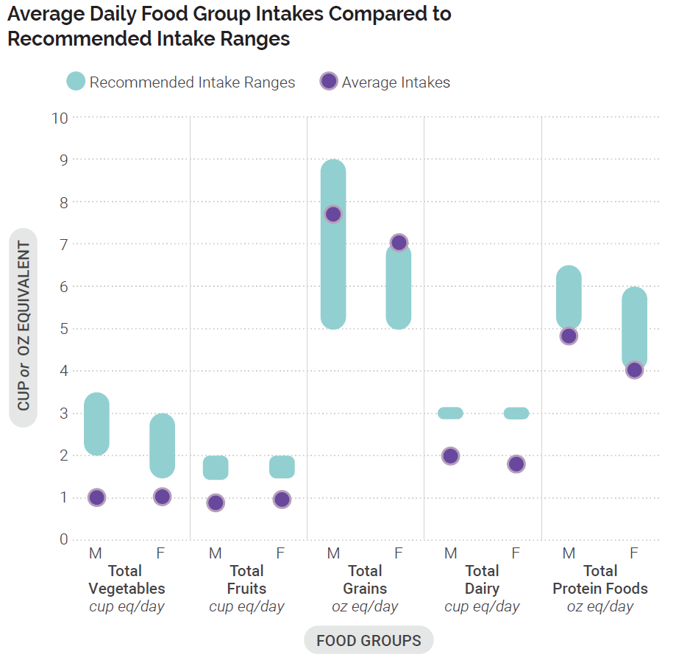
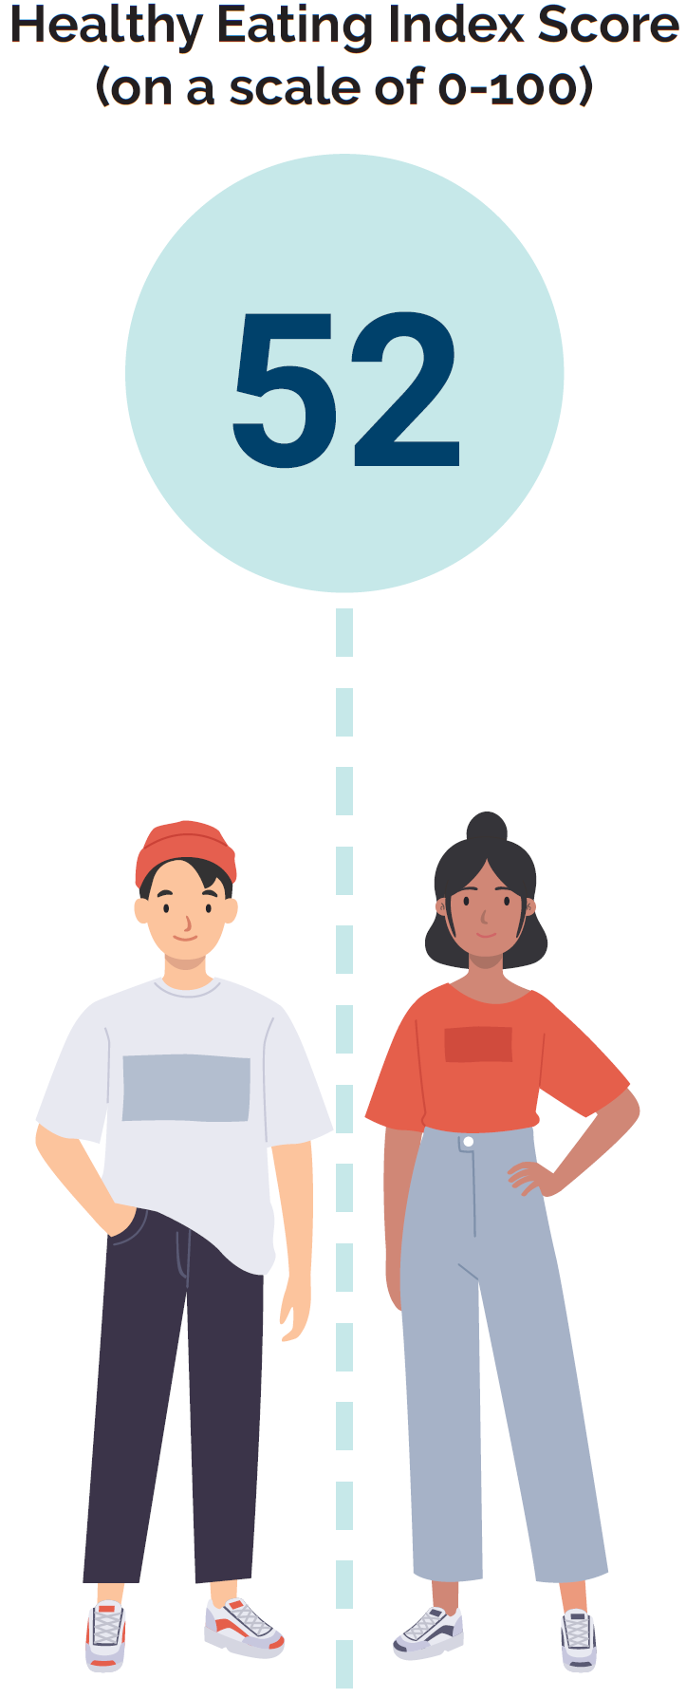
Current Intakes: Ages 9 Through 13
Data Source: Average Intakes and HEI-2015 Scores: Analysis of What We Eat in America, NHANES 2015-2016, day 1 dietary intake data, weighted. Recommended Intake Ranges: Healthy U.S.-Style Dietary Patterns.
Notes:
The bar chart shows average intakes of the food groups per day compared to recommended intake ranges for males and females ages 9 through 13. Average daily intakes of total fruit, total vegetables, and dairy foods are below the recommended intake ranges for both males and females. For males, average daily intake of total grains is within the recommended intake range, but for females, intakes exceed the recommended intake range. The average daily intake of total protein foods for males falls below the recommended intake range, while the average daily intake for females is within the recommended intake range.

Slide 85
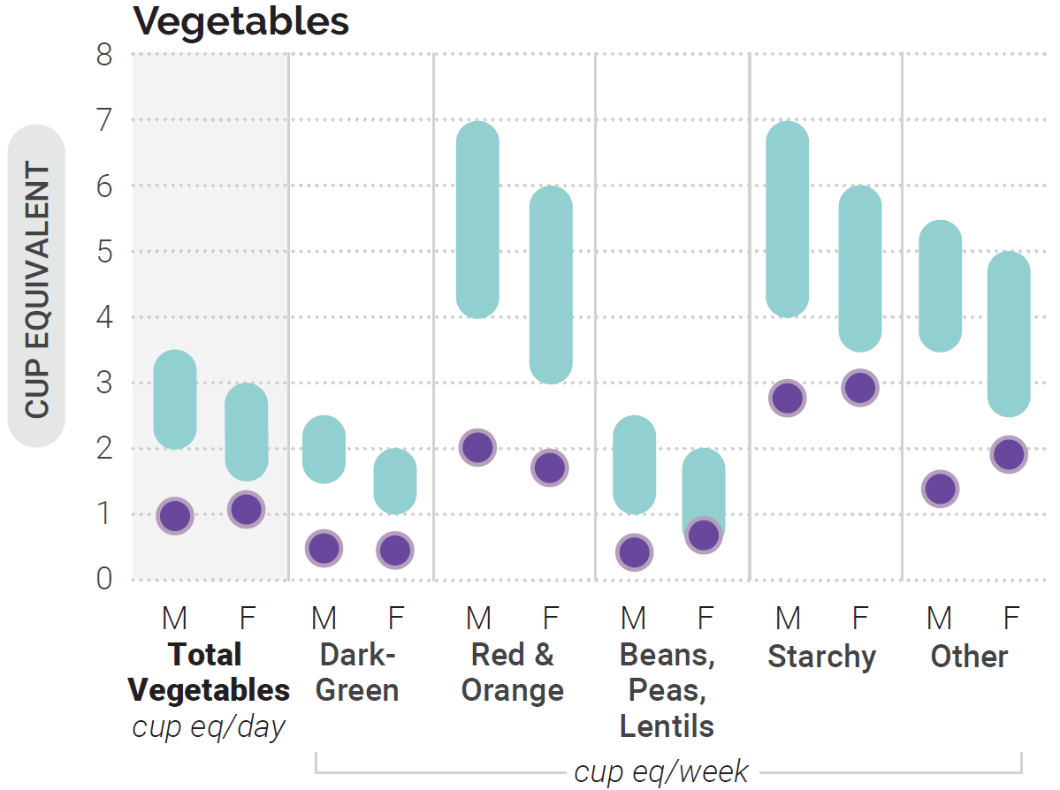
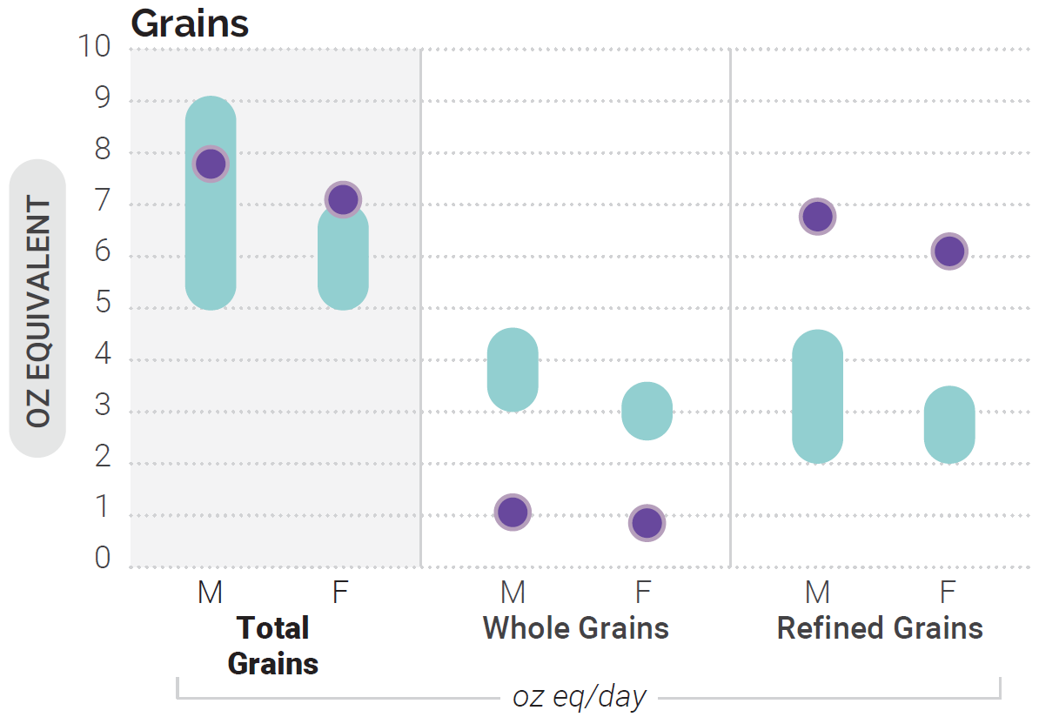

Average Intakes of Subgroups Compared to
Recommended Intake Ranges: Ages 9 Through 13
*Note: Estimates may be less precise than others due to small sample size and/or large relative standard error.
Data Source: Average Intakes: Analysis of What We Eat in America, NHANES 2015-2016, day 1 dietary intake data, weighted. Recommended Intake Ranges: Healthy U.S.-Style Dietary Patterns.
Notes:
Three bar charts show the average intakes for males and females ages 9 through 13, compared to recommended intake ranges of total vegetables and vegetable subgroups, total grains and grain subgroups, and total protein foods and protein food subgroups. For vegetables overall, average daily intakes are below recommended intakes ranges for both males and females. Average weekly intakes of dark-green vegetables, red and orange vegetables, and other vegetables are below recommended intake ranges for both males and females. Average weekly intake of beans, peas, and lentils is below the recommended intake range for males, but within the recommended intake range for females. Average daily intakes of total grains are within the recommended intake range for males and intakes exceed the recommended intake range for females. Average daily intakes for grain subgroups fall below recommended ranges for whole grains and above recommendations for refined grains for both males and females. The average daily intakes of protein foods fall below the recommended intake range for males and within the recommended intake range for females. Average weekly intakes of the protein food subgroups meat, poultry, eggs, nuts, seeds and soy are within the recommended intake ranges for both male and females. Average weekly intake of seafood is below the recommended intake level for both males and females.

Slide 86

Current Intakes: Ages 9 Through 13
Added Sugars, Saturated Fat & Sodium
Data Source: Percent Exceeding Limits: What We Eat in America, NHANES 2013-2016, 2 days dietary intake data, weighted.
Notes:
Circle charts are used to show the percent of this age group who exceed limits for added sugars, saturated fat, and sodium. 79 and 78% of males and females, respectively, exceed the limit for added sugars. 88 and 86% of males and females, respectively, exceed the limit for saturated fat. 97% and 96% of males and females, exceed the limit for sodium. The Healthy Eating Index score for this age group is 52 out of 100.

Slide 87

Healthy U.S. Style Dietary Pattern:
Ages 14 Through 18
Notes:
Children and adolescents are encouraged to follow the recommendations on the types of foods and beverages that make up a healthy dietary pattern described in Chapter 1. Nutrition and Health Across the Lifespan: The Guidelines and Key Recommendations. This table displays the Healthy U.S.-Style Dietary Pattern to illustrate the specific amounts and limits for food groups and other dietary components that make up healthy dietary patterns at the calorie levels appropriate for most adolescents ages 14 through 18.
Adolescent females require about 1,800 to 2,400 calories per day and males require about 2,000 to 3,200 calories per day.
Key Points on Food Groups:
Vegetables: 2.5-4 cups/day
Fruits: 1.5-2.5 cups/day
Grains: 6-10 oz/day
Dairy: 3 cups/day
Protein Foods: 5-7 oz/day
Oils: 24-51 g/day
Footnotes:
ª Calorie level ranges: Females: 1,800-2,400 calories; Males: 2,000-3,200 calories. Energy levels are calculated based on reference height (median) and reference weight (healthy) corresponding with a healthy body mass index (BMI). Calorie needs vary based on many factors. The DRI Calculator for Healthcare Professionals, available at nal.usda.gov/fnic/dri-calculator, can be used to estimate calorie needs based on age, sex, height, weight, activity level.
^{b} Definitions for each food group and subgroup and quantity (i.e., cup or ounce equivalents) are provided in Chapter 1 and are compiled in Appendix 3.
^{c} All foods are assumed to be in nutrient-dense forms; lean or low-fat; and prepared with minimal added sugars, saturated fat, refined starches, or sodium. If all food choices to meet food group recommendations are in nutrient-dense forms, a small number of calories remain within the overall limit of the pattern (i.e., limit on calories for other uses). The number of calories depends on the total calorie level of the pattern and the amounts of food from each food group required to meet nutritional goals. Calories up to the specified limit can be used for added sugars and/or saturated fat, or to eat more than the recommended amount of food in a food group.
NOTE: The total dietary pattern should not exceed Dietary Guidelines limits for added sugars and saturated fat; be within the Acceptable Macronutrient Distribution Ranges for protein, carbohydrate, and total fats; and stay within calorie limits. Values are rounded. See Appendix 3 for all calorie levels of the pattern.

Slide 88


Current Intakes: Ages 14 Through 18
Data Source: Average Intakes and HEI-2015 Scores: Analysis of What We Eat in America, NHANES 2015-2016, day 1 dietary intake data, weighted. Recommended Intake Ranges: Healthy U.S.-Style Dietary Patterns.
Notes:
The bar chart shows average intakes of the food groups per day compared to recommended intake ranges for males and females ages 14 through 18 years. Average daily intakes of total fruit, total vegetables, and dairy foods fall below the recommended intake ranges for both males and females. Average daily intakes of total grains are within the recommended intake ranges for both males and females. Average daily intakes of total protein foods fall within the range of recommended intakes for males, but below the recommended range of intakes for females. The Healthy Eating Index score for this age group is 51 out of 100.

Slide 89



Average Intakes of Subgroups Compared to
Recommended Intake Ranges: Ages 14 Through 18
Data Source: Average Intakes: Analysis of What We Eat in America, NHANES 2015-2016, day 1 dietary intake data, weighted. Recommended Intake Ranges: Healthy U.S.-Style Dietary Patterns.
Notes:
Three bar charts show the average intakes for males and females ages 14 through 18, compared to recommended intake ranges of total vegetables and vegetable subgroups, total grains and grain subgroups, and total protein foods and protein food subgroups. Total vegetables and all vegetable subgroups are below recommended intake ranges. Average daily intakes of total grains are within recommended intake ranges, however whole grains fall below recommended ranges and refined grains exceed recommended ranges. Average daily intake of total protein foods is within the recommended range for males, but below the range of recommended intakes for females. The average weekly intakes of meat, poultry, eggs, and for nuts, seeds and soy exceed the recommended intake ranges for males, but are within the recommended range of intakes for females. Average weekly intake of seafood is below the recommended intake range for both males and females.

Slide 90

Current Intakes: Ages 14 Through 18
Added Sugars, Saturated Fat & Sodium
Data Source: Percent Exceeding Limits: What We Eat in America, NHANES 2013-2016, 2 days dietary intake data, weighted.
Notes:
Circle charts are used to show the percent of this age group who exceed limits for added sugars, saturated fat and sodium. 72 and 76% of males and females, respectively, exceed the limit for added sugars. 85 and 78% of males and females, respectively, exceed the limit for saturated fat. 97 and 77% of males and females, respectively, exceed the limit for sodium. The Healthy Eating Index score for this age group is 51 out of 100.

Slide 91

Special Considerations: Children and Adolescents
Sugar-sweetened beverages. Sugar-sweetened beverages are a top contributor to intakes of added sugars. Sugar-sweetened beverages are not necessary in the child or adolescent diet nor are they a component of the USDA Dietary Patterns.
Dairy and fortified soy alternatives. Dairy and fortified soy alternatives provide protein and a variety of nutrients that are underconsumed during these life stages.
Adolescent nutrition. The difference between recommended food group amounts and current intakes is greater for adolescents ages 14 through 18 years than for any other age group across the lifespan.
Notes:
The nutrition considerations for the general U.S. population described in Chapter 1 apply to children and adolescents. For example, due to low intakes of food groups as described above, the nutrients of public health concern—calcium, vitamin D, potassium, and dietary fiber—apply to these life stages as well. Although the nutritional needs of youth are remarkably similar to their parents, guardians, and caregivers, these age groups do have some special nutrition considerations.
Increasing intakes of sugar-sweetened beverages– Intake of added sugars increases throughout childhood and adolescence, and sugar-sweetened beverages are a top contributor. As a percent of total daily energy intake, average intake of added sugars is 11 percent among young children and peaks at 15 percent during adolescence.
Decreasing intakes of dairy – a dietary component with notable and concerning shifts in consumption throughout youth. Throughout childhood and adolescence, the types of dairy foods consumed and their contribution to a healthy dietary pattern changes. Milk consumption, particularly milk as a beverage, is lower and cheese intake, typically as part of mixed dishes such as sandwiches, pizza, or pasta, is higher among adolescents when compared to younger children. Dairy and fortified soy alternatives provide protein and a variety of nutrients that are under consumed during these life stages. These include three nutrients of public health concern: potassium, calcium, and vitamin D. The nutrient composition of dairy foods highlights the importance of adequate consumption. This is especially relevant for calcium and vitamin D, given that adolescents have an increased need for consumption to support the accrual of bone mass.
Adolescent Nutrition: The difference between recommended food group amounts and current
intakes is greater for adolescents ages 14 through 18 years than for any other age group across the lifespan. Dietary intake patterns for adolescents, particularly females, also is an area of special consideration.

Slide 92
Supporting Healthy Eating: Children and Adolescents
Expose young children to a variety of nutrient-dense foods within each food group to help build a healthy dietary pattern.
Offer the same type of food to children multiple times, in different forms, to increase acceptance.
Create environments that support healthy eating at home, school and in communities.
Notes:
The physical, mental, and emotional changes that occur as children transition from pre-school to school-age and into adolescence come with diverse and changing opportunities to support a healthy dietary pattern. Support and active engagement from the various people and places involved in the lives of children and adolescents is necessary to help establish and maintain healthy dietary patterns that support healthy weight and the prevention of chronic disease.
Exposing young children to a variety of nutrient-dense foods within each food group helps build a healthy dietary pattern at an age when taste preferences are acquired.
Offering the same type of food to children multiple times, in a variety of forms, or prepared in different ways can increase acceptance and intake of healthy foods within food groups. For example, children may show a dislike for vegetables in the cooked form but accept the raw version. Or, children may only accept fruit when it is cut into small, bite-sized pieces. Even with these strategies, parents, guardians, and caregivers of young children should know it may take up to 8 to 10 exposures before a child will accept a new food.
Children’s dietary patterns often resemble those of their household, highlighting the importance of their
environment in the establishment of a healthy dietary pattern. Shared meals through shopping, cooking,
and consumption provides parents, guardians, and caregivers with an opportunity to model healthy
eating behaviors and dietary practices. By making nutrient-dense foods and beverages part of the normal household routine, children can observe and learn healthy behaviors that can extend throughout later life stages.

Slide 93

Resources: Children and Adolescents
Federal Programs
SNAP | Supplemental Nutrition Assistance Program
WIC | Special Supplemental Nutrition Program for Women, Infants, and Children
CACFP | Child and Adult Care Food Program
NSLP/ SBP | National School Lunch Program and School Breakfast Program
SFSP | Summer Food Service Program
Notes:
Many resources exist to support healthy growth and development during childhood and adolescence. The following Government programs play an essential role in providing access to healthy meals and educational resources to support healthy dietary patterns for all children and adolescents.
The Supplemental Nutrition Assistance Program (SNAP) provides temporary benefits to families with qualifying incomes for the purchase of foods and beverages. About one-half of all SNAP participants are children.
Households with young children may be eligible for the Special Supplemental Nutrition Program for Women, Infants, and Children (WIC). WIC can help families with limited resources meet their child’s nutritional needs by providing nutritious foods to supplement diets. WIC serves children up to the age of 5 who are at nutritional risk.
In childcare and afterschool settings, the Child and Adult Care Feeding Program (CACFP) can support the development of healthy dietary patterns. CACFP is a nutrition program that provides reimbursements for meals and snacks that align with the Dietary Guidelines to eligible children enrolled at childcare centers, daycare homes, and in afterschool programs.
School-age children can benefit from the National School Lunch Program and School Breakfast Program. The school meal programs can provide nearly two-thirds of daily calories, and therefore play an influential role in the development of a healthy dietary pattern.
Outside of the school year, the Summer Food Service Program (SFSP) fills the gap by ensuring that children continue to receive nutritious meals when school is not in session. The SFSP operates at sites in a community where children can receive nutritious meals in a safe and supervised environment.
Source: Characteristics of Supplemental Nutrition Assistance Program Households: Fiscal Year 2018. Available at: https://www.fns.usda.gov/snap/characteristics-supplemental-nutrition-assistance-program-households-fiscal-year-2018.

Slide 94
Adults
Notes:
Chapter 4 provides tailored information specific to adults. The adult life stage (ages 19 through 59) is characterized by independence, opportunity, and increased responsibility—from starting or completing education and training, to managing work and/or family, to planning for the transition to older adulthood.
More than one-half of adults are living with one or more chronic disease—diseases that are often related to poor-quality diets and physical inactivity.
Following a healthy dietary pattern, engaging in regular physical activity, and managing body weight are critical during this life stage.

Slide 95

Healthy U.S. Style Dietary Pattern:
Adults Ages 19 Through 59
Notes:
Adults are encouraged to follow the recommendations on the types of foods and beverages that make up a healthy dietary pattern described in Chapter 1. Nutrition and Health Across the Lifespan: The Guidelines and Key Recommendations. This table displays the Healthy U.S.-Style Dietary Pattern at eight calorie levels that are appropriate for most adults ages 19 through 59 years to illustrate the specific amounts and limits for food groups and other dietary components that make up healthy dietary patterns.
In general, calorie needs are lower for females compared to males. Calorie needs decline throughout adulthood due to changes in metabolism that accompany aging. Level of physical activity, body composition, and the presence of chronic disease are additional factors that affect calorie needs.
Females ages 19 through 30 require about 1,800 to 2,400 calories a day. Males in this age group have higher calorie needs of about 2,400 to 3,000 a day. Calorie needs for adults ages 31 through 59 are generally lower; most females require about 1,600 to 2,200 calories a day and males require about 2,200 to 3,000 calories a day.
Key Points on Food Groups:
Vegetables: 2-4 cups/day
Fruits: 1.5-2.5 cups/day
Grains: 5-10 oz/day
Dairy: 3 cups/day
Protein Foods: 5-7 oz/day
Oils: 22-44 g/day
Footnotes:
ª Calorie level ranges: Ages 19 through 30, Females: 1,800-2,400 calories; Males: 2,400-3,000 calories. Ages 31 through 59, Females: 1,600-2,200 calories; Males 2,200-3,000 calories. Energy levels are calculated based on median height and body weight for healthy body mass index (BMI) reference individuals. For adults, the reference man is 5 feet 10 inches tall and weighs 154 pounds. The reference woman is 5 feet 4 inches tall and weighs 126 pounds. Calorie needs vary based on many factors. The DRI Calculator for Healthcare Professionals, available at https://www.nal.usda.gov/fnic/dri-calculator, can be used to estimate calorie needs based on age, sex, height, weight, and activity level.
^{b} Definitions for each food group and subgroup and quantity (i.e., cup or ounce equivalents) are provided in Chapter 1 and are compiled in Appendix 3.
^{c} All foods are assumed to be in nutrient-dense forms; lean or low-fat; and prepared with minimal added sugars, refined starches, saturated fat, or sodium. If all food choices to meet food group recommendations are in nutrient-dense forms, a small number of calories remain within the overall limit of the pattern (i.e., limit on calories for other uses). The number of calories depends on the total calorie level of the pattern and the amounts of food from each food group required to meet nutritional goals. Calories up to the specified limit can be used for added sugars, saturated fat, or alcohol, or to eat more than the recommended amount of food in a food group.
NOTE: The total dietary pattern should not exceed Dietary Guidelines limits for added sugars, saturated fat, and alcohol; be within the Acceptable Macronutrient Distribution Ranges for protein, carbohydrate, and total fats; and stay within calorie limits. Values are rounded. See Appendix 3 for all calorie levels of the pattern.

Slide 96


Current Intakes: Ages 19 Through 30
Data Source: Average Intakes and HEI-2015 Scores: Analysis of What We Eat in America, NHANES 2015-2016, day 1 dietary intake data, weighted. Recommended Intake Ranges: Healthy U.S.-Style Dietary Patterns.
Notes:
The Bar Chart shows average intakes of the food groups per day compared to recommended intake ranges for males and females ages 19 through 30. Average daily intakes of total fruit, total vegetables, and dairy foods fall below the recommended intake ranges for both males and females. The average daily intake of total grains is within the recommended intake range for males, but falls below the range of recommended intakes for females. The average daily intake of total protein foods for males exceeds the recommended intake range, while the average daily intake for females is within the recommended range of intakes. The Healthy Eating Index score for this age group is 56 out of 100.

Slide 97



Average Intakes of Subgroups Compared to Recommended Intake Ranges: Ages 19 Through 30
Data Source: Average Intakes: Analysis of What We Eat in America, NHANES 2015-2016, day 1 dietary intake data, weighted. Recommended Intake Ranges: Healthy U.S.-Style Dietary Patterns.
Notes:
Three bar charts show the average intakes for males and females ages 19 through 30, compared to recommended intake ranges of total vegetables and vegetable subgroups, total grains and grain subgroups, and total protein foods and protein food subgroups. Average intakes of total vegetables and all vegetable subgroups are below recommended intakes ranges for both males and females. The average daily intake of total grains is within the recommended intake range for males but fall below the range of recommended intakes for females. However, whole grains intakes fall below recommended intake ranges and refined grains exceed recommended ranges for both males and females. The average daily intake of total protein foods for males exceeds the recommended intake range, while the average daily intake for females is within the recommended range of intakes. The average weekly intakes of meat, poultry, eggs, and nuts, seeds and soy exceed the recommended intake ranges for males, but fall within the recommended range of intakes for females. Average weekly intake of seafood is below the recommended intake range for both males and females.

Slide 98

Current Intakes: Ages 19 Through 30
Added Sugars, Saturated Fat & Sodium
Data Source: Percent Exceeding Limits: What We Eat in America, NHANES 2013-2016, 2 days dietary intake data, weighted.
Notes:
Circle charts are used to show the percent of this age group who exceed limits for added sugars, saturated fat and sodium. 62 and 66% of males and females, respectively, exceed the limit for added sugars. 76 and 71% of males and females, respectively, exceed the limit for saturated fat. 97 and 84% of males and females, respectively, exceed the limit for sodium.

Slide 99


Current Intakes: Ages 31 Through 59
Data Source: Average Intakes and HEI-2015 Scores: Analysis of What We Eat in America, NHANES 2015-2016, day 1 dietary intake data, weighted. Recommended Intake Ranges: Healthy U.S.-Style Dietary Patterns.
Notes:
The bar chart shows average intakes of the food groups per day compared to recommended intake ranges for males and females ages 31 through 59. Average daily intakes of total fruit, total vegetables, and dairy foods falls below the recommended intake ranges for both males and females. Average daily intake of total grains is within the recommended range of intakes for both males and females. Average daily intakes of total protein foods exceeds the recommended intake range for males, but are within the range of recommended intakes for females. The Healthy Eating Index score for this age group is 59 out of 100.

Slide 100



Average Intakes of Subgroups Compared to Recommended Intake Ranges: Ages 31 Through 59
Data Source: Average Intakes: Analysis of What We Eat in America, NHANES 2015-2016, day 1 dietary intake data, weighted. Recommended Intake Ranges: Healthy U.S.-Style Dietary Patterns.
Notes:
Three bar charts show the average intakes for males and females ages 31 through 59, compared to recommended intake ranges of total vegetables and vegetable subgroups, total grains and grain subgroups, and total protein foods and protein food subgroups. Average daily intakes of total vegetables fall below recommended intake ranges. Average weekly intakes of all vegetable subgroups, including dark green, red and orange, beans, peas, and lentils, starchy, and other vegetables fall below recommended intake ranges for males. Females also fall below average weekly recommendations for all vegetable subgroups, with the exception of other vegetables. Average daily intakes of total grains are within recommended ranges, however whole grains fall below recommended ranges and refined grains are above recommended ranges. Average daily intakes of total protein foods among males exceeds recommended ranges, but intakes fall within the range of recommended intakes for females. The average weekly intakes of meat, poultry and eggs exceed the range of recommended intakes for males but are within the range of recommended intakes for females. Average weekly intakes of nuts, seeds and soy exceed the recommended intake ranges for both males and females. Average weekly intake of seafood is below the recommended intake range for both males and females.

Slide 101

Current Intakes: Ages 31 Through 59
Added Sugars, Saturated Fat & Sodium
Data Source: Percent Exceeding Limits: What We Eat in America, NHANES 2013-2016, 2 days dietary intake data, weighted.
Notes:
Circle charts are used to show the percent of this age group who exceed limits for added sugars, saturated fat and sodium. 59 and 63% of males and females, respectively, exceed the limit for added sugars. 73 and 70% of males and females, respectively, exceed the limit for saturated fat. 97 and 82% of males and females, respectively, exceed the limit for sodium.

Slide 102

Special Considerations: Adults
The prevalence of overweight and obesity and diet-related chronic disease becomes more apparent during this life stage, making the following food components of particular concern:
  Dietary Fiber
  Calcium and Vitamin D
  Saturated Fat
  Sodium
  Added Sugars
  Alcoholic Beverages
Notes:
The dietary considerations for the general U.S. population, including adults, are described in Chapter 1. There are several special considerations to support a healthy dietary pattern for adults that reflect adults’ current intake patterns and the prevalence of overweight and obesity and diet-related chronic disease that become more apparent in this life stage.
Dietary Fiber- More than 90% of women and 97% of men do not meet recommended intakes for dietary fiber. Increasing intakes of fruits, vegetables, and replacing refined grains with whole grains improves dietary fiber intakes and is especially important during this life stage a the impact of poor diet quality becomes apparent with the onset and/or progression of diet-related chronic diseases.
Calcium and Vitamin D- Close to 30% of men and 60% of women older than 19 years do not consume enough calcium and more than 90% do not consume enough vitamin D. Particular attention should be given to consuming adequate amounts of food with these nutrients during adult years to promote optimal bone health and prevent the onset of osteoporosis. Intake of calcium and vitamin D is particularly important during ages 19-30 when peak bone mass is still actively accruing, and, for women, in the post-menopausal period when rapid bone remodeling occurs.
Saturated Fat- About 70 to 75% of adults exceed the 10% limit on saturated fat and the prevalence of coronary heart disease increases with age, so staying within saturated fat limits and replacing saturated fat with unsaturated fat is particularly important during this life stage. Strategies to reduce saturated fat include using lean meats and low-fat cheese or substituting beans for meat and using avocado or nuts instead of cheese. Cooking with oils (canola, corn, olive) instead of butter can also reduce intake of saturated fat.
Sodium- 45% of adults ages 18 and older are living with hypertension. During adulthood the prevalence of hypertension tension increases. Changing this trend is important because hypertension is a preventable risk factor for cardiovascular disease and stroke. Reducing dietary intake of sodium can improve blood pressure control and reduce risk of hypertension.
Added Sugars- Most adults exceed recommended limits for added sugars. This is a particular concern for adults because it contributes to excess calorie intake. Sugar-sweetened beverages and sweetened coffees and teas contribute over 40% of daily intake of added sugars. These should be limited to small amounts and most often replaced with beverage options that contain no added sugars, such as water. 30% of added sugars come from desserts and sweet snacks, candies, and sweetened breakfast cereals. Understanding which food choices contribute to intakes of added sugars without contributing to nutrient needs can help individuals remove or replace these foods with better choices that meet food group and nutrient recommendations within calorie needs.
Alcoholic Beverages- The majority of U.S. adults consume alcoholic beverages. Regular consumption of alcoholic beverages can make it challenging for adults to meet food group and nutrient needs while not consuming excess calories. Among adults who choose to drink, average intakes of calories from alcoholic beverages exceed the remaining calorie limit that is available after food group recommendations are met. There are some adults who should not drink alcoholic beverages at all. For those who choose to drink, intakes should be limited to 1 drink or less in a day for women and 2 drinks or less in a day for men, on days when alcohol is consumed.

Slide 103
Supporting Healthy Eating: Adults
Health professionals play an important role in supporting adults’ healthy eating behaviors and can help adults:
  Prepare and consume healthy meals at home, when possible, and make careful food selections away from home
  Adopt new habits and/or learn new skills, such as meal planning or cooking
Changing organizational practices, approaches, and/or policies to support improved dietary patterns is also needed.
Notes:
Individuals need support in making healthy choices at home, work, and in the community to build healthy dietary patterns.
The purchase of prepared foods is a regular habit for most adults, with expenditures outpacing those of foods purchased for household meal preparation. Additionally, the younger generation of American adults are spending an even larger proportion of their total food dollars on prepared foods than are older generations. When adults prepare meals themselves, they have more control over the types of food ingredients selected and can focus on choosing nutrient-dense options that contribute to food group goals with little or no added sugars and saturated fat and less sodium.
For some adults, preparing and consuming healthy meals at home will mean adopting a new habit and/or learning new skills, such as meal planning. It is not realistic or desirable to avoid the purchase and consumption of foods prepared by others. However, foods prepared outside of the home can contribute to the overconsumption of calories as a result of large portion sizes and methods of preparation. Health promotion activities that center on increasing consumer knowledge and access to healthy options in the places where Americans purchase prepared foods are needed.
Health professionals play an important role in supporting adults’ healthy eating behaviors. Helping adults become more aware of the foods and beverages that make up their typical dietary patterns and identifying areas for improvement can empower individuals to make changes to the types of foods they purchase or prepare. Teaching skills like cooking and meal planning and helping adults understand how to read labels or make healthy menu substitutions also will support the adoption of a healthy dietary pattern during this life stage.
Lastly, community support is also needed. In settings where adults spend their time, organizational practices, approaches, and/or policies should support improved dietary patterns. Strategies include offering healthy meals and snacks in workplace cafeterias and vending machines or implementing educational programs tailored to working adults.

Slide 104
Resources
Federal Programs
SNAP | Supplemental Nutrition Assistance Program
FDPIR | Food Distribution Program on Indian Reservations
SNAP-Ed | SNAP Education
EFNET | Expanded Food and Nutrition Education Program
Notes:
A healthy dietary pattern can only be achieved when adequate resources and supports exist in the places where adults live, work, and gather. Food access is crucial for adults to achieve a healthy dietary pattern and is influenced by diverse factors. Food insecurity, which occurs when access to nutritionally adequate and safe food is
limited or uncertain, is most prevalent in households with children and in single-parent households. Income is one of the primary characteristics associated with food insecurity. The following programs serve as resources for adults:
The Supplemental Nutrition Assistance Program (SNAP) or the Food Distribution Program on Indian Reservations (FDPIR), serve as a resource for low-income adults by supplementing food budgets to support healthy lifestyles.
Additional Government and non-Government resources, such as food banks or community meal sites and programming offered through SNAP Education (SNAP-Ed) and the Expanded Food and Nutrition Education Program (EFNEP), play a role in providing food and educational resources to support adults in making healthy food choices within a limited budget.
Innovative approaches to support health, such as incentive programs at farmers markets or healthy corner-store initiatives, continue to expand. Continued attention and creativity in approaches to expand food access are needed to support a healthy dietary pattern for adults and the larger social networks that they influence.

Slide 105
Women Who Are Pregnant or Lactating
Notes:
Chapter 5 addresses some important nutritional considerations for women before pregnancy and contains nutrition guidance for women during pregnancy and lactation. Pregnancy and lactation are special stages of life for women, and nutrition plays a vital role before, during, and after these life stages to support the health of the mother and her child.
Following a healthy dietary pattern is especially important for those who are pregnant or lactating for several reasons. Increased calorie and nutrient intakes are necessary to support the growth and development of the baby and to maintain the mother’s health. Consuming a healthy dietary pattern before and during pregnancy also may improve pregnancy outcomes. In addition, following a healthy dietary pattern before and during pregnancy and lactation has the potential to affect health outcomes for both the mother and child in subsequent life stages.
Following a healthy dietary pattern is especially important for those who are pregnant or lactating for several reasons:
Increased calorie and nutrient intakes are necessary to support the growth and development of the baby and to maintain the mother’s health.
Consuming a healthy dietary pattern before and during pregnancy also may improve pregnancy outcomes.
In addition, following a healthy dietary pattern before and during pregnancy and lactation has the potential to affect health outcomes for both the mother and child in subsequent life stages.

Slide 106

Healthy U.S. Style Dietary Pattern:
Women Who Are Pregnant or Lactating
Notes:
Women who are pregnant or lactating are encouraged to follow the recommendations on the types of foods and beverages that make up a healthy dietary pattern described in Chapter 1. Nutrition and Health Across the Lifespan: The Dietary Guidelines and Key Recommendations. The core elements of a healthy diet for women during these life stages are similar to the recommendations for women who are not pregnant. This table displays the Healthy U.S.-Style Dietary Pattern to illustrate the specific amounts and limits for food groups and other dietary components that make up healthy dietary patterns at the six calorie levels most relevant to women who are pregnant or lactating.
The increased calorie and nutrient needs during pregnancy and lactation should be met by consuming nutrient-dense food choices as part of a healthy dietary pattern. One way to achieve this is to follow the Healthy U.S.-Style Dietary Pattern, shown on this chart, throughout pregnancy and lactation, but adjust intake of food groups to reflect higher calorie patterns recommended during the second and third trimesters of pregnancy and throughout lactation. This chart illustrate the specific amounts and limits for food groups and other dietary components that make up healthy dietary patterns at the six calorie levels most relevant to women who are pregnant or lactating.
Key Points on Food Groups:
Vegetables: 2.5-3.5 cups/day
Fruits: 1.5-2.5 cups/day
Grains: 6-10 oz/day
Dairy: 3 cups/day
Protein Foods: 5-7 oz/day
Oils: 24-36 g/day
Footnotes:
ª Calorie level ranges: Prepregnancy energy levels are calculated based on median height and body weight for healthy body mass index (BMI) for a reference woman, who is 5 feet 4 inches tall and weighs 126 pounds. The calorie levels shown in this table include estimates for women during the first trimester of pregnancy, when calorie needs generally do not increase compared to prepregnancy needs, plus the additional calories needed for the later trimesters of pregnancy and during lactation. Calorie needs vary based on many factors. Women with overweight or obesity have lower recommended gestational weight gain during pregnancy, which may affect calorie needs. The DRI Calculator for Healthcare Professionals, available at nal.usda.gov/fnic/dri-calculator, can be used to estimate calorie needs based on age, sex, height, weight, activity level, and pregnancy or lactation status.
^{b} Definitions for each food group and subgroup and quantity (i.e., cup or ounce equivalents) are provided in Chapter 1 and are compiled in Appendix 3.
^{c} The U.S. Food and Drug Administration (FDA) and the U.S. Environmental Protection Agency (EPA) provide joint advice regarding seafood consumption to limit methylmercury exposure for women who might become or are pregnant or lactating. Depending on body weight, some women should choose seafood lowest in methylmercury or eat less seafood than the amounts in the Healthy U.S.-Style Dietary Pattern. More information is available on the FDA and EPA websites at FDA.gov/fishadvice and EPA.gov/fishadvice.
^{d} All foods are assumed to be in nutrient-dense forms; lean or low-fat; and prepared with minimal added sugars, refined starches, saturated fat, or sodium. If all food choices to meet food group recommendations are in nutrient-dense forms, a small number of calories remain within the overall limit of the pattern (i.e., limit on calories for other uses). The number of calories depends on the total calorie level of the pattern and the amounts of food from each food group required to meet nutritional goals. Calories up to the specified limit can be used for added sugars and/or saturated fat, or to eat more than the recommended amount of food in a food group.
NOTE: The total dietary pattern should not exceed Dietary Guidelines limits for added sugars and saturated fat; be within the Acceptable Macronutrient Distribution Ranges for protein, carbohydrate, and total fats; and stay within calorie limits. Values are rounded. See Appendix 3 for all calorie levels of the pattern.

Slide 107

Estimated Change in Calorie Needs: Women Who Are Pregnant or Lactating
NOTE: Estimates are based on Estimated Energy Requirements (EER) set by the Institute of Medicine. Source: Institute of Medicine. Dietary Reference Intakes for Energy, Carbohydrate, Fiber, Fat, Fatty Acids, Cholesterol, Protein, and Amino Acids. Washington, DC: The National Academies Press; 2005.
Estimates apply to women with a healthy prepregnancy weight. Women with a prepregnancy weight that is considered overweight or obese should consult their healthcare provider for guidance regarding appropriate caloric intake during pregnancy and lactation.
Notes:
The table on this slide summarizes estimated daily calorie needs during pregnancy and lactation compared to prepregnancy needs, for women with a healthy prepregnancy weight. Calorie needs generally increase as pregnancy progresses and remain elevated during lactation. It is important to note that this chart is for women with a healthy prepregnancy weight– women with a prepregnancy weight that is considered overweight or obese have lower weight gain recommendations than do women with a healthy prepregnancy weight, as we will see on the next slide.
Women should follow their healthcare provider’s guidance regarding appropriate caloric intake during pregnancy and lactation, as many factors, including prepregnancy weight status, gestational weight gain, and multiple pregnancies, may affect calorie needs.
Footnotes:
ª These estimates apply to women with a healthy prepregnancy weight. Women with a prepregnancy weight that is considered overweight or obese should consult their healthcare provider for guidance regarding appropriate caloric intake during pregnancy and lactation.
^{b} The EER for the first 6 months of lactation is calculated by adding 500 calories/day to prepregnancy needs to account for the energy needed for milk production during this time period, then subtracting 170 calories/day to account for weight loss in the first 6 months postpartum.
^{c} The EER for the second 6 months of lactation is calculated by adding 400 calories/day to prepregnancy needs to account for the energy needed for milk production during this time period. Weight stability is assumed after 6 months postpartum.
Note: Estimates are based on Estimated Energy Requirements (EER) set by the Institute of Medicine. Source: Institute of Medicine. Dietary Reference Intakes for Energy, Carbohydrate, Fiber, Fat, Fatty Acids, Cholesterol, Protein, and Amino Acids. Washington, DC: The National Academies Press; 2005.

Slide 108


Weight Management:
Women Who Are Pregnant or Lactating
ª Reference: Institute of Medicine and National Research Council. 2009. Weight Gain During Pregnancy: Reexamining the Guidelines. Washington, DC: The National Academies Press. doi.org/10.17226/12584.
^{b} Calculations assume a 1.1 to 4.4 lb weight gain in the first trimester.
Notes:
Weight management is complex, so women should seek advice from a healthcare provider on the best way to achieve their goals. Women should be encouraged to achieve and maintain a healthy weight before becoming pregnant, as well as follow the gestational weight gain guidelines developed by the National Academies of Science, Engineering, and Medicine during pregnancy. These guidelines are shown on this slide and serve as a tool to help balance the benefits and risks associated with pregnancy weight change.
Weight gain is a natural part of pregnancy, which is why it is important to have a plan. Meeting weight management goals may improve pregnancy outcomes, such as increasing the likelihood of delivering a healthy weight infant and improving the long-term health of both mother and child.

Slide 109


Current Intakes:
Women Who Are Pregnant or Lactating
Data Source: Average Intakes and HEI-2015 Scores: Analysis of What We Eat in America, NHANES 2013-2016, women ages 20-44, day 1 dietary intake data, weighted. Recommended Intake Ranges: Healthy U.S.-Style Dietary Patterns
Notes:
The Bar Chart shows average intakes of the food groups per day compared to recommended intake ranges for women who are pregnant or lactating. Average daily intakes of total fruit, total vegetables, and dairy foods fall below recommended intake ranges for both pregnant and lactating women. Average daily intake of total grains is within the recommended range of intake for both pregnant and lactating women. Average daily intake of total protein foods is within the recommended intake range for women who are pregnant, but exceeds the recommended intake range for women who are lactating. The Healthy Eating Index score is 63 for women who are pregnant and 62 for women who are lactating, in comparison to women of childbearing age, who have a score of 54 out of 100.

Slide 110



Average Intakes of Subgroups Compared to Recommended Intake Ranges:
Women Who Are Pregnant or Lactating
*Note: Estimates may be less precise than others due to small sample size and/or large relative standard error.
Data Source: Average Intakes: Analysis of What We Eat in America, NHANES 2013-2016, women ages 20-44, day 1 dietary intake data, weighted. Recommended Intake Ranges: Healthy U.S.-Style Dietary Patterns
Notes:
Three bar charts show the average intakes for women who are pregnant or lactating, compared to recommended intake ranges of total vegetables and vegetable subgroups, total grains and grain subgroups, and total protein foods and protein food subgroups. Total vegetable intakes are below recommended ranges and only dark-green vegetable intakes are within recommended intake ranges for women who are pregnant or lactating. Average daily intakes of total grains are within the range of recommended intakes, but whole grains intakes fall below recommended ranges and refined grain intakes exceed recommendations. Women who are pregnant have total protein foods intake within recommended ranges. Women who are lactating have total protein foods intakes that exceed the range of recommendations. Average weekly intakes for meats, poultry and eggs and nuts, seeds and soy exceed the range of recommended intakes for both pregnant and lactating women. Average weekly intake of seafood is below the recommended intake ranges for both pregnant and lactating women.

Slide 111

Current Intakes:
Women Who Are Pregnant or Lactating
Added Sugars, Saturated Fat & Sodium
Data Source: Percent Exceeding Limits: What We Eat in America, NHANES 2013-2016, 2 days dietary intake data, weighted.
Notes:
Circle charts are used to show the percent of this age group who exceed limits for added sugars, saturated fat and sodium. 70 and 51% of pregnant and lactating women, respectively, exceed the limit for added sugars. 75 and 77% of pregnant and lactating women, respectively, exceed the limit for saturated fat. 88 and 97% of pregnant and lactating women, respectively, exceed the limit for sodium.

Slide 112
Special Considerations:
Women Who Are Pregnant or Lactating
Pregnancy: increased nutrient needs
  Meet needs primarily through nutrient dense foods and beverages, especially those providing folate, iron, iodine, and choline
  Daily folic acid supplementation of 400-800 mcg is recommended
    Begin 1 month prior to conception through at least the 2nd or 3rd month of pregnancy
  A daily prenatal vitamin and mineral supplement may also be recommended
  Lactation: increased nutrient needs
  Meet needs primarily through nutrient dense foods and beverages, especially those providing folate, iron, iodine, and choline
    Menstruation status will impact iron needs
  Discuss appropriate supplementation with a healthcare provider
    Continued use of prenatal supplements may exceed folic acid and iron needs
Notes:
The nutrition considerations for the general U.S. population described in Chapter 1 apply to women who are pregnant or lactating. For example, the nutrients of public health concern—calcium, vitamin D, potassium, and dietary fiber—apply to these life stages as well. In addition, iron is a nutrient of public health concern for women who are pregnant. These life stages also have some special nutrient and dietary considerations regarding folate, iodine, choline, seafood, alcoholic beverages, and caffeinated beverages.
Meeting nutrient needs during pregnancy- As discussed earlier in the presentation, nutritional needs should be met primarily through foods and beverages. However, this may be difficult for some women, especially those who are pregnant. Most healthcare providers recommend women who are pregnant or planning to become pregnant take a daily prenatal vitamin and mineral supplement in addition to consuming a healthy dietary pattern.
Adequate folic acid intake is particularly important prior to conception and during the first trimester to help prevent neural tube defects. The United States Preventative Services Task Force (USPSTF) recommends that all women who are planning or capable of pregnancy take a daily supplement containing 400 to 800 mcg of folic acid. The critical period for supplementation starts at least 1 month before conception and continues through the first 2 to 3 months of pregnancy. The recommendation for folic acid supplementation is in addition to the amounts of food folate contained in a healthy eating pattern. Folate is found inherently in dark-green vegetables and beans, peas, and lentils. All enriched grains (i.e., bread, pasta, rice, and cereal) and some corn masa flours are fortified with folic acid.
Meeting nutrition needs during lactation- Nutritional needs should also be met primarily through foods and beverages during lactation. Nutrient needs for women who are lactating differ from those who are pregnant. For example, iron needs increased during pregnancy compared to prepregnancy, then fall during lactation and return to prepregnancy levels once menstruation resumes. Women should seek guidance from a healthcare provider on appropriate use of prenatal or other dietary supplements during lactation.
Continued use of prenatal supplements by women who are lactating may exceed their needs for folic acid and iron.

Slide 113

Special Considerations:
Women Who Are Pregnant or Lactating (continued)
Seafood
  Intake during pregnancy is associated with favorable measures of cognitive development in young children
  Consume 8-12 ounces per week from choices lower in methylmercury, following FDA/EPA joint advice
Alcohol
  Women should not drink during pregnancy
  Not drinking is also the safest option during lactation
Caffeine
  Women should discuss caffeine intake with their healthcare provider
  During lactation, moderate caffeine intake (≤300 milligrams) usually does not have adverse effects
Notes:
Seafood- Seafood intake during pregnancy is recommended, as it is associated with favorable measures of cognitive development in young children. Women who are pregnant or lactating should consume at least 8 and up to 12 ounces of a variety of seafood per week, from choices lower in methylmercury. The U.S. Food and Drug Administration (FDA) and the U.S. Environmental Protection Agency (EPA) provide joint advice regarding seafood consumption to limit methylmercury exposure for women who might become or who are pregnant or lactating. Based on FDA and EPA’s advice, depending on body weight, some women should choose seafood lowest in methylmercury or eat less seafood than the amounts in the Healthy U.S.-Style Dietary Pattern. Additionally, certain species of seafood should be avoided during pregnancy. More information is available at https://www.fda.gov/food/consumers/advice-about-eating-fish.
Alcoholic beverages- Women who are or who may be pregnant should not drink alcohol. Not drinking alcohol also is the safest option for women who are lactating. Generally, moderate consumption of alcoholic beverages by a woman who is lactating (up to 1 standard drink in a day) is not known to be harmful to the infant, especially if the woman waits at least 2 hours after a single drink before nursing or expressing breast milk. Additional information can be found at https://www.cdc.gov/breastfeeding/breastfeeding-special-circumstances/vaccinations-medications-drugs/index.html. Women considering consuming alcohol during lactation should talk to their healthcare provider.
Caffeine- Many women consume caffeine during pregnancy or lactation. Caffeine passes from the mother to infant in small amounts through breast milk, but usually does not adversely affect the infant when the mother consumes low to moderate amounts (about 300 milligrams or less per day, which is about 2 to 3 cups of coffee). More information is available at https://www.cdc.gov/breastfeeding/breastfeeding-special-circumstances/diet-and-micronutrients/maternal-diet.html. Women who could be or who are pregnant should consult their healthcare providers for advice concerning caffeine consumption.

Slide 114


Supporting Healthy Eating:
Women Who Are Pregnant or Lactating
Many women experience increased motivation to make healthy lifestyle changes during pregnancy and lactation, and these changes can have long-term health effects.
However, barriers include:
  Time and financial resources
  Limited access to high-quality childcare and family leave
  Inadequate breastfeeding support
Ensuring women have access to healthy, safe food is vital due to the critical role nutrition plays in health promotion during these life stages.
Notes:
Although many women have increased interest in and motivation to make healthy lifestyle changes during pregnancy and lactation, they face many real or perceived barriers when trying to meet the recommendations of the Dietary Guidelines. Constraints on time and financial resources, limited access to high-quality childcare and family leave policies, as well as inadequate breastfeeding support at home or at work are barriers women may face.
Ensuring women have access to healthy, safe food is vital due to the critical role nutrition plays in health promotion during these life stages. This is particularly critical for families dealing with food insecurity, which is most prevalent in households with children and in single-parent households.

Slide 115
Resources
Pregnancy and Lactation
Federal Programs and Resources
SNAP | Supplemental Nutrition Assistance Program
WIC | Special Supplemental Nutrition Program for Women, Infants, and Children
FDPIR | Food Distribution Program on Indian Reservations
 | USDA’s Healthy Eating on A Budget
Notes:
Many resources exist to support women during pregnancy and lactation.
The Supplemental Nutrition Assistance Program (SNAP) and the Food Distribution Program on Indian Reservations (FDPIR) can also serve as resources for low-income women and their families by both supplementing food budgets to support health and by providing nutrition education through the SNAP-Ed program.
Participation in Federal programs, such as the Special Supplemental Nutrition Program for Women, Infants, and Children (WIC), which serves low-income pregnant, breastfeeding, and non-breastfeeding postpartum women, and infants and children up to age 5, can help improve dietary intake for many women and children facing economic hardship.
Additionally, USDA’s Healthy Eating on A Budget can help women and families plan and prepare healthy, inexpensive meals.
Other Government and non-Government resources, such as food banks or community meal programs, also provide food and educational resources that can support women in making healthy food choices for themselves and their families.

Slide 116
Resources
Lactation
Community and Federal Resources
Worksite programs and policies
Childcare access
Breastfeeding peer counselors or support groups
USDA WIC Breastfeeding Support
HHS Your Guide to Breastfeeding
HHS National Breastfeeding Helpline
Notes:
Support during lactation can also help women meet their breastfeeding goals, despite significant demands on their time and energy during this life stage.
Worksite programs and policies that allow women adequate time to pump breast milk when away from their child, as well as access to good quality childcare, can allow women who return to work to achieve breastfeeding goals.
Access to breastfeeding peer counselors, such as those used in WIC, or free breastfeeding support groups through local hospitals also can support women during this life stage.
Health professionals can promote the USDA’s WIC Breastfeeding Support and the U.S. Department of Health and Human Services Office of Women’s Health (OWH) Your Guide to Breastfeeding and their National Breastfeeding Helpline, which are freely accessible to all women.

Slide 117
Older Adults
Notes:
Older adults include individuals ages 60 and older—a life stage that includes a broad range of ages and is influenced by a number of health and social changes that affect this population’s nutritional status.
Compared to younger adults, older adults are at greater risk of chronic diseases, such as cardiovascular disease and cancer, as well as health conditions related to changes in bone and muscle mass, such as osteoporosis and sarcopenia.
An increasing number of older adults start this life stage with excess body weight. Preventing additional weight gain and achieving a healthy weight by following a healthy dietary pattern, and adopting an active lifestyle can support healthy aging.

Slide 118

Healthy U.S. Style Dietary Pattern:
Older Adults
Ages 60 and Older
Notes:
Older adults are encouraged to follow the recommendations on the types of foods and beverages that make up a healthy dietary pattern described in Chapter 1. Nutrition and Health Across the Lifespan: The Guidelines and Key Recommendations. This table displays the Healthy U.S.-Style Dietary Pattern to illustrate the specific food group amounts and limits for other dietary components that make up healthy dietary patterns at the six calorie levels most relevant to older adults.
Older adults generally have lower calorie needs but similar or even increased nutrient needs compared to younger adults. The overall nutrient density of dietary patterns is particularly important to this age group. Calorie needs are generally lower for females compared to males, and for those who are older, smaller, and less physically active. Females ages 60 and older require about 1,600 to 2,200 calories per day and males ages 60 and older require about 2,000 to 2,600 calories per day.
Key Points on Food Groups:
Vegetables: 2-3.5 cups/day
Fruits: 1.5-2 cups/day
Grains: 5-9 oz/day
Dairy: 3 cups/day
Protein Foods: 5-6.5 oz/day
Oils: 22-34 g/day
Footnotes:
ª Calorie level ranges: Females: 1,600-2,200 calories; Males: 2,000-2,600 calories. Energy levels are calculated based on median height and body weight for healthy body mass index (BMI) reference individuals. For adults, the reference man is 5 feet 10 inches tall and weighs 154 pounds. The reference woman is 5 feet 4 inches tall and weighs 126 pounds. Calorie needs vary based on many factors. The DRI Calculator for Healthcare Professionals, available at nal.usda.gov/fnic/dri-calculator, can be used to estimate calorie needs based on age, sex, height, weight, and physical activity level.
^{b} Definitions for each food group and subgroup and quantity (e.g., cup or ounce equivalents) are provided in Chapter 1 and are compiled in Appendix 3.
^{c} All foods are assumed to be in nutrient-dense forms; lean or low-fat and prepared with minimal added sugars; refined starches, saturated fat, or sodium. If all food choices to meet food group recommendations are in nutrient-dense forms, a small number of calories remain within the overall limit of the pattern (i.e., limit on calories for other uses). The number of calories depends on the total calorie level of the pattern and the amounts of food from each food group required to meet nutritional goals. Calories up to the specified limit can be used for added sugars, saturated fat, and/or alcohol, or to eat more than the recommended amount of food in a food group.
NOTE: The total dietary pattern should not exceed Dietary Guidelines limits for added sugars, saturated fat, and alcohol; be within the Acceptable Macronutrient Distribution Ranges for protein, carbohydrate, and total fats; and stay within calorie limits. Values are rounded. See Appendix 3 for all calorie levels of the pattern.

Slide 119


Current Intakes: Ages 60 and Older
Data Source: Average Intakes and HEI-2015 Scores: Analysis of What We Eat in America, NHANES 2015-2016, day 1 dietary intake data, weighted. Recommended Intake Ranges: Healthy U.S.-Style Dietary Patterns.
Notes:
The Bar Chart shows average intakes of the food groups per day compared to recommended intake ranges for males and females ages 60 and older. Average daily intakes of total fruit, total vegetables, and dairy foods falls below the recommended intake ranges. Average daily intakes of total grains and total protein foods are within the recommended range of intakes for males, but below the range of recommended intakes for females. The Healthy Eating Index score for this age group is 63 out of 100.

Slide 120



Average Intakes of Subgroups Compared to Recommended Intake Ranges: Ages 60 and Older
Data Source: Average Intakes: Analysis of What We Eat in America, NHANES 2015-2016, day 1 dietary intake data, weighted. Recommended Intake Ranges: Healthy U.S.-Style Dietary Patterns.
Notes:
Three bar charts show the average intakes for males and females ages 60 and older, compared to recommended intake ranges of total vegetables and vegetable subgroups, total grains and grain subgroups, and total protein foods and protein food subgroups. Average daily intakes of total vegetables fall below the range of recommended intakes for both males and females. Average weekly intakes of most vegetable subgroups, including dark green, red and orange, beans, peas, and lentils, and starchy vegetables fall below recommendations for both males and females, while both fall within recommendations for the other vegetable subgroup. Total grains intakes fall within the range of recommended intakes for males, but falls below the range of recommended intakes for females. Average daily intakes for grain subgroups fall below recommended ranges for whole grains and above recommendations for refined grains for both males and females. Average daily intakes of total protein foods are within the recommended intake range for males, but below the range of recommended intakes for females. Weekly intakes of meats, poultry and eggs, and nuts, seeds and soy exceed the range of recommended intakes for males, but are within the range of recommended intakes for females. Average weekly intake of seafood is below the recommended intake ranges for both males and females.

Slide 121

Current Intakes: Ages 60 and Older
Added Sugars, Saturated Fat & Sodium
Data Source: Percent Exceeding Limits: What We Eat in America, NHANES 2013-2016, 2 days dietary intake data, weighted.
Notes:
Circle charts are used to show the percent of this age group who exceed limits for added sugars, saturated fat and sodium. 54 and 58% of males and females, respectively, exceed the limit for added sugars. 80 and 77% of males and females, respectively, exceed the limit for saturated fat. 94 and 72% of males and females, exceed the limit for sodium.

Slide 122

Special Considerations: Older Adults
Consuming enough protein is important to prevent the loss of lean muscle mass that occurs naturally with age.
The ability to absorb vitamin B₁₂ can decrease with age and use of certain medications can decrease absorption.
Drinking plenty of water and other nutrient-dense beverages (e.g., 100% fruit or vegetable juice and low-fat or fat-free milk) will help older adults stay hydrated.
The effects of alcohol may be experienced more quickly. Older adults can choose not to drink or drink in moderation (i.e., 2 drinks or less in a day for men and 1 drink or less in a day for women).
Notes:
The nutrition considerations for the general U.S. population described in Chapter 1. apply to older adults. For example, the nutrients of public concern—calcium, vitamin D, potassium, and dietary fiber—apply to this age group as well. However, this age group also has some special nutrition considerations, shown here.
Protein- Consuming enough protein is important to prevent the loss of lean muscle mass that occurs naturally with age. Intake patterns show average intakes of protein foods is lower for individuals ages 71 and older compared to adults ages 60 through 70. About 50 percent of women and 30 percent of men 71 and older fall short of protein foods recommendations.
Most older adults are meeting or exceeding weekly recommendations for meats, poultry, and eggs, making this subgroup a common source of protein foods for older adults. However, seafood, dairy and fortified soy alternatives, and beans, peas, and lentils are underconsumed, yet provide important nutrients that support healthy dietary patterns. Many older adults can improve their dietary pattern and better meet nutrient needs by choosing from a wider variety of protein sources.
Vitamin B12- Vitamin B12 is of concern for some older adults because the ability to absorb this nutrient can decrease with age and use of certain medications can decrease absorption. Older adults are encouraged to meet the recommendations for protein foods, a common source of vitamin B12, and include foods fortified with vitamin B12, such as breakfast cereals. Some individuals also may require vitamin B12 dietary supplements. Individuals are encouraged to speak with their healthcare provider to determine what, if any, supplementation is appropriate.
Beverages- Many older adults do not drink enough fluids to stay hydrated. One reason for this is that the sensation of thirst tends to decline with age. Concerns about bladder control or issues with mobility also may hinder intake of fluids among older adults. It is important that older adults drink plenty of water to prevent dehydration and aid in the digestion of food and absorption of nutrients. In addition to water, choosing unsweetened beverages such as 100% fruit or vegetable juice and low-fat or fat-free milk or fortified soy beverage can support fluid intake to prevent dehydration while helping to achieve food group recommendations. The water that is contained in foods, such as fruits, vegetables, and soups, contributes to hydration status and is a contributor to total fluid intake.
Alcoholic Beverages- The Dietary Guidelines do not recommend initiating alcohol consumption for any reason. To help older adults move toward a healthy dietary pattern and minimize risks associated with drinking, older adults can choose not to drink or drink in moderation—limiting intakes to 2 drinks or less in a day for men and 1 drink or less in a day for women, when alcohol is consumed. Older adults who choose to drink may experience the effects of alcohol more quickly than they did when they were younger. This puts older adults at higher risk of falls, car crashes, and other injuries that may result from drinking. In addition, older adults tend to have a greater number of comorbid health conditions than younger adults, and alcohol use or misuse may adversely affect the condition or interfere with management of the disease. Certain older adults should avoid drinking alcohol completely.

Slide 123
Supporting Healthy Eating: Older Adults
Sharing meals with friends and family can help increase food enjoyment and promote adequacy of dietary intake.
Identifying textures that are acceptable, appealing, and enjoyable is important for adults who have difficulties chewing or swallowing.
Practicing safe food handling procedures is of particular importance for older adults due to a decline in immune system function that accompanies age.
Notes:
Similar to other life stages, older adults can be supported by professionals, family, and friends to achieve a healthy dietary pattern that accounts for factors such as cost, preferences, traditions, and access. Additional factors to consider when supporting healthy eating for older adults include:
Enjoyment of food- Sharing meals with friends and family can help increase food enjoyment and promote adequacy of dietary intake for older adults
Ability to chew or swallow foods- Experimenting with the preparation of foods from all food groups can help identify textures that are acceptable, appealing, and enjoyable for adults who have difficulties chewing or swallowing. Good dental health is critical to the ability to chew foods properly.
Food safety- Practicing safe food handling procedures is of particular importance for older adults due to a decline in immune system function that accompanies age and that increases risk of foodborne illness

Slide 124

Resources: Older Adults
Federal Resources
 | Congregate Nutrition Services
 | Home-Delivered Nutrition Services
SNAP | Supplemental Nutrition Assistance Program
CSFP | Commodity Supplemental Food Program
CACFP | Child and Adult Care Food Program
Notes:
Older adults have access to a variety of Government resources to support a healthy dietary pattern as part of overall healthy aging. Professionals working with older Americans can use these resources to better support access to healthy, safe, and affordable food choices.
Congregate Nutrition Services: The Older Americans Act authorizes meals and related services in congregate settings for any person age 60 years and older and their spouse of any age. Program sites offer older individuals healthy meals and opportunities to socialize. Congregate meals are typically provided in senior centers, schools, churches, or other community settings.
Supplemental Nutrition Assistance Program (SNAP): Older adults with limited income may qualify for SNAP, a Federal program that provides temporary benefits to help individuals purchase foods and beverages to support a healthy dietary pattern when resources are constrained.
Commodity Supplemental Food Program (CSFP): The CSFP supplements the diets of low-income older adults by providing nutritious USDA packaged food to support a healthy dietary pattern. The CSFP is federally funded, and private and nonprofit institutions facilitate the distribution of monthly CSFP packages to eligible older adults.
Home-Delivered Nutrition Services: The Older Americans Act authorizes meals and related services in a person’s home for individuals ages 60 years and older and their spouse of any age. Older adults who experience difficulty leaving the home due to frailty, health concerns, or certain medical conditions may benefit from home-delivered meals offered under the Older Americans Act.
Child and Adult Care Food Program (CACFP): The CACFP is a Federal program that provides reimbursements for nutritious meals and snacks to older adults enrolled in day care facilities. Older adults receiving care at nonresidential care centers may receive meals and snacks that meet nutrition standards of the CACFP.
Additional resources to support older adults exist at the community level, such as the Senior Farmers Market Nutrition Program, as well as SNAP-Ed.

Slide 126
Customizing the Dietary Guidelines Framework: Vegetables
Dark-Green Vegetables: All fresh, frozen, and canned dark-green leafy vegetables and broccoli, cooked or raw: for example, amaranth leaves, bok choy, broccoli, chamnamul, chard, collards, kale, mustard greens, poke greens, romaine lettuce, spinach, taro leaves, turnip greens, and watercress.
Red and Orange Vegetables: All fresh, frozen, and canned red and orange vegetables or juice, cooked or raw: for example, calabaza, carrots, red or orange bell peppers, sweet potatoes, tomatoes, 100% tomato juice, and winter squash.
Beans, Peas, Lentils: All cooked from dry or canned beans, peas, chickpeas, and lentils: for example, black beans, black-eyed peas, bayo beans, chickpeas (garbanzo beans), edamame, kidney beans, lentils, lima beans, mung beans, pigeon peas, pinto beans, and split peas. Does not include green beans or green peas.
Starchy Vegetables: All fresh, frozen, and canned starchy vegetables: for example, breadfruit, burdock root, cassava, corn, jicama, lotus root, lima beans, plantains, white potatoes, salsify, taro root (dasheen or yautia), water chestnuts, yam, and yucca.
Other Vegetables: All other fresh, frozen, and canned vegetables, cooked or raw: for example, asparagus, avocado, bamboo shoots, beets, bitter melon, Brussels sprouts, cabbage (green, red, napa, savoy), cactus pads (nopales), cauliflower, celery, chayote (mirliton), cucumber, eggplant, green beans, kohlrabi, luffa, mushrooms, okra, onions, radish, rutabaga, seaweed, snow peas, summer squash, tomatillos, and turnips.

Slide 127
Customizing the Dietary Guidelines Framework: Fruits
All fresh, frozen, canned, and dried fruits and 100% fruit juices: for example, apples, Asian pears, bananas, berries (e.g., blackberries, blueberries, currants, huckleberries, kiwifruit, mulberries, raspberries, and strawberries); citrus fruit (e.g., calamondin, grapefruit, lemons, limes, oranges, and pomelos); cherries, dates, figs, grapes, guava, jackfruit, lychee, mangoes, melons (e.g., cantaloupe, casaba, honeydew, and watermelon); nectarines, papaya, peaches, pears, persimmons, pineapple, plums, pomegranates, raisins, rhubarb, sapote, and soursop.

Slide 128
Customizing the Dietary Guidelines Framework: Grains
Whole grains: All whole-grain products and whole grains used as ingredients: for example, amaranth, barley (not pearled), brown rice, buckwheat, bulgur, millet, oats, popcorn, quinoa, dark rye, whole-grain cornmeal, whole-wheat bread, whole-wheat chapati, whole-grain cereals and crackers, and wild rice.
Refined grains: All refined-grain products and refined grains used as ingredients: for example, white breads, refined-grain cereals and crackers, corn grits, cream of rice, cream of wheat, barley (pearled), masa, pasta, and white rice. Refined-grain choices should be enriched.

Slide 129
Customizing the Dietary Guidelines Framework: Dairy and Fortified Soy Products
All fluid, dry, or evaporated milk, including lactose-free and lactose-reduced products and fortified soy beverages (soy milk), buttermilk, yogurt, kefir, frozen yogurt, dairy desserts, and cheeses. Most choices should be fat-free or low-fat. Cream, sour cream, and cream cheese are not included due to their low calcium content.

Slide 130
Customizing the Dietary Guidelines Framework: Protein Foods
Meats, Poultry, Eggs: Meats include beef, goat, lamb, pork, and game meat (e.g., bison, moose, elk, deer). Poultry includes chicken, Cornish hens, duck, game birds (e.g., ostrich, pheasant, and quail), goose, and turkey. Organ meats include chitterlings, giblets, gizzard, liver, sweetbreads, tongue, and tripe. Eggs include chicken eggs and other birds’ eggs. Meats and poultry should be lean or low-fat.
Seafood: Seafood examples that are lower in methylmercury include: anchovy, black sea bass, catfish, clams, cod, crab, crawfish, flounder, haddock, hake, herring, lobster, mullet, oyster, perch, pollock, salmon, sardine, scallop, shrimp, sole, squid, tilapia, freshwater trout, light tuna, and whiting.
Nuts, Seeds, Soy Products: Nuts and seeds include all nuts (tree nuts and peanuts), nut butters, seeds (e.g., chia, flax, pumpkin, sesame, and sunflower), and seed butters (e.g., sesame or tahini and sunflower). Soy includes tofu, tempeh, and products made from soy flour, soy protein isolate, and soy concentrate. Nuts should be unsalted.

Slide 131

Making Healthy Choices: One Day At a Time Breakfast
Small changes to more nutrient-dense, single food and beverage choices that, when combined, become a nutrient-dense meal, can lead to a whole day made up of nutrient-dense meals and snacks. The following example, which comes in under 2,000 calories, shows how people can make thoughtful choices that meet their food group needs, stay within limits, and, importantly, that they can enjoy.
Breakfast
Total calories: 375
Banana-Walnut Overnight Oats (350 calories):
  Oats (½ cup raw)
  Low-fat, plain Greek yogurt (¼ cup)
  Fat-free milk (¼ cup)
  Banana (½ banana)
  Walnuts (4 nuts)
  Honey (1 tsp)
Coffee (25 calories):
  Coffee (1 cup)
  Fat-free milk (¼ cup)

Slide 132

Making Healthy Choices: One Day At a Time
Lunch
Small changes to more nutrient-dense, single food and beverage choices that, when combined, become a nutrient-dense meal, can lead to a whole day made up of nutrient-dense meals and snacks. The following example, which comes in under 2,000 calories, shows how people can make thoughtful choices that meet their food group needs, stay within limits, and, importantly, that they can enjoy.
Lunch
Total calories: 715
Chicken Burrito Bowl (710 calories)
  Brown rice (1 cup)
  Romaine lettuce (½ cup)
  Black beans, low sodium (⅓ cup)
  Grilled chicken with spice rub (2 ounces)
  Grilled vegetables (⅓ cup)
  Sliced avocado (5 slices)
  Fresh salsa/pico de gallo (¼ cup)
  Reduced-fat cheese (⅓ cup)
  Jalapeño (5 slices)
Iced Tea, No Sugar (16 ounces) (5 calories)

Slide 133

Making Healthy Choices: One Day At a Time
Dinner
Small changes to more nutrient-dense, single food and beverage choices that, when combined, become a nutrient-dense meal, can lead to a whole day made up of nutrient-dense meals and snacks. The following example, which comes in under 2,000 calories, shows how people can make thoughtful choices that meet their food group needs, stay within limits, and, importantly, that they can enjoy.
Dinner
Total calories: 375
Oven-Roasted Tilapia and Vegetables With Pasta
(510 calories)
  Tilapia (4 ounces)
  Broccoli (½ cup)
  Carrots (⅓ cup)
  Summer squash (⅓ cup)
  Pasta (¾ cup cooked)
  Garlic-herb oil (1 Tbsp)
Orange (1 medium) (75 calories)
Sparkling Water (8 ounces) (0 calories)

Slide 134


Making Healthy Choices: One Day At a Time
Snacks
Small changes to more nutrient-dense, single food and beverage choices that, when combined, become a nutrient-dense meal, can lead to a whole day made up of nutrient-dense meals and snacks. The following example, which comes in under 2,000 calories, shows how people can make thoughtful choices that meet their food group needs, stay within limits, and, importantly, that they can enjoy.
Snacks
Total calories: 375
Air-Popped Popcorn (2 cups) (60 calories)
Yogurt and Peaches (240 calories)
  Plain, low-fat Greek yogurt
  (1 cup yogurt)
  Canned peaches packed in 100% juice
  (½ cup)

Slide 135
The Importance of Physical Activity
Physical activity is an important component of a healthy lifestyle across all life stages.
The U.S. Department of Health and Human Service’s Physical Activity Guidelines for Americans and related Move Your Way resources have information about the benefits of physical activity and tips on how to get started.
Available at health.gov/paguidelines
Notes:
The U.S. Department of Health and Human Service’s Physical Activity Guidelines for Americans and related Move Your Way resources have more information about the benefits of physical activity and tips on how to get started. Available at health.gov/paguidelines.

Slide 136

Food Safety
Notes:
More information about food safety is available at:
Your Gateway to Food Safety: foodsafety.gov
USDA Food Safety Education campaigns: fsis.usda.gov/wps/portal/fsis/topics/food-safety-education/teach-others/fsis-educational-campaigns
Fight BAC!®: fightbac.org and for Babies and Toddlers: fightbac.org/kids/
CDC 4 Steps to Food Safety: cdc.gov/foodsafety
FDA: Buy, Store & Serve Safe Food at fda.gov/food/consumers/buy-store-serve-safe-food

Slide 137



Access the Dietary Guidelines and Supporting Materials
Visit DietaryGuidelines.gov to access the Dietary Guidelines and online-only supporting materials.
Sign up to receive email updates about additional materials.

Slide 138
Online Resources
DietaryGuidelines.gov

Slide 139




Visit DietaryGuidelines.gov to access online resources
Professional
Presentations
Infographics
Healthcare
Provider Toolkit
Most
Popular Questions
Notes:
Professional Presentations: 1 extensive, adaptable slide deck covers the entire Dietary Guidelines + a handful of adaptable life stage focused presentations. Available to download as either PPT or PDF.
Infographics: A series of infographics are also provided for your use covering both content within and the process to develop the Dietary Guidelines for Americans, 2020-2025, such as the difference between the Advisory Committee’s Scientific Report and the Dietary Guidelines or how public engagement strengthened the process (Note: The Departments received >106,000 public comments!)
Healthcare Provider Toolkit: This toolkit is provided to help healthcare providers communicate Dietary Guidelines messages. Content covers nutrition tips and conversations starters for dietitians, nurses and other providers working with the public.
Most Popular Questions: Have a specific question about the Dietary Guidelines? Visit dietaryguidelines.gov/most-popular-questions to find answers to questions such as, “What’s new and different in this edition of the Dietary Guidelines?” (partial answer: 1st set of guidelines to provide guidance by life stage!).

Slide 140




Visit DietaryGuidelines.gov to access online resources (continued)
Customizing the
Dietary Guidelines
Food Source Lists
All Figures
Notes:
Customizing the Dietary Guidelines: This resources puts guideline 2 into action by showcasing food diversity within each food group and subgroup. Professionals can use this resource to help individuals customize their dietary pattern to their own personal preferences, cultural traditions and budgetary considerations with the goal of improving overall enjoyment. Available within the Dietary Guidelines and can be downloaded as a standalone resource on DietaryGuidelines.gov.
Food Source Lists: Another example of a resource developed with guideline 2 in mind are the food sources of select nutrients lists. These lists were expanded to include more culturally diverse foods sources of calcium, potassium, dietary fiber, and vitamin D--all dietary components of public health concern for the general US population, and new for 2020, iron was added as it is a nutrient of public health concern for infants and women of childbearing age. Two tables which list ‘Standard’ or ‘Smaller’ portions are provided for each. Standard portions provide at least 130 mg of calcium; 280 mg of potassium; 2.8 g of dietary fiber; 80 IU of vitamin D; and 1.8 mg of iron. Smaller portions are generally one half of a standard portion and were created for ease of working with those who consume smaller amounts. However, neither portion size is a recommended amount. While these lists can be very helpful in finding foods that meet individual needs/preferences, they are by no means the only foods/beverages that contain these nutrients, nor are they lists of recommended foods. Rather, this resource is a starting place to highlight nutrient dense options that provide these important nutrients.
Figures: All figures from the Dietary Guidelines are provided for your use. Figures are downloadable and shareable as reference materials, printable handouts, or shareable as digital PDFs or image files (png). Figures can be used in presentations or incorporated into consumer or professional education materials. Topics covered include the 4 guidelines, population HEI scores, current intakes (population & by life stage), nutrient density, and identifying the top sources of added sugars, saturated fat, and sodium.

Slide 141



MyPlate Resources
Supporting The Dietary Guidelines
for Americans, 2020-2025

Slide 142

Implementing the Dietary Guidelines Through MyPlate
MyPlate is used by professionals to help people become more aware of and informed about making healthy food and beverage choices over time.
USDA’s Start Simple with MyPlate campaign offers resources to help Americans put the Guidelines into practice starting today.
The benefits of healthy eating add up over time, bite by bite. Small changes matter. Start Simple with MyPlate.

Slide 143


MyPlate Consumer Messaging
peach colored rectangle
2020-2025 DGA call to action (“what”)
MyPlate call to action (“how”)
Make every bite count with the Dietary Guidelines
Start Simple with MyPlate
Provides inspiration and simple ideas people can incorporate into their busy lives to help them improve their health and well-being over time
Encourages people to choose foods, beverages, meals that are full of important nutrients

Slide 144

Key Consumer Messages
*Dairy message was updated to be more inclusive
A healthy eating routine is important at every stage of life and can have positive effects that add up over time.
It’s important to eat a variety of fruits, vegetables, grains, protein foods, and dairy and fortified soy alternatives.
When deciding what to eat or drink, choose options that are full of nutrients. Make every bite count.

Slide 145



Key MyPlate Tools and Resources
New
MyPlate.gov
The newly designed website will be more visual and streamlined with easy-to-find information.
MyPlate Quiz
Consumers receive a snapshot of how they're doing on the MyPlate food groups and get personalized resources based on their quiz results.
New
MyPlate on Alexa
MyPlate is now available as an Alexa skill! Get MyPlate healthy eating tips for feeding babies and toddlers.
Toolkits for Partners and Professionals
Targeted roadmaps to key assets for dietitians, food industry, public health, educators, and communication partners.
Shop Simple with MyPlate tool
Find savings in your area and discover new ways to prepare budget-friendly foods.
New
New
New
Start Simple with MyPlate app
Set simple daily food group goals, see progress, and earn badges to celebrate success! NEW: sync results from the MyPlate Quiz to set goals! Available in the App Store and Google Play.
New

Slide 146


MyPlate.gov
MyPlate.gov– new design and layout
Information and resources available organized by Life Stages:
Pregnancy, Breastfeeding, Infants, Toddlers
Preschoolers, Kids, Teens
Young Adults, Adults, Older Adults
Families

Slide 147


Closer Look: MyPlate.gov
Life Stages
Each life stage page contains:
Key information for that audience from the Dietary Guidelines
Links to additional resources for that particular life stage

Slide 148



Closer Look: Healthy Eating on a Budget
Make a Plan
Making a plan can help you get organized, save money, and choose healthy options
Healthy Eating on
a Budget
Empower consumers to stretch food dollars with tips and links to budget-friendly resources
Shop Smart
To get the most for your dollar, follow the tips in this section as you shop
Prepare Healthy Meals
Find tips and tricks for making healthier meals that fit your schedule

Slide 149


MyPlate Quiz
New
An interactive online tool that consumers can use to get a general assessment of their eating behaviors
Users answer a series of 20 questions about the MyPlate food groups and their healthy eating interests
The MyPlate Quiz and supporting materials are available in Spanish

Slide 150

MyPlate Quiz – Results Page
On the results page, consumers receive:
A snapshot of how they’re doing on the MyPlate food groups
A MyPlate Level; there are 6 levels ranging from MyPlate Beginner to MyPlate Hall of Famer
Ability to save quiz results and download a PDF
Take the quiz, save your results, and take the quiz again to see if your level has improved overtime

Slide 151

MyPlate Quiz – Results Page
  Also on the results page, consumers receive tailored information and resources, including:
  Ability to sync their Quiz results with the Start Simple with MyPlate app
  The MyPlate Plan
  Recipes from MyPlate Kitchen in the targeted food groups
  Suggested tip sheets based on the quiz responses

Slide 152

Closer Look: MyPlate Resources
Print Materials & Graphics
Browse our collection of resources,
including 29 new tip sheets
Search by Audience, Topic, and Resource Type
Find tip sheets, infographics, lesson
plans, activity sheets, and more
New Dietary Guidelines 2020-2025 consumer brochure (available in Spanish)
MyPlate icon available in 22 languages
New

Slide 153

Closer Look: MyPlate Resources
New Print Materials search tool
Filter through resources by Audience, Topic, and/or Resource Type
Over 75 print materials available
Results are displayed as gallery “cards” to give a preview of the material before clicking/tapping
Optimized to work well on both desktop/laptop and mobile, for on-the-go education needs

Slide 154

New Toolkits for Partners and Professionals
New

Slide 155


Start Simple with MyPlate App
For more information and a video tutorial, visit:
Start Simple with MyPlate App page on MyPlate.gov

Slide 156

Start Simple with MyPlate App: Overview
Overview
Goal-setting tool for consumers, to meet them where they are
Designed with simplicity in mind to engage a broad audience of users
Highly customizable – users choose food group goals that work for them
See real-time progress: check off goals on the Dashboard as they are completed
Earn badges to celebrate success: variety of badges are available as goals are completed. Share badges on social media
Join challenges to stay motivated and try new goals

Slide 157


Start Simple with MyPlate App: Goals
Start Simple with MyPlate App
A closer look at goals:
App users choose daily food group goals that are the best fit for them
Within each food group, users can select up to 3 goals from a bank of 7
Users are not required to select goals for all food groups
Each goal has 3 corresponding tips with ideas for implementing the goal or change

Slide 158

Start Simple with MyPlate App: Tips
A closer look at tips:
Tips with written with variety in mind: ease of implementation, availability of ingredients, costs of foods
Colorful photos accompany each tip for motivation
Each tip can be “favorited” or shared
At the bottom of each tip is a link for recipes from that food group

Slide 159




Start Simple with MyPlate App: Badges
Earn a variety of badges including:
First Goal Complete
Daily Streaks
Food Group Badges
MyPlate Badge
Challenge Badges
Badges can be shared with friends and family on social media

Slide 160

Start Simple with MyPlate App
Sync with Smartwatch

Slide 161

Sync Quiz with the MyPlate App
New
Users have the option to use their quiz results to set goals in the Start Simple with MyPlate app
Users receive a custom code on their quiz results page that can be used in the app

Slide 162

Personalized MyPlate Plans
Consumers can use the MyPlate Plan calculator get a personalized plan based on their age, sex, height, weight, and physical activity level
Also available in Spanish
The calculator tool can be embedded as a widget onto any website

Slide 163

Closer Look: MyPlate Plans
The resulting MyPlate Plan shows food group targets – what and how much to eat within a personalized calorie allowance
MyPlate Plans are available for 31 age/calorie
levels (in English and Spanish), including new Plans for ages 12-23 months
MyPlate Plan PDFs are available in both English and Spanish
New
New

Slide 164

Welcome to MyPlate Kitchen

Slide 165

MyPlate Kitchen Overview
Approximately 1,000 “MyPlate-inspired” recipes and resources to support building healthy and budget-friendly meals
MyPlate Kitchen includes recipes from the USDA Food and Nutrition Service (FNS) programs from the Center for Nutrition Policy and Promotion (CNPP) and the Supplemental Nutrition Assistance Program (SNAP)
Recipes are budget-friendly and include commonly available ingredients
Homepage features: Recipe of the Month along with Trending, Seasonal, and recipes that take 30 minutes
or less to make

Slide 166

MyPlate Kitchen Features
Comprehensive search filters such as program area, cooking equipment, cuisine as well as nutrition-related messages to help users find recipes according to personal interest
Browse recipes by Total Cost ranges ($, $$, $$$, $$$$)
Save your favorite recipes with an e-Auth account or add them to a personal online cookbook
Recipes available in Spanish

Slide 167

MyPlate Kitchen Recipes
Recipe layout includes:
  Yield, Total Cost Range, Cook, and
  Prep Time (if available), Ingredients, and Directions
View star ratings and add your own
Share recipes on social media
Browse suggestions for similar recipes
Detailed nutrition analysis and MyPlate food group amounts

Slide 168


My Saved Recipes & My Cookbooks
Create an e-Auth account
Click the ‘+’ on the Recipe photo
and select ‘My Saved Recipes’ or Click the ‘+’ on the Recipe photo and select ‘My Saved Recipes’ or which Cookbook you would like to add the recipe to.
Notes:
You can add the recipe to multiple cookbooks at a time.
Similar to ‘My Saved Recipes’, you can search and sort

Slide 169

MyPlate on Alexa
“Alexa, open MyPlate”
Nutrition information for parents and caregivers on how and what foods to feed babies and toddlers based on their age
Information available for ages 4-24 months
Based on the Dietary Guidelines for Americans

Slide 170



MyPlate on Alexa: Sample Tips
Sample tip: 4-6 months
Sample tip: 6-11 months
Sample tip: 12-24 months
“Foods that are smaller and softer will be easier for your baby to swallow. Dice up some zucchini and steam until the pieces are soft for a great vegetable option.”
“Curious if your baby is ready to start trying food? Look for signs. If they can control their head and neck, sit up in a chair, grasp small objects, and are swallowing food rather than pushing it out, you might be ready to offer your baby food.”
“Feed your toddler the foods and flavors your family eats. A healthy diet can come in many different forms, flavors and textures. Have your child enjoy them with you.”

Slide 171

Shop Simple with MyPlate
Overview: Shop Simple with MyPlate is a web app to help Americans save money while shopping for healthy food choices
How to access: Available directly at MyPlate.gov/ShopSimple; nothing to download from the App Store or Google Play. No login required.
Works on all devices: Optimized for use on a smartphone (feels like an app), but it can be used on a desktop, laptop, or tablet in an iframe.

Slide 172


Shop Simple with MyPlate: Savings
SNAP Savings: Enter your zip code to find cost-saving opportunities in your local area, including:
  SNAP Rewards
  SNAP Retailer Stores
  Online SNAP Stores
  Farmer's Markets
Healthy Eating on a Budget: Discover general tips for saving money when purchasing and preparing healthy foods

Slide 173

Shop Simple with MyPlate: Foods
Budget-Friendly Foods: View suggestions from each of the MyPlate food groups. Each individual food features:
  Tips: Guidance on selecting, purchasing, storing, and seasonality
  Serving ideas: Quick and easy ways to use the food
  Recipes: Low-cost meal and snack recipes from MyPlate Kitchen
  Nutrition information

Slide 174






Thank you!

